Slide 2
Now the man Jeroboam was a valiant warrior, and when Solomon saw that the young man was industrious, he appointed him over all the forced labor of the house of Joseph.
1 Kings 11:28

Slide 3
²⁹ It came about at that time, when Jeroboam went out of Jerusalem, that the prophet Ahijah the Shilonite found him on the road. Now Ahijah had clothed himself with a new cloak; and both of them were alone in the field. ³⁰ Then Ahijah took hold of the new cloak which was on him and tore it into twelve pieces. ³¹ He said to Jeroboam, “Take for yourself ten pieces; for thus says the Lord, the God of Israel, ‘Behold, I will tear the kingdom out of the hand of Solomon and give you ten tribes ³² (but he will have one tribe, for the sake of My servant David and for the sake of Jerusalem, the city which I have chosen from all the tribes of Israel), 1 Kings 11:29-32

Slide 4
³⁸ Then it will be, that if you listen to all that I command you and walk in My ways, and do what is right in My sight by observing My statutes and My commandments, as My servant David did, then I will be with you and build you an enduring house as I built for David, and I will give Israel to you. ³⁹ Thus I will afflict the descendants of David for this, but not always.’” ⁴⁰ Solomon sought therefore to put Jeroboam to death; but Jeroboam arose and fled to Egypt to Shishak king of Egypt, and he was in Egypt until the death of Solomon. 1 Kings 11:38-40

Slide 5
And Solomon slept with his fathers and was buried in the city of his father David, and his son Rehoboam reigned in his place. 1 Kings 11:43

Slide 6
¹ Then Rehoboam went to Shechem, for all Israel had come to Shechem to make him king. ² Now when Jeroboam the son of Nebat heard of it, he was living in Egypt (for he was yet in Egypt, where he had fled from the presence of King Solomon). ³ Then they sent and called him, and Jeroboam and all the assembly of Israel came and spoke to Rehoboam, saying, ⁴ “Your father made our yoke hard; now therefore lighten the hard service of your father and his heavy yoke which he put on us, and we will serve you.” ⁵ Then he said to them, “Depart for three days, then return to me.” So the people departed. 1 Kings 12:1-5

Slide 7
So the king did not listen to the people; for it was a turn of events from the Lord, that He might establish His word, which the Lord spoke through Ahijah the Shilonite to Jeroboam the son of Nebat. 1 Kings 12:15

Slide 8
It came about when all Israel heard that Jeroboam had returned, that they sent and called him to the assembly and made him king over all Israel. None but the tribe of Judah followed the house of David. 1 Kings 12:20

Slide 9
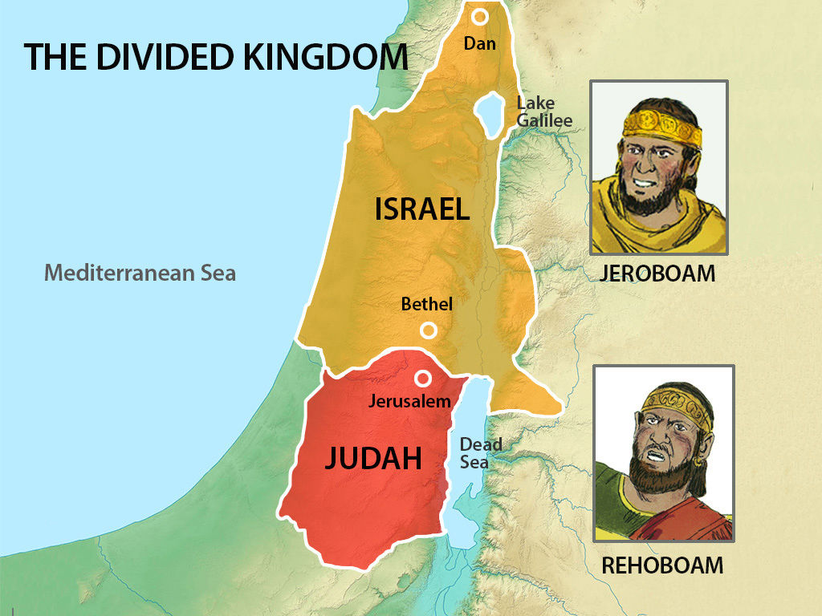

Slide 10
Now when Rehoboam had come to Jerusalem, he assembled all the house of Judah and the tribe of Benjamin, 180,000 chosen men who were warriors, to fight against the house of Israel to restore the kingdom to Rehoboam the son of Solomon.
1 Kings 12:21

Slide 11
²² But the word of God came to Shemaiah the man of God, saying, ²³ “Speak to Rehoboam the son of Solomon, king of Judah, and to all the house of Judah and Benjamin and to the rest of the people, saying, ²⁴ ‘Thus says the Lord, “You must not go up and fight against your relatives the sons of Israel; return every man to his house, for this thing has come from Me.”’” So they listened to the word of the Lord, and returned and went their way according to the word of the Lord. 1 Kings 12:22-24

Slide 12
²⁶ Jeroboam said in his heart, “Now the kingdom will return to the house of David. ²⁷ If this people go up to offer sacrifices in the house of the Lord at Jerusalem, then the heart of this people will return to their lord, even to Rehoboam king of Judah; and they will kill me and return to Rehoboam king of Judah.” ²⁸ So the king consulted, and made two golden calves, and he said to them, “It is too much for you to go up to Jerusalem; behold your gods, O Israel, that brought you up from the land of Egypt.” 1 Kings 12:26-28

Slide 13
³¹ And he made houses on high places, and made priests from among all the people who were not of the sons of Levi. ³² Jeroboam instituted a feast in the eighth month on the fifteenth day of the month, like the feast which is in Judah, and he went up to the altar; thus he did in Bethel, sacrificing to the calves which he had made. And he stationed in Bethel the priests of the high places which he had made. ³³ Then he went up to the altar which he had made in Bethel on the fifteenth day in the eighth month, even in the month which he had devised in his own heart; and he instituted a feast for the sons of Israel and went up to the altar to burn incense. 1 Kings 12:31-33

Slide 14
The Blind Prophet Who Sees and the Fall of Jeroboam
1 Kings 14:1-19

Slide 15
For the Lord will strike Israel, as a reed is shaken in the water; and He will uproot Israel from this good land which He gave to their fathers, and will scatter them beyond the Euphrates River, because they have made their Asherim, provoking the Lord to anger.
1 Kings 14:15

Slide 16
In those days the people of Judah will join the people of Israel, and together they will come from a northern land to the land I gave your ancestors as an inheritance. Jeremiah 3:18

Slide 17
²¹ and say to them, ‘This is what the Sovereign Lord says: I will take the Israelites out of the nations where they have gone. I will gather them from all around and bring them back into their own land. ²² I will make them one nation in the land, on the mountains of Israel. There will be one king over all of them and they will never again be two nations or be divided into two kingdoms. Ezekiel 37:21-22

Slide 18
²⁰ “I do not ask on behalf of these alone, but for those also who believe in Me through their word; ²¹ that they may all be one; even as You, Father, are in Me and I in You, that they also may be in Us, so that the world may believe that You sent Me. ²² The glory which You have given Me I have given to them, that they may be one, just as We are one; ²³ I in them and You in Me, that they may be perfected in unity, so that the world may know that You sent Me, and loved them, even as You have loved Me. John 17:20-23

