Slide 2
¹⁰ It came about at the end of twenty years in which Solomon had built the two houses, the house of the Lord and the king’s house ¹¹ (Hiram king of Tyre had supplied Solomon with cedar and cypress timber and gold according to all his desire), then King Solomon gave Hiram twenty cities in the land of Galilee. ¹² So Hiram came out from Tyre to see the cities which Solomon had given him, and they did not please him. ¹³ He said, “What are these cities which you have given me, my brother?” So they were called the land of Cabul to this day. ¹⁴ And Hiram sent to the king 120 talents of gold.
1 King 9:10-14

Slide 3
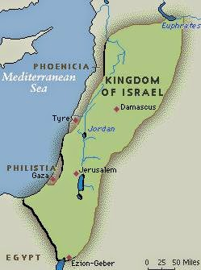

Slide 4
¹⁵ Now this is the account of the forced labor which King Solomon levied to build the house of the Lord, his own house, the Millo, the wall of Jerusalem, Hazor, Megiddo, and Gezer. …²⁰ As for all the people who were left of the Amorites, the Hittites, the Perizzites, the Hivites and the Jebusites, who were not of the sons of Israel, ²¹ their descendants who were left after them in the land whom the sons of Israel were unable to destroy utterly, from them Solomon levied forced laborers, even to this day. ²² But Solomon did not make slaves of the sons of Israel; for they were men of war, his servants, his princes, his captains, his chariot commanders, and his horsemen. 1 King 9:15, 20-22

Slide 5
As soon as Pharaoh’s daughter came up from the city of David to her house which Solomon had built for her, then he built the Millo. 1 King 9:24

Slide 6
Now three times in a year Solomon offered burnt offerings and peace offerings on the altar which he built to the Lord, burning incense with them on the altar which was before the Lord. So he finished the house. 1 King 9:25

Slide 7
The Queen of Sheba
1 King 10:1-13

Slide 8
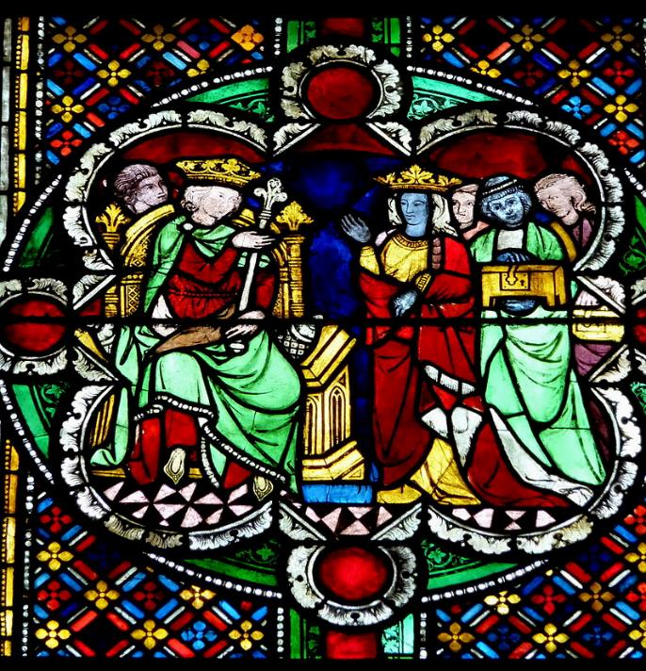
1280

Slide 9
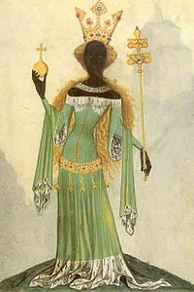
14th century

Slide 10
1555

Slide 11
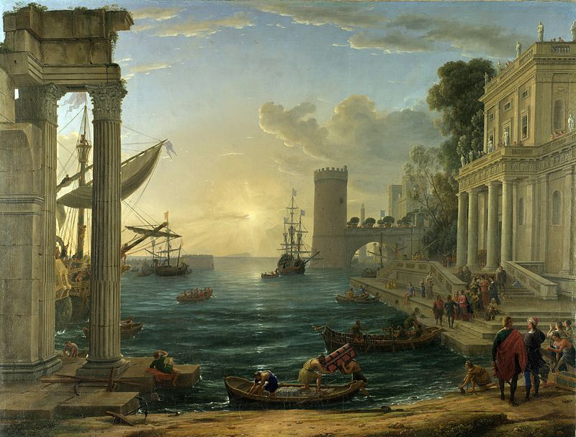
1600s

Slide 12
⁴¹ The men of Nineveh will stand up with this generation at the judgment, and will condemn it because they repented at the preaching of Jonah; and behold, something greater than Jonah is here. ⁴² The Queen of the South will rise up with this generation at the judgment and will condemn it, because she came from the ends of the earth to hear the wisdom of Solomon; and behold, something greater than Solomon is here.
Matthew 12:42 (Luke 11:41)

Slide 13
The Wealth of Solomon
1 King 10:14-29

Slide 14
Moreover, he shall not multiply horses for himself, nor shall he cause the people to return to Egypt to multiply horses, since the Lord has said to you, ‘You shall never again return that way.’
Deuteronomy 17:16

Slide 15
Moreover, he shall not multiply horses for himself, nor shall he cause the people to return to Egypt to multiply horses, since the Lord has said to you, ‘You shall never again return that way.’ He shall not multiply wives for himself, or else his heart will turn away; nor shall he greatly increase silver and gold for himself.
Deuteronomy 17:16-17

Slide 16
Moreover, he shall not multiply horses for himself, nor shall he cause the people to return to Egypt to multiply horses, since the Lord has said to you, ‘You shall never again return that way.’ He shall not multiply wives for himself, or else his heart will turn away; nor shall he greatly increase silver and gold for himself.
Deuteronomy 17:16-17

Slide 17
Moreover, he shall not multiply horses for himself, nor shall he cause the people to return to Egypt to multiply horses, since the Lord has said to you, ‘You shall never again return that way.’ He shall not multiply wives for himself, or else his heart will turn away; nor shall he greatly increase silver and gold for himself.
Deuteronomy 17:16-17

Slide 18
¹ Now King Solomon loved many foreign women along with the daughter of Pharaoh: Moabite, Ammonite, Edomite, Sidonian, and Hittite women, ² from the nations concerning which the Lord had said to the sons of Israel, “You shall not associate with them, nor shall they associate with you, for they will surely turn your heart away after their gods.” Solomon held fast to these in love. ³ He had seven hundred wives, princesses, and three hundred concubines, and his wives turned his heart away.
1 Kings 11:1-3

Slide 19
¹¹ So the Lord said to Solomon, “Because you have done this, and you have not kept My covenant and My statutes, which I have commanded you, I will surely tear the kingdom from you, and will give it to your servant. ¹² Nevertheless I will not do it in your days for the sake of your father David, but I will tear it out of the hand of your son. ¹³ However, I will not tear away all the kingdom, but I will give one tribe to your son for the sake of My servant David and for the sake of Jerusalem which I have chosen.”
1 Kings 11:11-13

Slide 20
¹¹ So the Lord said to Solomon, “Because you have done this, and you have not kept My covenant and My statutes, which I have commanded you, I will surely tear the kingdom from you, and will give it to your servant. ¹² Nevertheless I will not do it in your days for the sake of your father David, but I will tear it out of the hand of your son. ¹³ However, I will not tear away all the kingdom, but I will give one tribe to your son for the sake of My servant David and for the sake of Jerusalem which I have chosen.”
1 Kings 11:11-13

Slide 21
¹⁴ Then the Lord raised up an adversary to Solomon, Hadad the Edomite… ²³ God also raised up another adversary to him, Rezon the son of Eliad. … ²⁶ Then Jeroboam the son of Nebat, an Ephraimite of Zeredah, Solomon’s servant, whose mother’s name was Zeruah, a widow, also rebelled against the king.
1 Kings 11:14,23,26

