Slide 2
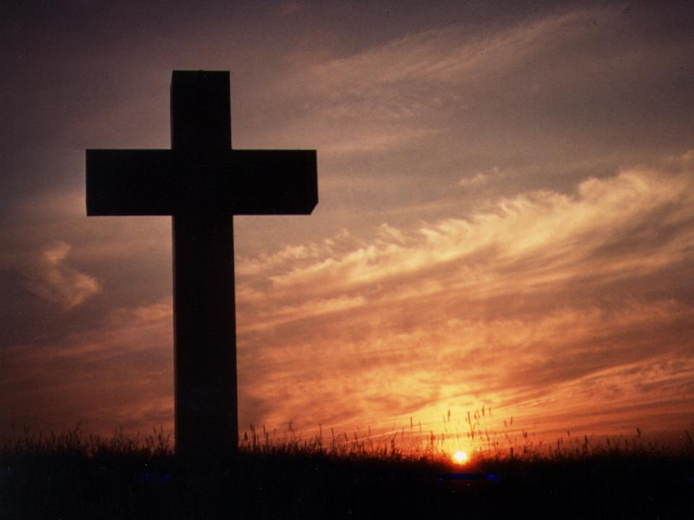
Trauma, Grief, and the Body of Christ

Slide 4
Deceit
Desertion
Despair
Death

Slide 5
Deceit
Matthew 26:46-56a
Desertion
Matthew 26:56b
Matthew 26:59-68
27:27-49
Despair
Death
Matthew 27:31,35

Slide 6
“O death, where is your victory? O death, where is your sting?”
1 Corinthians 15:55

Slide 7
Jesus said to her, “Stop clinging to Me, for I have not yet ascended to the Father; but go to My brethren and say to them, ‘I ascend to My Father and your Father, and My God and your God.’”
John 20:17

Slide 8
¹⁹ So when it was evening on that day, the first day of the week, and when the doors were shut where the disciples were, for fear of the Jews, Jesus came and stood in their midst and said to them, “Peace be with you.” ²⁰ And when He had said this, He showed them both His hands and His side. The disciples then rejoiced when they saw the Lord. John 20:19-20

Slide 9
²⁴ But Thomas, one of the twelve, called Didymus, was not with them when Jesus came. ²⁵ So the other disciples were saying to him, “We have seen the Lord!” But he said to them, “Unless I see in His hands the imprint of the nails, and put my finger into the place of the nails, and put my hand into His side, I will not believe.” ²⁶ After eight days His disciples were again inside, and Thomas with them. Jesus came, the doors having been shut, and stood in their midst and said, “Peace be with you.” ²⁷ Then He said to Thomas, “Reach here with your finger, and see My hands; and reach here your hand and put it into My side; and do not be unbelieving, but believing.” ²⁸ Thomas answered and said to Him, “My Lord and my God!” ²⁹ Jesus said to him, “Because you have seen Me, have you believed? Blessed are they who did not see, and yet believed.” John 20:24-29

Slide 10
⁹ And after He had said these things, He was lifted up while they were looking on, and a cloud received Him out of their sight. ¹⁰ And as they were gazing intently into the sky while He was going, behold, two men in white clothing stood beside them. ¹¹ They also said, “Men of Galilee, why do you stand looking into the sky? This Jesus, who has been taken up from you into heaven, will come in just the same way as you have watched Him go into heaven.”
Acts 1:9-11

