Slide 2
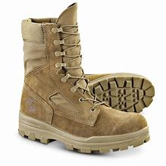
Worship as Basic Training
Giving

Slide 4
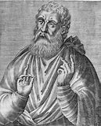
Those who have means and are willing, each according to his own choice, gives what he wills, and what is collected is deposited with the president. He provides for the orphans and the widows, those who are in account of sickness or some other causes, those who are in bonds and strangers who are sojourning, and in a word he becomes a protector of all who are in need.
–Justin Martyr (100-165 AD)

Slide 5
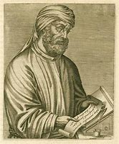
Although we have a kind of money-chest, it is not gathered from the fees of our leaders as if religion were a matter of purchase. Every individual puts in a small contribution on the monthly day, or when he wishes and only if he wishes and is able. For no one is compelled, but he contributes voluntarily. These contributions are trust funds of piety.
–Tertullian (160-240 AD)

Slide 6
These contributions are the trust funds of piety. For they are not spent on banquets, drinking parties, or dining clubs. …So great a work of love burns a brand upon us in regards to some. “See,” they say, “how they love one another.” …So we who are united in mind and soul have no hesitation about sharing property.
–Tertullian (160-240 AD)

Slide 7
They love one another. They do not overlook the widow, and they love the orphan. He who has ministers unbregrudingly to him who does not have. When they see strangers, they take them under their own roof and rejoice over him as a true brother, for they do not call themselves brothers according to the flesh but according to the soul. …And if they hear that some are condemned or imprisoned on account of the name of their Lord, they contribute for those condemned and send to them what they need, and if it is possible, they redeem him. –Aristides (2nd century AD)

Slide 8
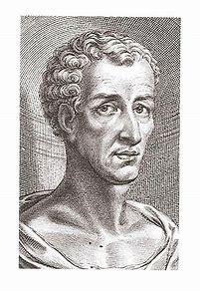
There were some even from the cities of Asia who came, the Christians sending them from their common fund to succour, defend, and encourage the man. They exhibit extraordinary haste whenever one of them becomes such a public victim, for in no time they lavish their all. And also to Peregrinus at that time much money came from them on account of his bonds, and he made of this no little revenue. –Lucian of Samasota (125-180 AD)

Slide 9
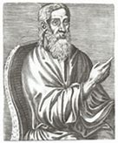
And it is not right for one to live in luxury, while many are in want. How much more glorious is it to do good to many, than to live sumptuously! How much wiser to spend money on human beings than on jewels and gold!
–Clement of Alexandria (150-215 AD)

Slide 10
⁴³ Everyone kept feeling a sense of awe; and many wonders and signs were taking place through the apostles. ⁴⁴ And all those who had believed were together and had all things in common; ⁴⁵ and they began selling their property and possessions and were sharing them with all, as anyone might have need. ⁴⁶ Day by day continuing with one mind in the temple, and breaking bread from house to house, they were taking their meals together with gladness and sincerity of heart, ⁴⁷ praising God and having favor with all the people. And the Lord was adding to their number day by day those who were being saved. Acts 2:43-47

Slide 11
³² And the congregation of those who believed were of one heart and soul; and not one of them claimed that anything belonging to him was his own, but all things were common property to them. ³³ And with great power the apostles were giving testimony to the resurrection of the Lord Jesus, and abundant grace was upon them all. ³⁴ For there was not a needy person among them, for all who were owners of land or houses would sell them and bring the proceeds of the sales ³⁵ and lay them at the apostles’ feet, and they would be distributed to each as any had need. Acts 4:32-35

Slide 13
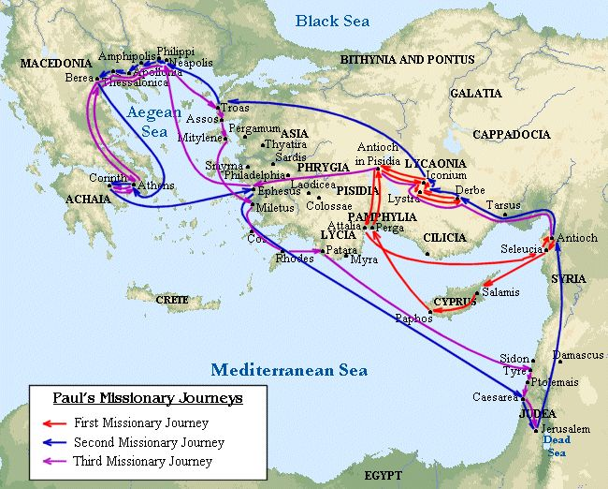

Slide 15
King
citizens

Slide 16
King
citizens
citizens

Slide 17
¹¹ a renewal in which there is no distinction between Greek and Jew, circumcised and uncircumcised, barbarian, Scythian, slave and freeman, but Christ is all, and in all. ¹² So, as those who have been chosen of God, holy and beloved, put on a heart of compassion, kindness, humility, gentleness and patience; ¹³ bearing with one another, and forgiving each other, whoever has a complaint against anyone; just as the Lord forgave you, so also should you. ¹⁴ Beyond all these things put on love, which is the perfect bond of unity. ¹⁵ Let the peace of Christ rule in your hearts, to which indeed you were called in one body; and be thankful. ¹⁶ Let the word of Christ richly dwell within you, with all wisdom teaching and admonishing one another with psalms and hymns and spiritual songs, singing with thankfulness in your hearts to God. ¹⁷ Whatever you do in word or deed, do all in the name of the Lord Jesus, giving thanks through Him to God the Father. Col 3:11-17

Slide 18
²⁴ and when He had given thanks, He broke it and said, “This is My body, which is for you; do this in remembrance of Me.” ²⁵ In the same way He took the cup also after supper, saying, “This cup is the new covenant in My blood; do this, as often as you drink it, in remembrance of Me.”
1 Corinthians 11:24-25
¹⁶ Is not the cup of blessing which we bless a sharing in the blood of Christ? Is not the bread which we break a sharing in the body of Christ? ¹⁷ Since there is one bread, we who are many are one body; for we all partake of the one bread. 1 Corinthians 10:16-17

Slide 20
¹ Now concerning the collection for the saints, as I directed the churches of Galatia, so do you also. ² On the first day of every week each one of you is to put aside and save, as he may prosper, so that no collections be made when I come. ³ When I arrive, whomever you may approve, I will send them with letters to carry your gift to Jerusalem; ⁴ and if it is fitting for me to go also, they will go with me.
1 Corinthians 16:1-4

Slide 21
“lay by him in store, as God hath prospered him”
KJV
“lay something aside, storing up as he may prosper”
NKJV
“put something aside and store it up, as he may prosper”
ESV
“put aside and save, as he may prosper”
NASB
“set aside a sum of money in keeping with your income”
NIV

Slide 23
Blessings from God

Slide 24
Blessings from God
Giving

Slide 25
Blessings from God
Thanks and glory given to God
Giving

Slide 26
¹⁰ Now He who supplies seed to the sower and bread for food will supply and multiply your seed for sowing and increase the harvest of your righteousness; ¹¹ you will be enriched in everything for all liberality, which through us is producing thanksgiving to God. ¹² For the ministry of this service is not only fully supplying the needs of the saints, but is also overflowing through many thanksgivings to God. ¹³ Because of the proof given by this ministry, they will glorify God for your obedience to your confession of the gospel of Christ and for the liberality of your contribution to them and to all, ¹⁴ while they also, by prayer on your behalf, yearn for you because of the surpassing grace of God in you. ¹⁵ Thanks be to God for His indescribable gift! 2 Corinthians 9:10-15

Slide 27
¹³ For this is not for the ease of others and for your affliction, but by way of equality— ¹⁴ at this present time your abundance being a supply for their need, so that their abundance also may become a supply for your need, that there may be equality… ²⁴ Therefore openly before the churches, show them the proof of your love and of our reason for boasting about you.
2 Corinthians 8:13-14, 24

Slide 28
⁴ For just as we have many members in one body and all the members do not have the same function, ⁵ so we, who are many, are one body in Christ, and individually members one of another.
Romans 12:4-5

Slide 29
⁴ For just as we have many members in one body and all the members do not have the same function, ⁵ so we, who are many, are one body in Christ, and individually members one of another. …¹³ contributing to the needs of the saints, practicing hospitality.
Romans 12:4-5, 13

Slide 30
²⁵ but now, I am going to Jerusalem serving the saints. ²⁶ For Macedonia and Achaia have been pleased to make a contribution for the poor among the saints in Jerusalem. ²⁷ Yes, they were pleased to do so, and they are indebted to them. For if the Gentiles have shared in their spiritual things, they are indebted to minister to them also in material things.
Romans 15:25-27

