Slide 2
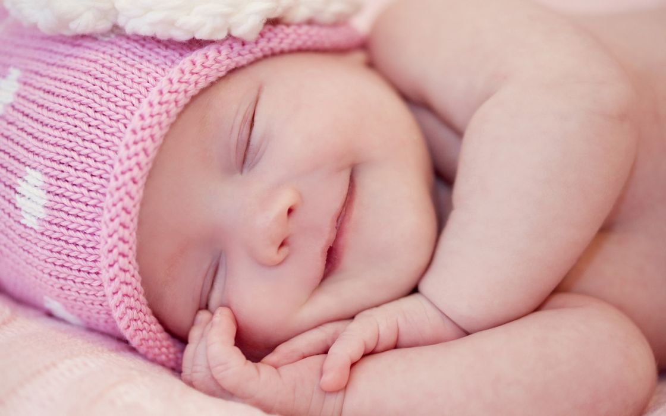

Slide 3
You were unmindful of the Rock that bore you, and you forgot the God who gave you birth.
- Deuteronomy 32:18 (ESV)

Slide 4
You were unmindful of the Rock that bore you, and you forgot the God who gave you birth.
- Deuteronomy 32:18 (ESV)

Slide 5
“El Chuwl”

Slide 6
For You formed my inward parts; You knitted me together in my mother's womb. I praise You, for I am fearfully and wonderfully made. Wonderful are Your works; my soul knows it very well. My frame was not hidden from You, when I was being made in secret, intricately woven in the depths of the earth. Your eyes saw my unformed substance; in Your book were written, every one of them, the days that were formed for me, when as yet there was none of them.
How precious to me are Your thoughts, O God! How vast is the sum of them! If I would count them, they are more than the sand. I awake, and I am still with You.
- Psalm 139:13-18 (ESV)

Slide 7
Then the word of the LORD came to me, saying: “Before I formed you in the womb I knew you ….”
- Jeremiah 1:4-5 (ESV)

Slide 8
Then the word of the LORD came to me, saying: “Before I formed you in the womb I knew you ….”
- Jeremiah 1:4-5a (ESV)

Slide 9
“But when it pleased God, who separated me from my mother’s womb and called me through His grace”
- Galatians 1:15 (ESV)

Slide 10
If I have denied justice to any of my servants, whether male or female, when they had a grievance against me, what will I do when God confronts me? What will I answer when called to account? Did not He who made me in the womb make them? Did not the same One form us both within our mothers?
- Job 31:13-15 (NIV)

Slide 11
“Listen, O coastlands, to Me, And take heed, you peoples from afar! The Lord has called Me from the womb; From the matrix of My mother He has made mention of My name.”
- Isaiah 49:1 (NKJV)

Slide 12
And the angel of the Lord said to her,
“Behold, you are pregnant and shall bear a son. You shall call his name Ishmael, because the Lord has listened to your affliction.”
- Genesis 16:11 (ESV)

Slide 13
And Abraham said to God, “Oh that Ishmael might live before you!” God said, “No, but Sarah your wife shall bear you a son, and you shall call his name Isaac. I will establish my covenant with him as an everlasting covenant for his offspring after him.”
- Genesis 17:18-19 (ESV)

Slide 14
“Behold, a son shall be born to you who shall be a man of rest. I will give him rest from all his surrounding enemies. For his name shall be Solomon, and I will give peace and quiet to Israel in his days.”
- 1 Chronicles 22:9 (ESV)

Slide 15
“It is I who says of Cyrus, ‘He is My shepherd! And he will perform all My desire.’ And he declares of Jerusalem, ‘She will be built,’ And of the temple, ‘Your foundation will be laid.’”
- Isaiah 44:28 (NASB)

Slide 16
And the man cried against the altar by the word of the Lord and said, “O altar, altar, thus says the Lord: ‘Behold, a son shall be born to the house of David, Josiah by name, and he shall sacrifice on you the priests of the high places who make offerings on you, and human bones shall be burned on you.’”
- 1 Kings 13:2 (ESV)

Slide 17
But the angel said to him, “Do not be afraid, Zechariah, for your prayer has been heard, and your wife Elizabeth will bear you a son, and you shall call his name John.”
- Luke 1:13 (ESV)

Slide 18
“Listen, O coastlands, to Me, And take heed, you peoples from afar! The Lord has called Me from the womb; From the matrix of My mother He has made mention of My name.”
- Isaiah 49:1 (NKJV)

Slide 19
Thus says the Lord who made you, who formed you from the womb and will help you: Fear not, O Jacob my servant, Jeshurun whom I have chosen.
- Isaiah 44:2 (ESV)

Slide 20
Then the word of the LORD came to me, saying: “Before I formed you in the womb I knew you ….”
- Jeremiah 1:4-5a (ESV)

Slide 21
Then the word of the LORD came to me, saying: “Before I formed you in the womb I knew you ….”
- Jeremiah 1:4-5a (ESV)

Slide 22
But now thus says the Lord, He who created you, O Jacob (your name here), He who formed you, O Israel (your name here): “Fear not, for I have redeemed you; I have called you by name, you are mine. When you pass through the waters, I will be with you; and through the rivers, they shall not overwhelm you; when you walk through fire you shall not be burned, and the flame shall not consume you. For I am the Lord your God, the Holy One of Israel, your Savior.”
- Isaiah 43:1-3a (ESV)

Slide 23
“Can a mother forget the baby at her breast and have no compassion on the child she has borne? Though she may forget, I will not forget you!”
- Isaiah 49:15 (NIV)

Slide 24
“Can a maid forget her ornaments,
or a bride her attire?
yet My people have forgotten Me
days without number.”
- Jeremiah 2:32 (KJV)

Slide 25
For the wages of sin is death, but the free gift of God is eternal life in Christ Jesus our Lord.
- Romans 6:23 (ESV)

Slide 27
“… and you forgot the God who gave you birth”
- Deuteronomy 32:18b (ESV)

