Slide 2
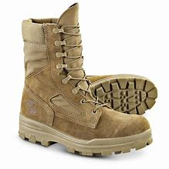
Worship as Basic Training
Greet One Another

Slide 4
⁶ For while we were still helpless, at the right time Christ died for the ungodly. ⁷ For one will hardly die for a righteous man; though perhaps for the good man someone would dare even to die. ⁸ But God demonstrates His own love toward us, in that while we were yet sinners, Christ died for us. ⁹ Much more then, having now been justified by His blood, we shall be saved from the wrath of God through Him. ¹⁰ For if while we were enemies we were reconciled to God through the death of His Son, much more, having been reconciled, we shall be saved by His life. ¹¹ And not only this, but we also exult in God through our Lord Jesus Christ, through whom we have now received the reconciliation. Romans 5:6-11

Slide 5
¹² “This is My commandment, that you love one another, just as I have loved you. ¹³ Greater love has no one than this, that one lay down his life for his friends. ¹⁴ You are My friends if you do what I command you. ¹⁵ No longer do I call you slaves, for the slave does not know what his master is doing; but I have called you friends, for all things that I have heard from My Father I have made known to you.
John 15:12-15

Slide 7
²¹ Was not Abraham our father justified by works when he offered up Isaac his son on the altar? ²² You see that faith was working with his works, and as a result of the works, faith was perfected; ²³ and the Scripture was fulfilled which says, “And Abraham believed God, and it was reckoned to him as righteousness,” and he was called the friend of God. ²⁴ You see that a man is justified by works and not by faith alone. James 2:21-24

