Slide 2
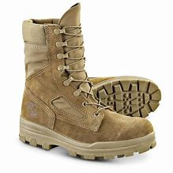
Worship as Basic Training
Reasons to Sing

Slide 4
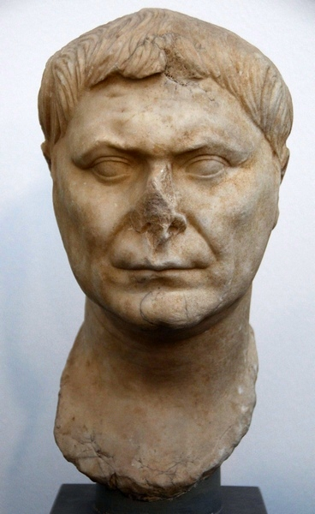
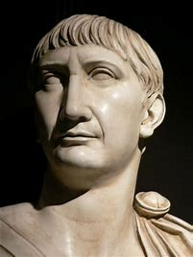
“they were accustomed to meet on a fixed day before dawn and sing responsively a hymn to Christ as to a god”
--Pliny the Younger, 112

Slide 6
²⁷ For all of you who were baptized into Christ have clothed yourselves with Christ. ²⁸ There is neither Jew nor Greek, there is neither slave nor free man, there is neither male nor female; for you are all one in Christ Jesus. ²⁹ And if you belong to Christ, then you are Abraham’s descendants, heirs according to promise. Galatians 3:27-29

Slide 7
¹² For even as the body is one and yet has many members, and all the members of the body, though they are many, are one body, so also is Christ. ¹³ For by one Spirit we were all baptized into one body, whether Jews or Greeks, whether slaves or free, and we were all made to drink of one Spirit.
1 Corinthians 12:12-13

Slide 8
¹⁸ And do not get drunk with wine, for that is dissipation, but be filled with the Spirit, ¹⁹ speaking to one another in psalms and hymns and spiritual songs, singing and making melody with your heart to the Lord
Ephesians 5:18-19
Let the word of Christ richly dwell within you, with all wisdom teaching and admonishing one another with psalms and hymns and spiritual songs, singing with thankfulness in your hearts to God. Colossians 3:16

Slide 9
¹⁸ And do not get drunk with wine, for that is dissipation, but be filled with the Spirit, ¹⁹ speaking to one another in psalms and hymns and spiritual songs, singing and making melody with your heart to the Lord
Ephesians 5:18-19
Let the word of Christ richly dwell within you, with all wisdom teaching and admonishing one another with psalms and hymns and spiritual songs, singing with thankfulness in your hearts to God. Colossians 3:16

Slide 11
¹³ But now in Christ Jesus you who formerly were far off have been brought near by the blood of Christ. ¹⁴ For He Himself is our peace, who made both groups into one and broke down the barrier of the dividing wall, ¹⁵ by abolishing in His flesh the enmity, which is the Law of commandments contained in ordinances, so that in Himself He might make the two into one new man, thus establishing peace, ¹⁶ and might reconcile them both in one body to God through the cross, by it having put to death the enmity. ¹⁷ And He came and preached peace to you who were far away, and peace to those who were near; ¹⁸ for through Him we both have our access in one Spirit to the Father.
Ephesians 2:13-18

Slide 12
³ being diligent to preserve the unity of the Spirit in the bond of peace. ⁴ There is one body and one Spirit, just as also you were called in one hope of your calling; ⁵ one Lord, one faith, one baptism, ⁶ one God and Father of all who is over all and through all and in all.
Ephesians 4:3-6

Slide 13
¹⁸ And do not get drunk with wine, for that is dissipation, but be filled with the Spirit, ¹⁹ speaking to one another in psalms and hymns and spiritual songs, singing and making melody with your heart to the Lord; ²⁰ always giving thanks for all things in the name of our Lord Jesus Christ to God, even the Father; ²¹ and be subject to one another in the fear of Christ.
Ephesians 5:18-21

Slide 14
¹¹ a renewal in which there is no distinction between Greek and Jew, circumcised and uncircumcised, barbarian, Scythian, slave and freeman, but Christ is all, and in all. ¹² So, as those who have been chosen of God, holy and beloved, put on a heart of compassion, kindness, humility, gentleness and patience; ¹³ bearing with one another, and forgiving each other, whoever has a complaint against anyone; just as the Lord forgave you, so also should you. ¹⁴ Beyond all these things put on love, which is the perfect bond of unity. ¹⁵ Let the peace of Christ rule in your hearts, to which indeed you were called in one body; and be thankful. ¹⁶ Let the word of Christ richly dwell within you, with all wisdom teaching and admonishing one another with psalms and hymns and spiritual songs, singing with thankfulness in your hearts to God. Colossians 3:11-16

Slide 15
⁵ Now may the God who gives perseverance and encouragement grant you to be of the same mind with one another according to Christ Jesus, ⁶ so that with one accord you may with one voice glorify the God and Father of our Lord Jesus Christ. ⁷ Therefore, accept one another, just as Christ also accepted us to the glory of God.
Romans 15:5-7

Slide 17
Let the word of Christ richly dwell within you, with all wisdom teaching and admonishing one another with psalms and hymns and spiritual songs, singing with thankfulness in your hearts to God.
Colossians 3:16

Slide 19
¹⁹ speaking to one another in psalms and hymns and spiritual songs, singing and making melody with your heart to the Lord; ²⁰ always giving thanks for all things in the name of our Lord Jesus Christ to God, even the Father Ephesians 5:19-20
Whatever you do in word or deed, do all in the name of the Lord Jesus, giving thanks through Him to God the Father.
Colossians 3:17

Slide 21
¹⁵ Let the peace of Christ rule in your hearts, to which indeed you were called in one body; and be thankful. ¹⁶ Let the word of Christ richly dwell within you, with all wisdom teaching and admonishing one another with psalms and hymns and spiritual songs, singing with thankfulness in your hearts to God. ¹⁷ Whatever you do in word or deed, do all in the name of the Lord Jesus, giving thanks through Him to God the Father. Colossians 3:15-17

Slide 23
Is anyone among you suffering? Then he must pray. Is anyone cheerful? He is to sing praises. James 5:13

