Slide 2
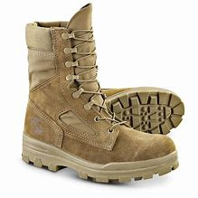
Worship as Basic Training
The Why and When of Worship

Slide 4
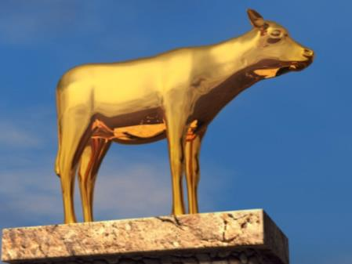
And the LORD said to Moses, “I have seen this people, and behold, it is a stiff-necked people.
Exodus 32:9

Slide 5
Go up to a land flowing with milk and honey; but I will not go up among you, lest I consume you on the way, for you are a stiff-necked people…For the Lord had said to Moses, “Say to the people of Israel, ‘You are a stiff-necked people; if for a single moment I should go up among you, I would consume you.
Exodus 33:3,5

Slide 6
However, they did not listen, but stiffened their neck like their fathers, who did not believe in the LORD their God.
2 Kings 17:14

Slide 7
You stiff-necked people, uncircumcised in heart and ears, you always resist the Holy Spirit. As your fathers did, so do you.
Acts 7:51

Slide 8
⁴ Their idols are silver and gold, the work of human hands. ⁵ They have mouths, but do not speak; eyes, but do not see. ⁶ They have ears, but do not hear; noses, but do not smell. ⁷ They have hands, but do not feel; feet, but do not walk; and they do not make a sound in their throat. ⁸ Those who make them become like them; so do all who trust in them.
Psalm 115:4-8

Slide 9
¹⁵ The idols of the nations are silver and gold, the work of human hands. ¹⁶ They have mouths, but do not speak; they have eyes, but do not see; ¹⁷ they have ears, but do not hear, nor is there any breath in their mouths. ¹⁸ Those who make them become like them, so do all who trust in them.
Psalm 135:15-18

Slide 10
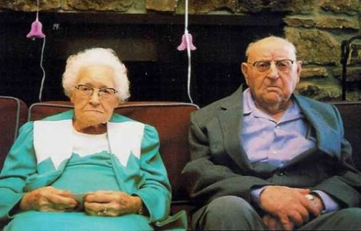
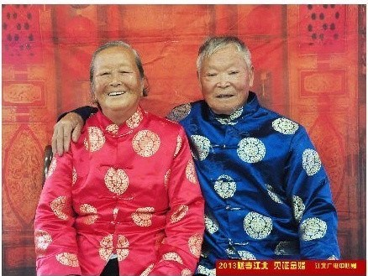
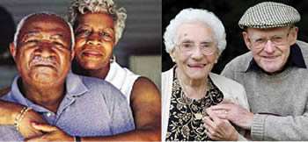

Slide 12
¹⁵ He is the image of the invisible God, the firstborn of all creation. ¹⁶ For by Him all things were created, both in the heavens and on earth, visible and invisible, whether thrones or dominions or rulers or authorities—all things have been created through Him and for Him. ¹⁷ He is before all things, and in Him all things hold together. ¹⁸ He is also head of the body, the church; and He is the beginning, the firstborn from the dead, so that He Himself will come to have first place in everything. ¹⁹ For it was the Father’s good pleasure for all the fullness to dwell in Him, ²⁰ and through Him to reconcile all things to Himself, having made peace through the blood of His cross; through Him, I say, whether things on earth or things in heaven.
Colossians 1:15-20

Slide 13
⁹ Do not lie to one another, since you laid aside the old self with its evil practices, ¹⁰ and have put on the new self who is being renewed to a true knowledge according to the image of the One who created him— ¹¹ a renewal in which there is no distinction between Greek and Jew, circumcised and uncircumcised, barbarian, Scythian, slave and freeman, but Christ is all, and in all.
Colossians 3:9-11

Slide 14
³ seeing that His divine power has granted to us everything pertaining to life and godliness, through the true knowledge of Him who called us by His own glory and excellence. ⁴ For by these He has granted to us His precious and magnificent promises, so that by them you may become partakers of the divine nature, having escaped the corruption that is in the world by lust.
2 Peter 1:3-4

Slide 15
Beloved, now we are children of God, and it has not appeared as yet what we will be. We know that when He appears, we will be like Him, because we will see Him just as He is.
1 John 3:2

Slide 16
²⁰ For our citizenship is in heaven, from which also we eagerly wait for a Savior, the Lord Jesus Christ; ²¹ who will transform the body of our humble state into conformity with the body of His glory, by the exertion of the power that He has even to subject all things to Himself.
Philippians 3:20-21

Slide 18
On the first day of the week, when we were gathered together to break bread, Paul began talking to them, intending to leave the next day, and he prolonged his message until midnight.
Acts 20:7
Now concerning the collection for the saints, as I directed the churches of Galatia, so do you also. On the first day of every week each one of you is to put aside and save, as he may prosper, so that no collections be made when I come.
Romans 16:1-2

Slide 19
Very early on the first day of the week, they came to the tomb when the sun had risen.
Mark 16:2
But on the first day of the week, at early dawn, they came to the tomb bringing the spices which they had prepared.
Luke 24:1
Now on the first day of the week Mary Magdalene came early to the tomb, while it was still dark, and saw the stone already taken away from the tomb.
John 20:1

