Slide 1
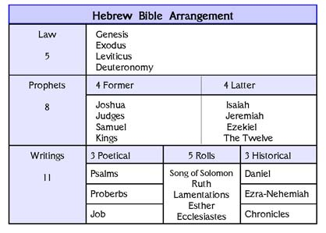

Slide 2
Nathan
Ahijah
Micaiah
Isaiah
Huldah
Shemaiah
Elijah
Elisha
Isaiah

Slide 3
Ahab called Obadiah who was over the household. (Now Obadiah feared the Lord greatly; ⁴ for when Jezebel destroyed the prophets of the Lord, Obadiah took a hundred prophets and hid them by fifties in a cave, and provided them with bread and water.)
1 Kings 18:3-4

Slide 4
Now a certain woman of the wives of the sons of the prophets cried out to Elisha, “Your servant my husband is dead, and you know that your servant feared the Lord; and the creditor has come to take my two children to be his slaves.” 2 Kings 4:1

Slide 5
When Elisha returned to Gilgal, there was a famine in the land. As the sons of the prophets were sitting before him, he said to his servant, “Put on the large pot and boil stew for the sons of the prophets.” 2 Kings 4:38

Slide 6
Now then send and gather to me all Israel at Mount Carmel, together with 450 prophets of Baal and 400 prophets of the Asherah, who eat at Jezebel’s table.”
God or Baal on Mount Carmel. So Ahab sent a message among all the sons of Israel and brought the prophets together at Mount Carmel.
1 Kings 18:19-20

Slide 7
⁵ Moreover, Jehoshaphat said to the king of Israel, “Please inquire first for the word of the Lord.” ⁶ Then the king of Israel gathered the prophets together, about four hundred men, and said to them, “Shall I go against Ramoth-gilead to battle or shall I refrain?” And they said, “Go up, for the Lord will give it into the hand of the king.” ⁷ But Jehoshaphat said, “Is there not yet a prophet of the Lord here that we may inquire of him?” ⁸ The king of Israel said to Jehoshaphat, “There is yet one man by whom we may inquire of the Lord, but I hate him, because he does not prophesy good concerning me, but evil. He is Micaiah son of Imlah.”
1 Kings 22:5-8

Slide 9
the LORD, the God of Israel
kings
prophets
Israelites
non-Israelites

Slide 10
-The living God vs. lifeless idols
-True prophecy vs false prophecy
-Covenant loyalty vs rebellion
-Unity vs division
-Covenant loyalty vs rebellion
-God’s power vs human pride
-God is faithful

Slide 11
Deuteronomy 28:32-37
2 Samuel 7:8-13

