Slide 2
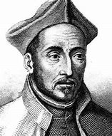
Therefore in your concord and harmonious love, Jesus Christ is sung. And do ye man by man, become a choir, that being harmonious in love, and taking up the song in unison, yet may with one voice sing to the Father through Jesus Christ.
Ignatius (35-107)

Slide 3
For he is in harmony with the commandments, even as the harp is with its strings.
Ignatius (35-107)

Slide 4
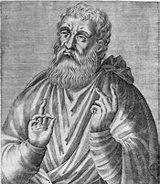
Musical organs pertain to the Jewish ceremonies and agree no more to us than circumcision.
Justin Martyr (100-165)

Slide 5
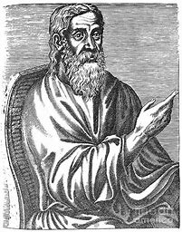
Leave the pipe to the shepherd, the flute to the men who are in the fear of gods and are intent on idol-worshipping.
Clement of Alexandria (150-215)

Slide 6
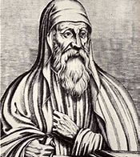
These are in tune for the wise man who employs the members of the body and powers of the soul as strings. He who makes melody with the mind makes melody well, speaking spiritual songs and singing in his heart to God.
Origen (185-254)

Slide 7
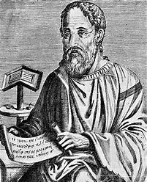
And so more pleasing to God than any musical instruments would be the symphony of the people of God, by which, in every church of God, with kindred spirit and single disposition, with one mind and unanimity of faith and piety, we raise melody in unison in our psalmody.
Eusebius (260-339)

Slide 8
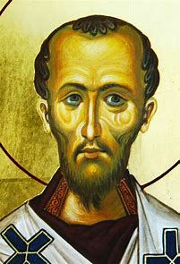
but now instead of organs, we may use our own bodies to praise him withal.
Chrysostom (345-404)

Slide 10
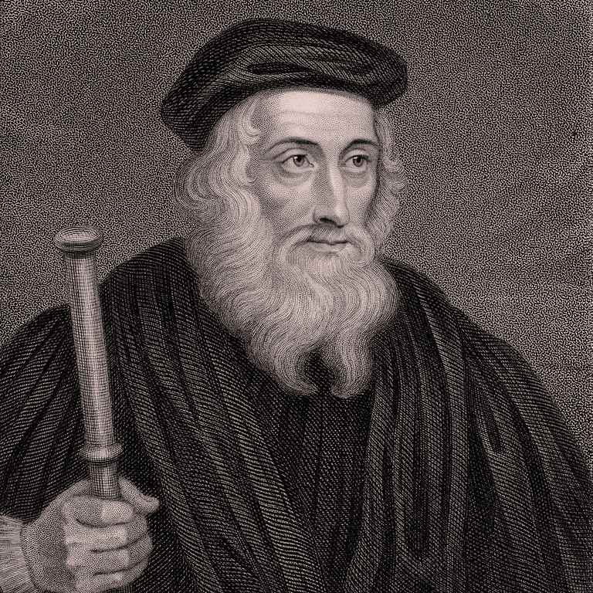
…feed their senses to excess in religion…their eyes with the sumptuous spectacle of the Church’s ornaments, their ears with bells and organs and the new art of striking the hour of the day by the wonderful chimes.
John Wycliffe (1320-1384)

Slide 11
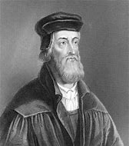
…gape at the pictures, the vestments, chalices and other marvelous furnishings of the churches. Their ears are filled with the sound of bells, organs, and small bells, by frivolous singing which incites to dance rather than to piety.
John Hus (1369-1415)

Slide 12
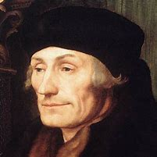
The choristers themselves do not understand what they are singing.
Erasmus (1466-1536)

Slide 13
They perform everything with slide-trumpets, trombones, cornets, and little flutes, and with these the voices of men contend. Men run to the church as to a theatre, to have their ears tickled.
Erasmus (1466-1536)

Slide 14
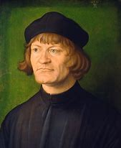
For we are not unaware that the words of Paul in Ephesians 5:19 and Colossians 3:16 concerning psaltery and singing in the heart give no help to those who protect their swan songs by them. For in the heart, he says, not with the voice. Therefore, the psalms and praises of God ought to be treated as if our minds sing to God.
Zwingli (1484-1531)

Slide 15
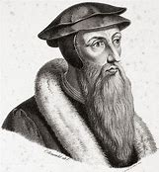
But when they frequent their sacred assemblies, musical instruments in celebrating the praises of God would be no more suitable than the burning of incense, the lighting up of lamps, and the restoration of other shadows of the law. …Men who are fond of outward pomp may delight in that noise; but the simplicity which God recommends to us by the apostle is far more pleasing to Him.
John Calvin (1509-1564)

Slide 16
We are not, indeed, forbidden to use, in private, musical instruments, but they are banished out of the churches by the plain command of the Holy Spirit, when Paul, in 1 Cor 14:13, lays it down as an invariable rule, that we must praise God, and pray to him only in a known tongue.
John Calvin (1509-1564)

Slide 17
On Sundays…we sing a psalm of David or some other prayer taken from the New Testament. The psalm or prayer is sung by everyone together, men as well as women, with a beautiful unanimity, which is something beautify to behold. For you must understand that each one has a music book in his hand; that is why they cannot lose touch with one another. Never did I think that it could be as pleasing and delightful as it is. For five or six days at first, I looked upon this little company, exiled from countries everywhere for having upheld the honor of God and His gospel, I would begin to weep, not at all from sadness, but from joy at hearing them sing so heartily, and as they sang, giving thanks to the Lord that He had led them to a place where His name is honored and glorified. No one could believe the joy which one experiences when one is singing the praises and wonders of the Lord in the mother tongue as one sings them here. --Church Member (1545)

Slide 18
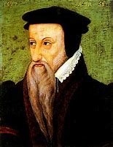
If the apostle justly prohibits the use of the unknown tongues in the church, much less would he have tolerated these artificial musical performances which are addressed to the ear alone, and seldom strike the understanding even of the performers themselves.
Theodore Beza (1519-1565)

Slide 19
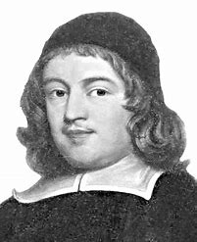
the very external act is by singing, the usual vent of our joy.
Thomas Manton (1620-1677)

Slide 20
