Slide 2
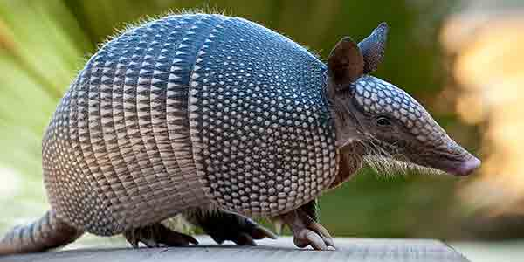

Slide 3
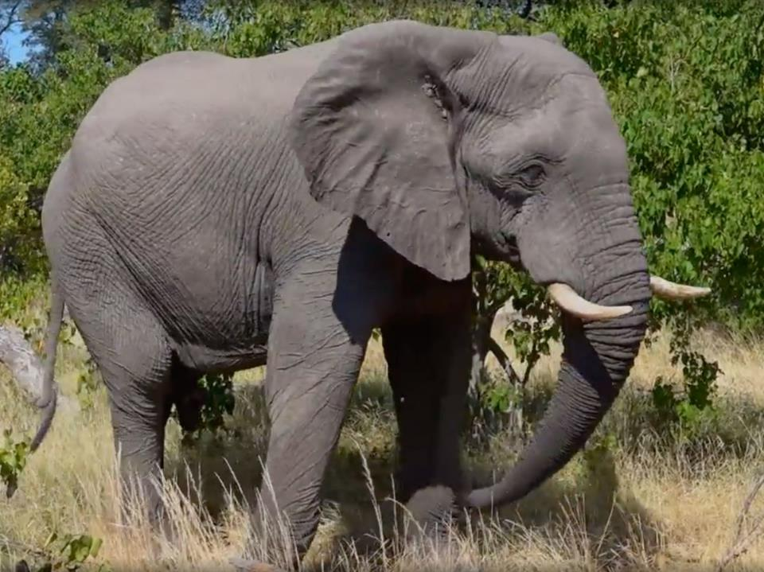

Slide 4
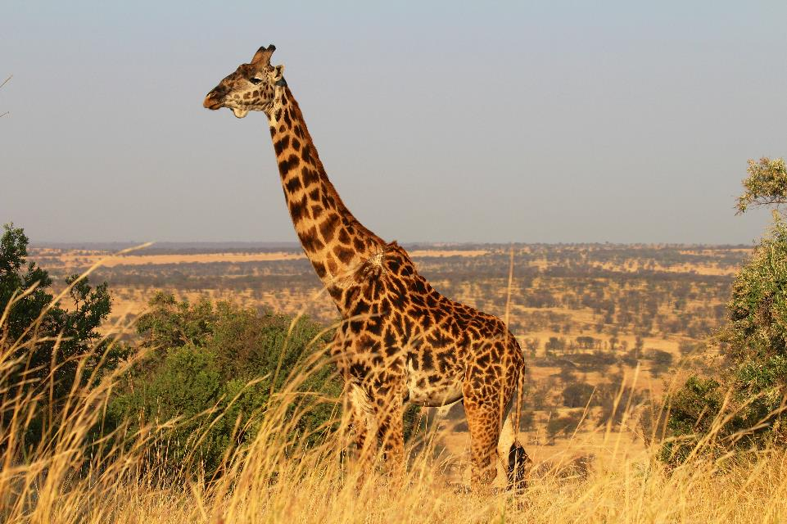

Slide 5
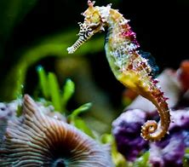

Slide 6
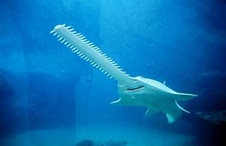

Slide 8
I will also rejoice in Jerusalem and be glad in My people; And there will no longer be heard in her The voice of weeping and the sound of crying.
Isaiah 65:19

Slide 9
Oh, that the salvation of Israel would come out of Zion! When the Lord restores His captive people, Jacob will rejoice, Israel will be glad. Psalm 14:7

Slide 10
When the Lord brought back the captive ones of Zion, We were like those who dream. Then our mouth was filled with laughter And our tongue with joyful shouting; Then they said among the nations, “The Lord has done great things for them.” The Lord has done great things for us; We are glad.
Psalm 126:1-3

Slide 11
The people who walk in darkness Will see a great light; Those who live in a dark land, The light will shine on them. You shall multiply the nation, You shall increase their gladness; They will be glad in Your presence As with the gladness of harvest, As men rejoice when they divide the spoil. Isaiah 9:2-3

Slide 12
Praise the Lord in song,
for He has done excellent things; Let this be known throughout the earth. Cry aloud and shout for joy, O inhabitant of Zion, For great in your midst is the Holy One of Israel. Isaiah 12:5-6

Slide 13
Shout for joy, O daughter of Zion! Shout in triumph, O Israel! Rejoice and exult with all your heart, O daughter of Jerusalem! The Lord has taken away His judgments against you, He has cleared away your enemies. The King of Israel, the Lord, is in your midst; You will fear disaster no more. Zephaniah 3:14-15

Slide 14
Do not fear, O land, rejoice and be glad, For the Lord has done great things. Joel 2:21

Slide 16
²⁸ and I give eternal life to them, and they will never perish; and no one will snatch them out of My hand. ²⁹ My Father, who has given them to Me, is greater than all; and no one is able to snatch them out of the Father’s hand. ³⁰ I and the Father are one.”
John 10:28-30

Slide 17
If you keep My commandments, you will abide in My love; just as I have kept My Father’s commandments and abide in His love. These things I have spoken to you so that My joy may be in you, and that your joy may be made full. John 15:10-11

Slide 18
I have no greater joy than this, to hear of my children walking in the truth. 3 John 4

Slide 20
But even if I am being poured out as a drink offering upon the sacrifice and service of your faith, I rejoice and share my joy with you all. You too, I urge you, rejoice in the same way and share your joy with me.
Philippians 2:17-18

