Slide 2
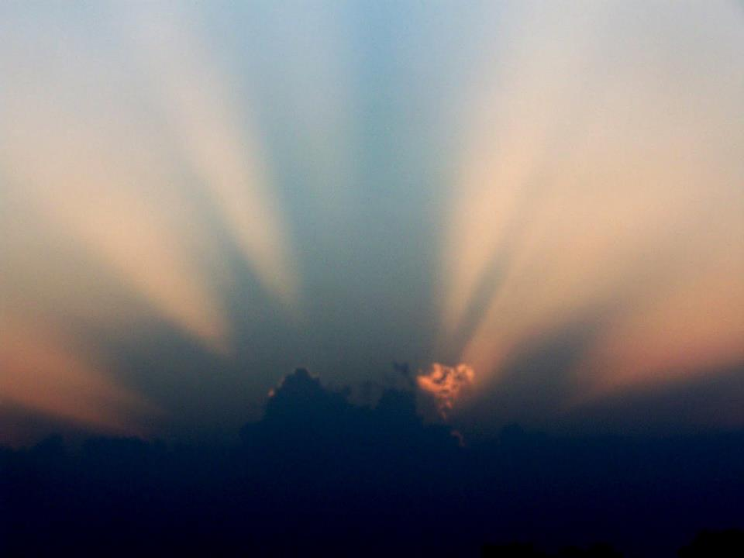
The Beauty of the Spirit

Slide 3
The earth was formless and void, and darkness was over the surface of the deep, and the Spirit of God was moving over the surface of the waters. Genesis 1:2
You send forth Your Spirit, they are created; And You renew the face of the ground. Psalm 104:30
By the word of the Lord the heavens were made, And by the breath of His mouth all their host Psalm 33:6

Slide 4
The earth was formless and void, and darkness was over the surface of the deep, and the Spirit of God was moving over the surface of the waters. Genesis 1:2
You send forth Your Spirit, they are created; And You renew the face of the ground. Psalm 104:30
By the word of the Lord the heavens were made, And by the breath of His mouth all their host Psalm 33:6

Slide 6
Now the Lord spoke to Moses, saying, ² “See, I have called by name Bezalel, the son of Uri, the son of Hur, of the tribe of Judah. ³ I have filled him with the Spirit of God in wisdom, in understanding, in knowledge, and in all kinds of craftsmanship, ⁴ to make artistic designs for work in gold, in silver, and in bronze, ⁵ and in the cutting of stones for settings, and in the carving of wood, that he may work in all kinds of craftsmanship. ⁶ And behold, I Myself have appointed with him Oholiab, the son of Ahisamach, of the tribe of Dan; and in the hearts of all who are skillful I have put skill, that they may make all that I have commanded you: ⁷ the tent of meeting, and the ark of testimony, and the mercy seat upon it, and all the furniture of the tent
Exodus 31:1-7

Slide 7
³⁰ Then Moses said to the sons of Israel, “See, the Lord has called by name Bezalel the son of Uri, the son of Hur, of the tribe of Judah. ³¹ And He has filled him with the Spirit of God, in wisdom, in understanding and in knowledge and in all craftsmanship; ³² to make designs for working in gold and in silver and in bronze, ³³ and in the cutting of stones for settings and in the carving of wood, so as to perform in every inventive work. ³⁴ He also has put in his heart to teach, both he and Oholiab, the son of Ahisamach, of the tribe of Dan. ³⁵ He has filled them with [skill to perform every work of an engraver and of a designer and of an embroiderer, in blue and in purple and in scarlet material, and in fine linen, and of a weaver, as performers of every work and makers of designs. Exodus 35:30-35

Slide 8
³⁴ Then the cloud covered the tent of meeting, and the glory of the Lord filled the tabernacle. ³⁵ Moses was not able to enter the tent of meeting because the cloud had settled on it, and the glory of the Lord filled the tabernacle. ³⁶ Throughout all their journeys whenever the cloud was taken up from over the tabernacle, the sons of Israel would set out; ³⁷ but if the cloud was not taken up, then they did not set out until the day when it was taken up. ³⁸ For throughout all their journeys, the cloud of the Lord was on the tabernacle by day, and there was fire in it by night, in the sight of all the house of Israel.
Exodus 40:34-38

Slide 10
¹⁰ It happened that when the priests came from the holy place, the cloud filled the house of the Lord, ¹¹ so that the priests could not stand to minister because of the cloud, for the glory of the Lord filled the house of the Lord.
¹² Then Solomon said,
“The Lord has said that He would dwell in the thick cloud. ¹³ I have surely built You a lofty house, A place for Your dwelling forever.”
1 Kings 8:10-13

Slide 12
Then a shoot will spring from the stem of Jesse, And a branch from his roots will bear fruit. The Spirit of the Lord will rest on Him, The spirit of wisdom and understanding, The spirit of counsel and strength, The spirit of knowledge and the fear of the Lord. Isaiah 11:1-2

Slide 13
Behold, My Servant, whom I uphold; My chosen one in whom My soul delights. I have put My Spirit upon Him; He will bring forth justice to the nations. Isaiah 42:1

Slide 14
The Spirit of the Lord God is upon me, Because the Lord has anointed me To bring good news to the afflicted; He has sent me to bind up the brokenhearted, To proclaim liberty to captives And freedom to prisoners; ² To proclaim the favorable year of the Lord And the day of vengeance of our God; To comfort all who mourn, Isaiah 61:1-2

Slide 16
The Spirit and the bride say, “Come.” And let the one who hears say, “Come.” And let the one who is thirsty come; let the one who wishes take the water of life without cost.
Revelation 22:17

Slide 18
¹⁶ Do you not know that you are a temple of God and that the Spirit of God dwells in you? ¹⁷ If any man destroys the temple of God, God will destroy him, for the temple of God is holy, and that is what you are. 1 Corinthians 3:16-17

Slide 19
¹⁹ Or do you not know that your body is a temple of the Holy Spirit who is in you, whom you have from God, and that you are not your own? ²⁰ For you have been bought with a price: therefore glorify God in your body.
1 Corinthians 6:19-20

Slide 20
¹⁶ Or what agreement has the temple of God with idols? For we are the temple of the living God; just as God said,
“I will dwell in them and walk among them; And I will be their God, and they shall be My people. ¹⁷ “Therefore, come out from their midst and be separate,” says the Lord. “And do not touch what is unclean; And I will welcome you. ¹⁸ “And I will be a father to you, And you shall be sons and daughters to Me,” Says the Lord Almighty.
2 Corinthians 6:16-18

Slide 21
²⁰ having been built on the foundation of the apostles and prophets, Christ Jesus Himself being the corner stone, ²¹ in whom the whole building, being fitted together, is growing into a holy temple in the Lord, ²² in whom you also are being built together into a dwelling of God in the Spirit. Ephesians 2:20-22

Slide 22
⁴ And coming to Him as to a living stone which has been rejected by men, but is choice and precious in the sight of God, ⁵ you also, as living stones, are being built up as a spiritual house for a holy priesthood, to offer up spiritual sacrifices acceptable to God through Jesus Christ. 1 Peter 2:4-5

Slide 23
But the fruit of the Spirit is love, joy, peace, patience, kindness, goodness, faithfulness, gentleness, self-control; against such things there is no law. Galatians 5:22-23

