Slide 2
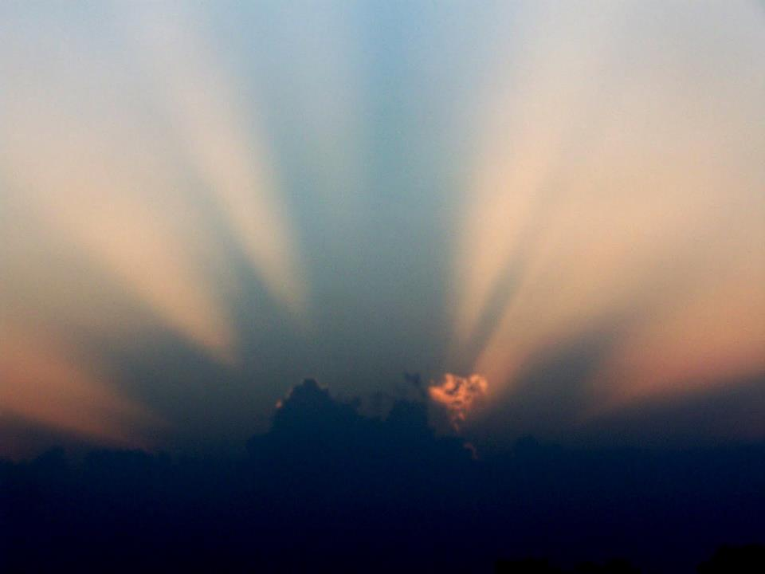
The Beauty of God

Slide 3
One thing I have asked from the Lord, that I shall seek:
That I may dwell in the house of the Lord all the days of my life, To behold the beauty of the Lord And to meditate in His temple.
Psalm 27:4

Slide 5
¹⁰ Now a river flowed out of Eden to water the garden; and from there it divided and became four rivers. ¹¹ The name of the first is Pishon; it flows around the whole land of Havilah, where there is gold. ¹² The gold of that land is good; the bdellium and the onyx stone are there. ¹³ The name of the second river is Gihon; it flows around the whole land of Cush. ¹⁴ The name of the third river is Tigris; it flows east of Assyria. And the fourth river is the Euphrates.
Genesis 2:10-14

Slide 7
Exodus 25-40

Slide 9
¹⁹ Then he prepared an inner sanctuary within the house in order to place there the ark of the covenant of the Lord. ²⁰ The inner sanctuary was twenty cubits in length, twenty cubits in width, and twenty cubits in height, and he overlaid it with pure gold. He also overlaid the altar with cedar. ²¹ So Solomon overlaid the inside of the house with pure gold. And he drew chains of gold across the front of the inner sanctuary, and he overlaid it with gold. ²² He overlaid the whole house with gold, until all the house was finished. Also the whole altar which was by the inner sanctuary he overlaid with gold.
1 Kings 6:19-21

Slide 11
¹⁸ The material of the wall was jasper; and the city was pure gold, like clear glass. ¹⁹ The foundation stones of the city wall were adorned with every kind of precious stone. The first foundation stone was jasper; the second, sapphire; the third, chalcedony; the fourth, emerald; ²⁰ the fifth, sardonyx; the sixth, sardius; the seventh, chrysolite; the eighth, beryl; the ninth, topaz; the tenth, chrysoprase; the eleventh, jacinth; the twelfth, amethyst. ²¹ And the twelve gates were twelve pearls; each one of the gates was a single pearl. And the street of the city was pure gold, like transparent glass. ²² I saw no temple in it, for the Lord God the Almighty and the Lamb are its temple.
Revelation 21:18-22

Slide 12
Then he showed me a river of the water of life, clear as crystal, coming from the throne of God and of the Lamb, ² in the middle of its street. On either side of the river was the tree of life, bearing twelve kinds of fruit, yielding its fruit every month; and the leaves of the tree were for the healing of the nations. ³ There will no longer be any curse; and the throne of God and of the Lamb will be in it, and His bond-servants will serve Him; ⁴ they will see His face, and His name will be on their foreheads. ⁵ And there will no longer be any night; and they will not have need of the light of a lamp nor the light of the sun, because the Lord God will illumine them; and they will reign forever and ever. Revelation 22:1-5.

Slide 14
In that day the Branch of the Lord will be beautiful and glorious, and the fruit of the earth will be the pride and the adornment of the survivors of Israel.
Isaiah 4:2
In that day the Lord of hosts will become a beautiful crown And a glorious diadem to the remnant of His people Isaiah 28:5
Your eyes will see the King in His beauty; They will behold a far-distant land.
Isaiah 33:17

Slide 15
Do you not know that you are a temple of God and that the Spirit of God dwells in you?
1 Corinthians 3:16
Or do you not know that your body is a temple of the Holy Spirit who is in you, whom you have from God, and that you are not your own? 1 Corinthians 6:19
…For we are the temple of the living God…
2 Corinthians 6:16

Slide 16
For we are His workmanship, created in Christ Jesus for good works, which God prepared beforehand so that we would walk in them.
Ephesians 2:10

