Slide 2
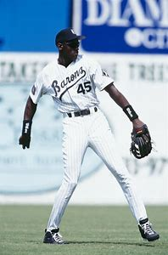

Slide 3
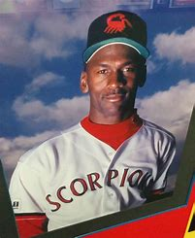

Slide 4
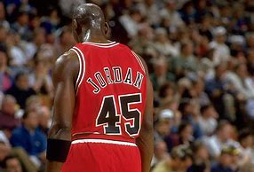

Slide 5
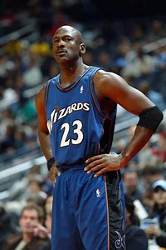

Slide 7
²³ therefore the Lord God sent him out from the garden of Eden to work the ground from which he was taken. ²⁴ He drove out the man, and at the east of the garden of Eden He placed the cherubim and a flaming sword that turned every way to guard the way to the tree of life. Genesis 3:23-24

Slide 8
Cain spoke to Abel his brother. And when they were in the field, Cain rose up against his brother Abel and killed him. Genesis 4:8

Slide 9
Genesis 5:3-31

Slide 11
²¹ For to me to live is Christ, and to die is gain. ²² If I am to live in the flesh, that means fruitful labor for me. Yet which I shall choose I cannot tell. ²³ I am hard pressed between the two. My desire is to depart and be with Christ, for that is far better. ²⁴ But to remain in the flesh is more necessary on your account. ²⁵ Convinced of this, I know that I will remain and continue with you all, for your progress and joy in the faith, ²⁶ so that in me you may have ample cause to glory in Christ Jesus, because of my coming to you again.
Philippians 1:21-26

Slide 13
⁴ For when Solomon was old his wives turned away his heart after other gods, and his heart was not wholly true to the Lord his God, as was the heart of David his father. ⁵ For Solomon went after Ashtoreth the goddess of the Sidonians, and after Milcom the abomination of the Ammonites. ⁶ So Solomon did what was evil in the sight of the Lord and did not wholly follow the Lord, as David his father had done.
1 Kings 11:4-6

Slide 14
⁶ For I am already being poured out as a drink offering, and the time of my departure has come. ⁷ I have fought the good fight, I have finished the race, I have kept the faith. ⁸ Henceforth there is laid up for me the crown of righteousness, which the Lord, the righteous judge, will award to me on that day, and not only to me but also to all who have loved his appearing.
2 Timothy 4:6-8

Slide 15
⁶ For I am already being poured out as a drink offering, and the time of my departure has come. ⁷ I have fought the good fight, I have finished the race, I have kept the faith. ⁸ Henceforth there is laid up for me the crown of righteousness, which the Lord, the righteous judge, will award to me on that day, and not only to me but also to all who have loved his appearing.
2 Timothy 4:6-8

Slide 16
⁶ For I am already being poured out as a drink offering, and the time of my departure has come. ⁷ I have fought the good fight, I have finished the race, I have kept the faith. ⁸ Henceforth there is laid up for me the crown of righteousness, which the Lord, the righteous judge, will award to me on that day, and not only to me but also to all who have loved his appearing.
2 Timothy 4:6-8

Slide 17
⁶ For I am already being poured out as a drink offering, and the time of my departure has come. ⁷ I have fought the good fight, I have finished the race, I have kept the faith. ⁸ Henceforth there is laid up for me the crown of righteousness, which the Lord, the righteous judge, will award to me on that day, and not only to me but also to all who have loved his appearing.
2 Timothy 4:6-8

Slide 18
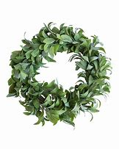

Slide 19
⁶ For I am already being poured out as a drink offering, and the time of my departure has come. ⁷ I have fought the good fight, I have finished the race, I have kept the faith. ⁸ Henceforth there is laid up for me the crown of righteousness, which the Lord, the righteous judge, will award to me on that day, and not only to me but also to all who have loved his appearing.
2 Timothy 4:6-8

Slide 20
⁶ For I am already being poured out as a drink offering, and the time of my departure has come. ⁷ I have fought the good fight, I have finished the race, I have kept the faith. ⁸ Henceforth there is laid up for me the crown of righteousness, which the Lord, the righteous judge, will award to me on that day, and not only to me but also to all who have loved his appearing.
2 Timothy 4:6-8

Slide 22
Lord, you have been our dwelling place in all generations. Before the mountains were brought forth, or ever you had formed the earth and the world, from everlasting to everlasting you are God. Psalm 90:1-2

Slide 23
Whoever loves his life loses it, and whoever hates his life in this world will keep it for eternal life.
John 12:25
For the one who sows to his own flesh will from the flesh reap corruption, but the one who sows to the Spirit will from the Spirit reap eternal life Galatians 6:8

