Slide 1
With One Accord & With One Voice

Slide 2
¹¹ Therefore remember that formerly you, the Gentiles in the flesh, who are called “Uncircumcision” by the so-called “Circumcision,” which is performed in the flesh by human hands— ¹² remember that you were at that time separate from Christ, excluded from the commonwealth of Israel, and strangers to the covenants of promise, having no hope and without God in the world. ¹³ But now in Christ Jesus you who formerly were far off have been brought near by the blood of Christ. ¹⁴ For He Himself is our peace, who made both groups into one and broke down the barrier of the dividing wall, ¹⁵ by abolishing in His flesh the enmity, which is the Law of commandments contained in ordinances, so that in Himself He might make the two into one new man, thus establishing peace, ¹⁶ and might reconcile them both in one body to God through the cross, by it having put to death the enmity.
Ephesians 2:11-16

Slide 3
¹⁸ for through Him we both have our access in one Spirit to the Father. …²² in whom you also are being built together into a dwelling of God in the Spirit. Ephesians 2:18, 22
⁶ to be specific, that the Gentiles are fellow heirs and fellow members of the body, and fellow partakers of the promise in Christ Jesus through the gospel … ⁸ To me, the very least of all saints, this grace was given, to preach to the Gentiles the unfathomable riches of Christ
Ephesians 3:6, 8

Slide 4
¹⁴ For this reason I bow my knees before the Father, ¹⁵ from whom every family in heaven and on earth derives its name
Ephesians 3:14-15
³ being diligent to preserve the unity of the Spirit in the bond of peace.⁴ There is one body and one Spirit, just as also you were called in one hope of your calling; ⁵ one Lord, one faith, one baptism, ⁶ one God and Father of all who is over all and through all and in all.
Ephesians 4:3-6

Slide 5
¹⁸ And do not get drunk with wine, for that is dissipation, but be filled with the Spirit, ¹⁹ speaking to one another in psalms and hymns and spiritual songs, singing and making melody with your heart to the Lord; ²⁰ always giving thanks for all things in the name of our Lord Jesus Christ to God, even the Father; ²¹ and be subject to one another in the fear of Christ.
Ephesians 5:18-21

Slide 6
¹⁸ And do not get drunk with wine, for that is dissipation, but be filled with the Spirit, ¹⁹ speaking to one another in psalms and hymns and spiritual songs, singing and making melody with your heart to the Lord; ²⁰ always giving thanks for all things in the name of our Lord Jesus Christ to God, even the Father; ²¹ and be subject to one another in the fear of Christ.
Ephesians 5:18-21

Slide 7
¹⁸ And do not get drunk with wine, for that is dissipation, but be filled with the Spirit, ¹⁹ speaking to one another in psalms and hymns and spiritual songs, singing and making melody with your heart to the Lord; ²⁰ always giving thanks for all things in the name of our Lord Jesus Christ to God, even the Father; ²¹ and be subject to one another in the fear of Christ.
Ephesians 5:18-21

Slide 8
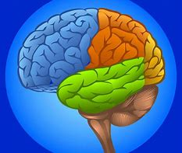

Slide 12
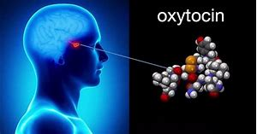
Actively Participating
Synchronized Moving

Slide 13
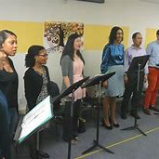
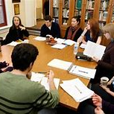

Slide 14
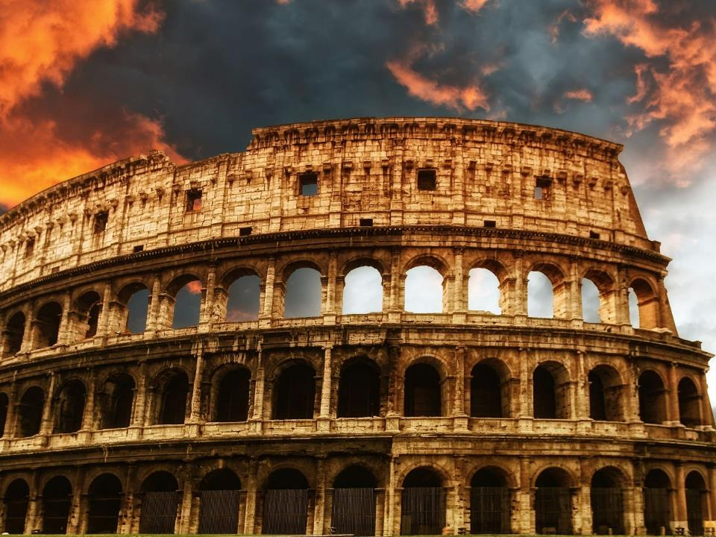
And he found a Jew named Aquila, a native of Pontus, having recently come from Italy with his wife Priscilla, because Claudius had commanded all the Jews to leave Rome.
Acts 18:2
Romans

Slide 15
For I am not ashamed of the gospel, for it is the power of God for salvation to everyone who believes, to the Jew first and also to the Greek. Romans 1:16

Slide 16
For all who have sinned without the Law will also perish without the Law, and all who have sinned under the Law will be judged by the Law
Romans 2:12
What then? Are we better than they? Not at all; for we have already charged that both Jews and Greeks are all under sin Romans 3:9
for all have sinned and fall short of the glory of God Romans 3:23
Or is God the God of Jews only? Is He not the God of Gentiles also? Yes, of Gentiles also Romans 3:29

Slide 17
Therefore, having been justified by faith, we have peace with God through our Lord Jesus Christ Romans 5:1
Or do you not know that all of us who have been baptized into Christ Jesus have been baptized into His death? Romans 6:3

Slide 18
¹⁴ For all who are being led by the Spirit of God, these are sons of God. ¹⁵ For you have not received a spirit of slavery leading to fear again, but you have received a spirit of adoption as sons by which we cry out, “Abba! Father!” ¹⁶ The Spirit Himself testifies with our spirit that we are children of God, ¹⁷ and if children, heirs also, heirs of God and fellow heirs with Christ, if indeed we suffer with Him so that we may also be glorified with Him.
Romans 8:14-17

Slide 19
For just as we have many members in one body and all the members do not have the same function, so we, who are many, are one body in Christ, and individually members one of another.
Romans 12:4-5
Therefore let us not judge one another anymore, but rather determine this—not to put an obstacle or a stumbling block in a brother’s way. Romans 14:13

Slide 20
⁵ Now may the God who gives perseverance and encouragement grant you to be of the same mind with one another according to Christ Jesus, ⁶ so that with one accord you may with one voice glorify the God and Father of our Lord Jesus Christ.
⁷ Therefore, accept one another, just as Christ also accepted us to the glory of God.
Romans 15:5-7
Live in Harmony

