Slide 2
The Organized Church
The Letters to Timothy and Titus

Slide 3
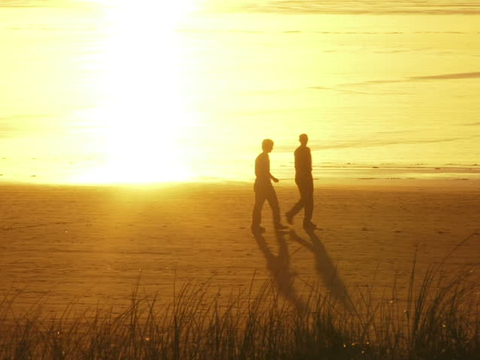
As I urged you when I was going to Macedonia, remain at Ephesus so that you may charge certain persons not to teach any different doctrine 1 Timothy 1:3
This is why I left you in Crete, so that you might put what remained into order, and appoint elders in every town as I directed you Titus 1:5

Slide 4
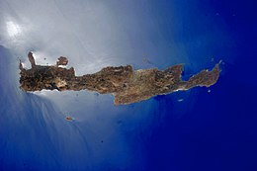
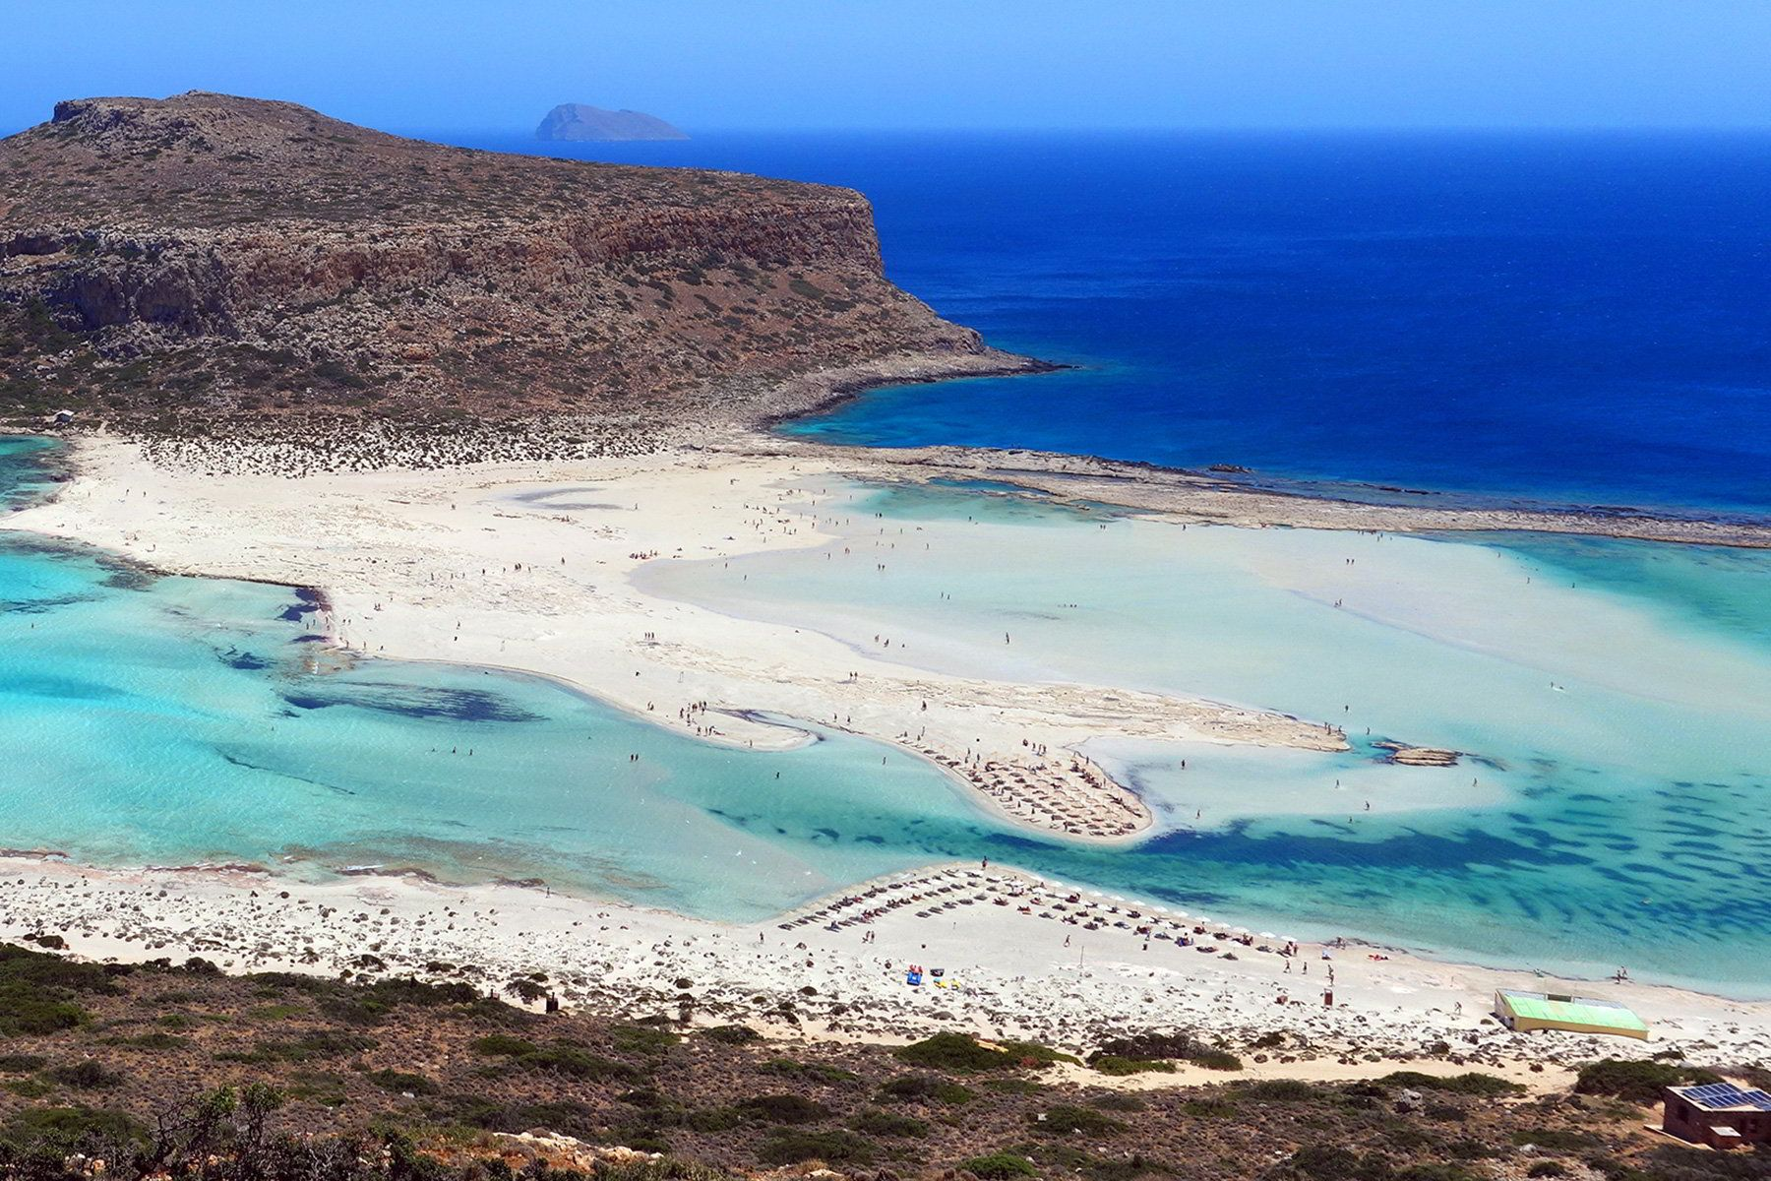
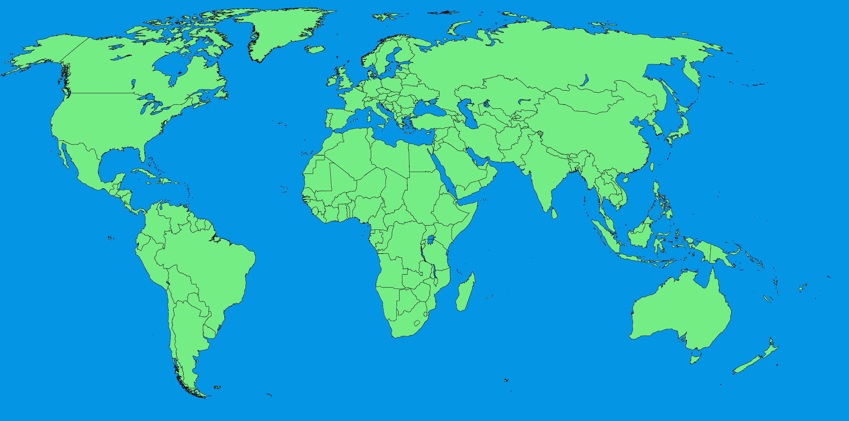
4x

Slide 5
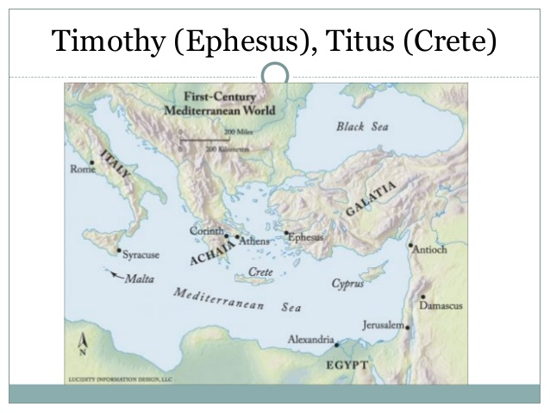

Slide 6
⁹ Do your best to come to me soon… When you come, bring the cloak that I left with Carpus at Troas, also the books, and above all the parchments. …Do your best to come before winter. 2 Timothy 4:9, 13, 21

Slide 7
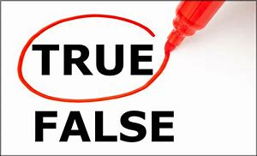
…charge certain persons not to teach any different doctrine, ⁴ nor to devote themselves to myths and endless genealogies, which promote speculations rather than the stewardship from God that is by faith. ⁵ The aim of our charge is love that issues from a pure heart and a good conscience and a sincere faith. ⁶ Certain persons, by swerving from these, have wandered away into vain discussion, ⁷ desiring to be teachers of the law, without understanding either what they are saying or the things about which they make confident assertions.
1 Timothy 1:3-7

Slide 8
¹⁹ holding faith and a good conscience. By rejecting this, some have made shipwreck of their faith, ²⁰ among whom are Hymenaeus and Alexander, whom I have handed over to Satan that they may learn not to blaspheme.
1 Timothy 1:19-20

Slide 9
³ If anyone teaches a different doctrine and does not agree with the sound words of our Lord Jesus Christ and the teaching that accords with godliness, ⁴ he is puffed up with conceit and understands nothing. He has an unhealthy craving for controversy and for quarrels about words, which produce envy, dissension, slander, evil suspicions, ⁵ and constant friction among people who are depraved in mind and deprived of the truth, imagining that godliness is a means of gain.
1 Timothy 6:3-5

Slide 10
¹⁶ But avoid irreverent babble, for it will lead people into more and more ungodliness, ¹⁷ and their talk will spread like gangrene. Among them are Hymenaeus and Philetus, ¹⁸ who have swerved from the truth, saying that the resurrection has already happened. They are upsetting the faith of some.
2 Timothy 2:16-18

Slide 11
Alexander the coppersmith did me great harm; the Lord will repay him according to his deeds. Beware of him yourself, for he strongly opposed our message. 2 Timothy 4:14-15

Slide 12
¹⁰ For there are many who are insubordinate, empty talkers and deceivers, especially those of the circumcision party. ¹¹ They must be silenced, since they are upsetting whole families by teaching for shameful gain what they ought not to teach.
Titus 1:10-11

Slide 13
Now the Spirit expressly says that in later times some will depart from the faith by devoting themselves to deceitful spirits and teachings of demons
1 Timothy 4:1
But understand this, that in the last days there will come times of difficulty
2 Timothy 3:1
But this is what was uttered through the prophet Joel:
“‘And in the last days it shall be, God declares, that I will pour out my Spirit on all flesh
Acts 2:16-17

Slide 14
Now the Spirit expressly says that in later times some will depart from the faith by devoting themselves to deceitful spirits and teachings of demons
1 Timothy 4:1
But understand this, that in the last days there will come times of difficulty
2 Timothy 3:1
Long ago, at many times and in many ways, God spoke to our fathers by the prophets, but in these last days he has spoken to us by his Son, whom he appointed the heir of all things, through whom also he created the world. Hebrews 1:1-2

Slide 15
Now the Spirit expressly says that in later times some will depart from the faith by devoting themselves to deceitful spirits and teachings of demons
1 Timothy 4:1
But understand this, that in the last days there will come times of difficulty
2 Timothy 3:1
Children, it is the last hour, and as you have heard that antichrist is coming, so now many antichrists have come. Therefore we know that it is the last hour.
1 John 2:18

Slide 17
¹ But understand this, that in the last days there will come times of difficulty. ² For people will be lovers of self, lovers of money, proud, arrogant, abusive, disobedient to their parents, ungrateful, unholy, ³ heartless, unappeasable, slanderous, without self-control, brutal, not loving good, ⁴ treacherous, reckless, swollen with conceit, lovers of pleasure rather than lovers of God, ⁵ having the appearance of godliness, but denying its power. Avoid such people. ⁶ For among them are those who creep into households and capture weak women, burdened with sins and led astray by various passions, ⁷ always learning and never able to arrive at a knowledge of the truth. 1 Timothy 4:1-7

Slide 18
¹ But understand this, that in the last days there will come times of difficulty. ² For people will be lovers of self, lovers of money, proud, arrogant, abusive, disobedient to their parents, ungrateful, unholy, ³ heartless, unappeasable, slanderous, without self-control, brutal, not loving good, ⁴ treacherous, reckless, swollen with conceit, lovers of pleasure rather than lovers of God, ⁵ having the appearance of godliness, but denying its power. Avoid such people. ⁶ For among them are those who creep into households and capture weak women, burdened with sins and led astray by various passions, ⁷ always learning and never able to arrive at a knowledge of the truth. 1 Timothy 4:1-7

Slide 19
The saying is trustworthy: If anyone aspires to the office of overseer, he desires a noble task. ² Therefore an overseer must be above reproach, the husband of one wife, sober-minded, self-controlled, respectable, hospitable, able to teach, ³ not a drunkard, not violent but gentle, not quarrelsome, not a lover of money. ⁴ He must manage his own household well, with all dignity keeping his children submissive, ⁵ for if someone does not know how to manage his own household, how will he care for God's church? ⁶ He must not be a recent convert, or he may become puffed up with conceit and fall into the condemnation of the devil. ⁷ Moreover, he must be well thought of by outsiders, so that he may not fall into disgrace, into a snare of the devil. 1 Timothy 3:1-7

Slide 20
⁸ Deacons likewise must be dignified, not double-tongued, not addicted to much wine, not greedy for dishonest gain. ⁹ They must hold the mystery of the faith with a clear conscience. ¹⁰ And let them also be tested first; then let them serve as deacons if they prove themselves blameless. ¹¹ Their wives likewise must be dignified, not slanderers, but sober-minded, faithful in all things. ¹² Let deacons each be the husband of one wife, managing their children and their own households well. ¹³ For those who serve well as deacons gain a good standing for themselves and also great confidence in the faith that is in Christ Jesus. 1 Timothy 3:8-13

Slide 21
⁵ This is why I left you in Crete, so that you might put what remained into order, and appoint elders in every town as I directed you— ⁶ if anyone is above reproach, the husband of one wife, and his children are believers and not open to the charge of debauchery or insubordination. ⁷ For an overseer, as God's steward, must be above reproach. He must not be arrogant or quick-tempered or a drunkard or violent or greedy for gain, ⁸ but hospitable, a lover of good, self-controlled, upright, holy, and disciplined. ⁹ He must hold firm to the trustworthy word as taught, so that he may be able to give instruction in sound doctrine and also to rebuke those who contradict it. Titus 1:5-9

Slide 22
¹ So I exhort the elders among you, as a fellow elder and a witness of the sufferings of Christ, as well as a partaker in the glory that is going to be revealed: ² shepherd the flock of God that is among you, exercising oversight, not under compulsion, but willingly, as God would have you; not for shameful gain, but eagerly; ³ not domineering over those in your charge, but being examples to the flock. ⁴ And when the chief Shepherd appears, you will receive the unfading crown of glory. 1 Peter 5:1-4

Slide 23
The Organized Church
The Letters to Timothy and Titus

