Slide 2
The Organized Church
Virtuous Shepherds

Slide 3
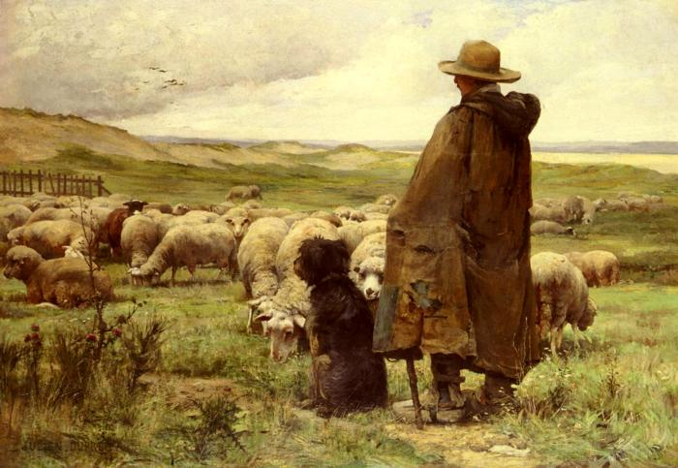
Now Moses was pasturing the flock of Jethro his father-in-law, the priest of Midian; and he led the flock to the west side of the wilderness and came to Horeb, the mountain of God. Exodus 3:1

Slide 4
⁵² But He led forth His own people like sheep And guided them in the wilderness like a flock; ⁵³ He led them safely, so that they did not fear; But the sea engulfed their enemies.
Psalm 78:52-53

Slide 5
And Samuel said to Jesse, “Are these all the children?” And he said, “There remains yet the youngest, and behold, he is tending the sheep.” … 1 Samuel 16:11

Slide 6
⁷⁰ He also chose David His servant And took him from the sheepfolds;
⁷¹ From the care of the ewes with suckling lambs He brought him To shepherd Jacob His people, And Israel His inheritance. ⁷² So he shepherded them according to the integrity of his heart, And guided them with his skillful hands. Psalm 78:70-72

Slide 7
“My people have become lost sheep; Their shepherds have led them astray. … Jeremiah 50:6
“Woe to the worthless shepherd Who leaves the flock! … Zechariah 11:17

Slide 8
“Son of man, prophesy against the shepherds of Israel. Prophesy and say to those shepherds, ‘Thus says the Lord God, “Woe, shepherds of Israel who have been feeding themselves! Should not the shepherds feed the flock? … “As I live,” declares the Lord God, “surely because My flock has become a prey, My flock has even become food for all the beasts of the field for lack of a shepherd, and My shepherds did not search for My flock, but rather the shepherds fed themselves and did not feed My flock; Ezekiel 34:2, 8

Slide 9
“I am the good shepherd; the good shepherd lays down His life for the sheep. …I am the good shepherd, and I know My own and My own know Me. John 10:11, 14
Now the God of peace, who brought up from the dead the great Shepherd of the sheep through the blood of the eternal covenant, even Jesus our Lord, Hebrews 13:20
And when the Chief Shepherd appears, you will receive the unfading crown of glory. 1 Peter 5:4

Slide 10
Be on guard for yourselves and for all the flock, among which the Holy Spirit has made you overseers, to shepherd the church of God which He purchased with His own blood. I know that after my departure savage wolves will come in among you, not sparing the flock
Acts 20:28-29

Slide 11
It is a trustworthy statement:
if any man aspires to the office of overseer, it is a fine work he desires to do.
1 Timothy 3:1

Slide 12
It is a trustworthy statement:
if any man aspires to the office of overseer, it is a fine work he desires to do.
1 Timothy 3:1

Slide 13
It is a trustworthy statement:
if any man aspires to the office of overseer, it is a fine work he desires to do.
1 Timothy 3:1

Slide 14
above reproach (1 Timothy 3:2, Titus 1:6)
temperate, self-controlled (1 Timothy 3:2, Titus 1:8)
prudent, sensible (1 Timothy 3:2, Titus 1:8)
respectable, loving good (1 Timothy 3:2, Titus 1:8)
hospitable, hospitable (1 Timothy 3:2, Titus 1:8)
able to teach (1 Timothy 3:2)
holding fast the faithful word which is in accordance with the teaching, so that he will be able both to exhort in sound doctrine and to refute those who contradict.
Titus 1:9

Slide 15
above reproach (1 Timothy 3:2, Titus 1:5)
temperate, self-controlled (1 Timothy 3:2, Titus 1:8)
prudent, sensible (1 Timothy 3:2, Titus 1:8)
respectable, loving good (1 Timothy 3:2, Titus 1:8)
hospitable, hospitable (1 Timothy 3:2, Titus 1:8)
able to teach (1 Timothy 3:2, Titus 1:9)
not addicted to wine (1 Timothy 3:3; Titus 1:7)
not pugnacious (1 Timothy 3:3; Titus 1:7)
gentle, not self-willed (1 Timothy 3:3; Titus 1:7)
uncontentious, not quick-tempered (1 Timothy 3:3; Titus 1:7)

Slide 16
free from the love of money, not fond of sordid gain (1 Timothy 3:3; Titus 1:7)
not a new convert, so that he will not become conceited and fall into the condemnation incurred by the devil. (1 Timothy 3:6)
he must have a good reputation with those outside the church, so that he will not fall into reproach and the snare of the devil. (1 Timothy 3:7)

Slide 17
free from the love of money, not fond of sordid gain (1 Timothy 3:3; Titus 1:7)
not a new convert, so that he will not become conceited and fall into the condemnation incurred by the devil. (1 Timothy 3:6)
he must have a good reputation with those outside the church, so that he will not fall into reproach and the snare of the devil. (1 Timothy 3:7)

Slide 18
It is a trustworthy statement: if any man aspires to the office of overseer, it is a fine work he desires to do. ² An overseer, then, must be above reproach, the husband of one wife, temperate, prudent, respectable, hospitable, able to teach, ³ not addicted to wine or pugnacious, but gentle, peaceable, free from the love of money. ⁴ He must be one who manages his own household well, keeping his children under control with all dignity ⁵ (but if a man does not know how to manage his own household, how will he take care of the church of God?),
⁶ and not a new convert, so that he will not become conceited and fall into the condemnation incurred by the devil. ⁷ And he must have a good reputation with those outside the church, so that he will not fall into reproach and the snare of the devil. 1 Timothy 3:1-7

Slide 19
It is a trustworthy statement: if any man aspires to the office of overseer, it is a fine work he desires to do. ² An overseer, then, must be above reproach, the husband of one wife, temperate, prudent, respectable, hospitable, able to teach, ³ not addicted to wine or pugnacious, but gentle, peaceable, free from the love of money. ⁴ He must be one who manages his own household well, keeping his children under control with all dignity ⁵ (but if a man does not know how to manage his own household, how will he take care of the church of God?), ⁶ and not a new convert, so that he will not become conceited and fall into the condemnation incurred by the devil. ⁷ And he must have a good reputation with those outside the church, so that he will not fall into reproach and the snare of the devil. 1 Timothy 3:1-7

Slide 20
The Organized Church
Virtuous Shepherds

