Slide 2
9 statements of blessedness
6 areas of greater righteousness
3 areas of quiet righteousness

Slide 3
Do not store up for yourselves treasures on earth… 6:19
“do not worry”
6:25, 31, 34
Disciples and Possessions

Slide 4
Do not store up for yourselves treasures on earth… 6:19
“do not worry”
6:25, 31, 34
Disciples and Possessions
Disciples and Discernment
Judge not…
7:1
Do not give what is holy to dogs…
7:6

Slide 5
¹⁹ I call heaven and earth as witnesses today against you, that I have set before you life and death, blessing and cursing; therefore choose life, that both you and your descendants may live; ²⁰ that you may love the Lord your God, that you may obey His voice, and that you may cling to Him, for He is your life and the length of your days; and that you may dwell in the land which the Lord swore to your fathers, to Abraham, Isaac, and Jacob, to give them.”
Deuteronomy 30:19-20

Slide 6
Two gates (7:13-14)
Two trees (7:15-23)
Two houses (7:24-27)

Slide 7
²¹ “Not everyone who says to me, ‘Lord, Lord,’ will enter the kingdom of heaven,
but
the one who does the will of my Father who is in heaven.

Slide 8
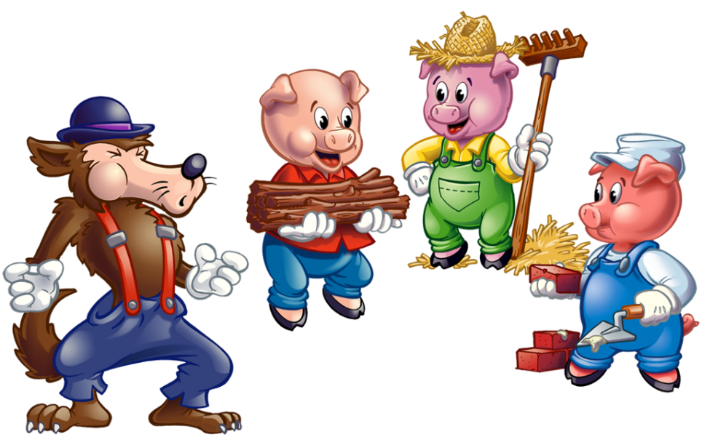

Slide 9
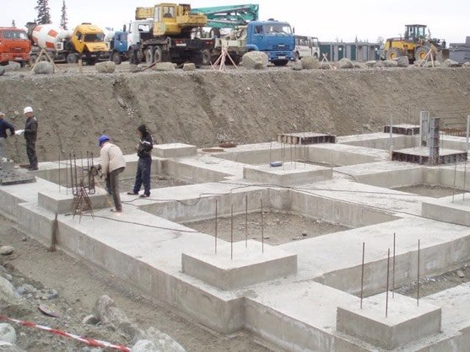

Slide 10
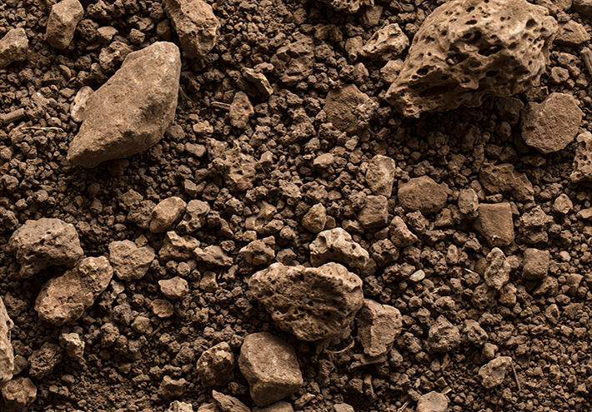
²⁴ “Therefore whoever hears these sayings of Mine, and does them, I will liken him to a wise man who built his house on the rock: ²⁵ and the rain descended, the floods came, and the winds blew and beat on that house; and it did not fall, for it was founded on the rock.

Slide 11
²⁴ “Therefore whoever hears these sayings of Mine, and does them, I will liken him to a wise man who built his house on the rock: ²⁵ and the rain descended, the floods came, and the winds blew and beat on that house; and it did not fall, for it was founded on the rock.

Slide 12
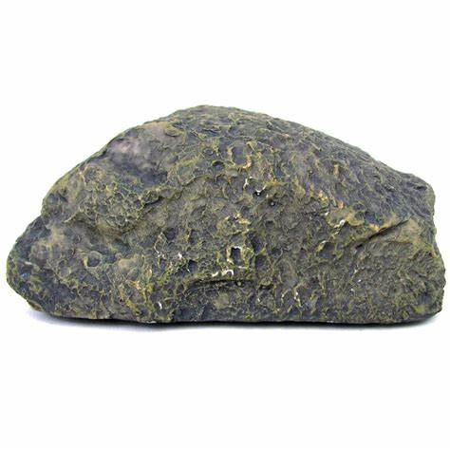
He is the Rock, His work is perfect; For all His ways are justice, A God of truth and without injustice; Righteous and upright is He.
Deuteronomy 32:4

Slide 13
The Lord is my rock and my fortress and my deliverer; My God, my strength, in whom I will trust; My shield and the horn of my salvation, my stronghold.
Psalm 18:2

Slide 14
For who is God, except the Lord? And who is a rock, except our God?
Psalm 18:31

Slide 15
²⁴ “Therefore whoever hears these sayings of Mine, and does them, I will liken him to a wise man who built his house on the rock: ²⁵ and the rain descended, the floods came, and the winds blew and beat on that house; and it did not fall, for it was founded on the rock.

Slide 16
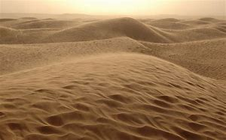
²⁶ “But everyone who hears these sayings of Mine, and does not do them, will be like a foolish man who built his house on the sand: ²⁷ and the rain descended, the floods came, and the winds blew and beat on that house; and it fell. And great was its fall.”

Slide 17
²⁴ “Therefore whoever hears these sayings of Mine, and does them, I will liken him to a wise man who built his house on the rock: ²⁵ and the rain descended, the floods came, and the winds blew and beat on that house; and it did not fall, for it was founded on the rock.
²⁶ “But everyone who hears these sayings of Mine, and does not do them, will be like a foolish man who built his house on the sand: ²⁷ and the rain descended, the floods came, and the winds blew and beat on that house; and it fell. And great was its fall.”

Slide 18
“Truly I say to you…” 5:18, 26; 6:2, 5, 16
“For I say to you…” 5:20
“But I say to you…” 5:22, 28,32, 34, 39, 44
“I say to you…” 6:25, 29

Slide 19
²¹ “Not everyone who says to Me, ‘Lord, Lord,’ shall enter the kingdom of heaven, but he who does the will of My Father in heaven. ²² Many will say to Me in that day, ‘Lord, Lord, have we not prophesied in Your name, cast out demons in Your name, and done many wonders in Your name?’ ²³ And then I will declare to them, ‘I never knew you; depart from Me, you who practice lawlessness!’
Matthew 7:21-23

Slide 20
²⁸ And so it was, when Jesus had ended these sayings, that the people were astonished at His teaching, ²⁹ for He taught them as one having authority, and not as the scribes.

Slide 21
When He had come down from the mountain, great multitudes followed Him.
Matthew 8:1

