Slide 2
From the Water to the Table
Baptism and Lord’s Supper

Slide 3
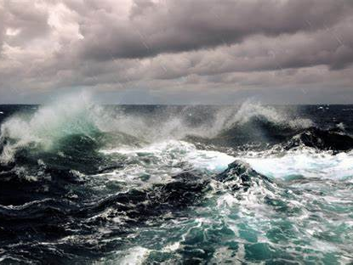
Water as Power

Slide 4
Creation (Genesis 1:2,6,7,9,10,20,21,22)
The Flood (Genesis 6:17; 7:6,7,10,17,18,19,20,24; 8:1,3,4,5,6,7,8,9,11,13; 9:11,15)
The Exodus (Exodus 14:21,22,28,29; 15:8,10,19)

Slide 5
Have you entered into the springs of the sea, or walked in the recesses of the deep?
Job 38:16
The voice of the Lord is over the waters; the God of glory thunders, the Lord, over many waters. Psalm 29:3

Slide 6
Water as Purifier

Slide 7
Aaron and his sons are washed. Exodus 29:4
Aaron is told to wash his body.
Leviticus 16:4,24
The one who is unclean needs to wash. Leviticus 11:40; 15:13
Naaman has to wash to be cleansed. 2 Kings 5:1-14

Slide 8
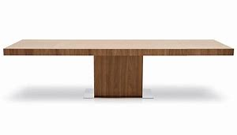
Covenant/Sacrifice

Slide 9
³ So Moses came and told the people all the words of the Lord and all the judgments. And all the people answered with one voice and said, “All the words which the Lord has said we will do.” ⁴ And Moses wrote all the words of the Lord. And he rose early in the morning, and built an altar at the foot of the mountain, and twelve pillars according to the twelve tribes of Israel. ⁵ Then he sent young men of the children of Israel, who offered burnt offerings and sacrificed peace offerings of oxen to the Lord.
Exodus 24:3-5

Slide 10
⁶ And Moses took half the blood and put it in basins, and half the blood he sprinkled on the altar. ⁷ Then he took the Book of the Covenant and read in the hearing of the people. And they said, “All that the Lord has said we will do, and be obedient.” ⁸ And Moses took the blood, sprinkled it on the people, and said, “This is the blood of the covenant which the Lord has made with you according to all these words.”
Exodus 24:6-8

Slide 11
⁹ Then Moses went up, also Aaron, Nadab, and Abihu, and seventy of the elders of Israel, ¹⁰ and they saw the God of Israel. And there was under His feet as it were a paved work of sapphire stone, and it was like the very heavens in its clarity. ¹¹ But on the nobles of the children of Israel He did not lay His hand. So they saw God, and they ate and drank.
Exodus 24:9-11

Slide 12
Hospitality

Slide 13
² He lifted up his eyes and looked, and behold, three men were standing in front of him. When he saw them, he ran from the tent door to meet them and bowed himself to the earth ³ and said, “O Lord, if I have found favor in your sight, do not pass by your servant. ⁴ Let a little water be brought, and wash your feet, and rest yourselves under the tree, ⁵ while I bring a morsel of bread, that you may refresh yourselves, and after that you may pass on—since you have come to your servant.” So they said, “Do as you have said.”
Genesis 18:2-5

Slide 14
⁶ And Abraham went quickly into the tent to Sarah and said, “Quick! Three seahs of fine flour! Knead it, and make cakes.” ⁷ And Abraham ran to the herd and took a calf, tender and good, and gave it to a young man, who prepared it quickly. ⁸ Then he took curds and milk and the calf that he had prepared, and set it before them. And he stood by them under the tree while they ate.
Genesis 18:6-8

Slide 15
Passover

Slide 16
²⁵ And when you come to the land that the Lord will give you, as he has promised, you shall keep this service. ²⁶ And when your children say to you, ‘What do you mean by this service?’ ²⁷ you shall say, ‘It is the sacrifice of the Lord's Passover, for he passed over the houses of the people of Israel in Egypt, when he struck the Egyptians but spared our houses.’” Exodus 12:25-27

Slide 18
⁵ For if we have been united with him in a death like his, we shall certainly be united with him in a resurrection like his. ⁶ We know that our old self was crucified with him in order that the body of sin might be brought to nothing, so that we would no longer be enslaved to sin.
Romans 6:5-6

Slide 19
And he took bread, and when he had given thanks, he broke it and gave it to them, saying, “This is my body, which is given for you. Do this in remembrance of me.”
Luke 22:19

Slide 20
And Peter said to them, “Repent and be baptized every one of you in the name of Jesus Christ for the forgiveness of your sins, and you will receive the gift of the Holy Spirit. Acts 2:38

Slide 21
And he took bread, and when he had given thanks, he broke it and gave it to them, saying, “This is my body, which is given for you. Do this in remembrance of me.”
Luke 22:19

Slide 22
¹⁶ The cup of blessing that we bless, is it not a participation in the blood of Christ? The bread that we break, is it not a participation in the body of Christ? ¹⁷ Because there is one bread, we who are many are one body, for we all partake of the one bread.
1 Corinthians 10:16-17

Slide 23
For as often as you eat this bread and drink the cup, you proclaim the Lord's death until he comes. 1 Corinthians 11:26

Slide 24
⁵ For if we have been united with him in a death like his, we shall certainly be united with him in a resurrection like his. Romans 6:5

Slide 25
I tell you I will not drink again of this fruit of the vine until that day when I drink it new with you in my Father's kingdom.
Matthew 26:29

Slide 26
From the Water to the Table
Baptism and Lord’s Supper

