Slide 3
Streams of Preaching
In American History

Slide 4
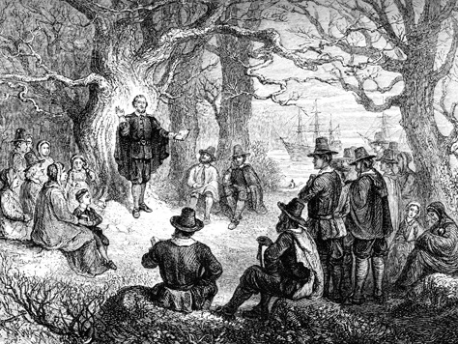

Slide 5
Teach

Slide 7
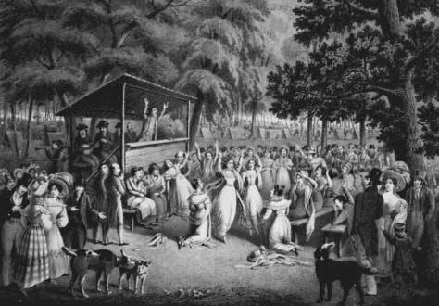

Slide 8
Evangelize
Teach

Slide 9
Evangelize
Teach

Slide 10
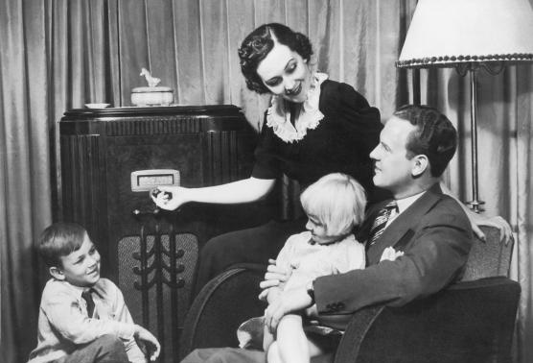

Slide 11
Encourage
Evangelize
Teach

Slide 12
Encourage
Evangelize
Teach

Slide 13
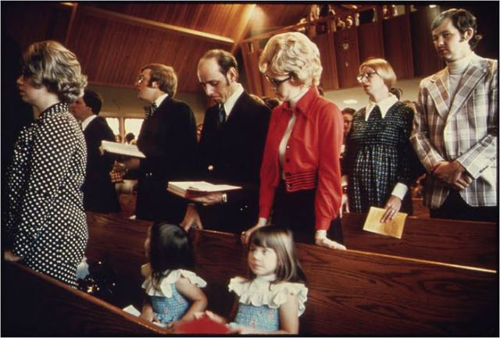

Slide 14
Experience
Encourage
Evangelize
Teach

Slide 15
Experience
Encourage
Evangelize
Teach

Slide 18
Listen
Experience
Encourage
Evangelize
Teach

Slide 19
Listen
Translate
Experience
Encourage
Evangelize
Teach

Slide 20
Listen
Translate
Experience
Encourage
Evangelize
Teach
Baptism

