Slide 2
9 statements of blessedness
6 areas of greater righteousness
3 areas of quiet righteousness

Slide 3
Do not store up for yourselves treasures on earth… 6:19
…do not be worried…
6:25
Disciples and Possessions

Slide 4
⁷ Hypocrites! Well did Isaiah prophesy about you, saying:
⁸ ‘These people draw near to Me with their mouth, And honor Me with their lips, But their heart is far from Me. ⁹ And in vain they worship Me, Teaching as doctrines the commandments of men.’ ”
Matthew 15:7-9

Slide 5
But all their works they do to be seen by men. …
Matthew 23:5

Slide 6
Woe to you, scribes and Pharisees, hypocrites! For you cleanse the outside of the cup and dish, but inside they are full of extortion and self-indulgence. Matthew 23:25

Slide 8
Disciples and Discernment

Slide 9
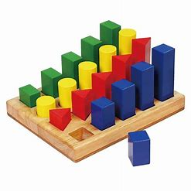
¹ Judge not, that you be not judged.

Slide 10
¹ Judge not, that you be not judged.
²¹ Test all things; hold fast what is good. ²² Abstain from every form of evil.
1 Thessalonians 5:21-22

Slide 11
² For with what judgment you judge, you will be judged; and with the measure you use, it will be measured back to you.

Slide 12
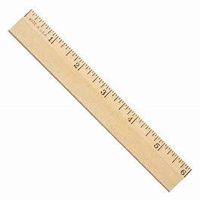
² For with what judgment you judge, you will be judged; and with the measure you use, it will be measured back to you.

Slide 13
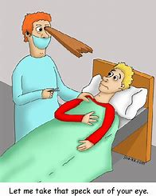
³ And why do you look at the speck in your brother’s eye, but do not consider the plank in your own eye? ⁴ Or how can you say to your brother, ‘Let me remove the speck from your eye’; and look, a plank is in your own eye?

Slide 14
⁵ Hypocrite! First remove the plank from your own eye, and then you will see clearly to remove the speck from your brother’s eye.

Slide 15
⁵ Hypocrite! First remove the plank from your own eye, and then you will see clearly to remove the speck from your brother’s eye.

Slide 16
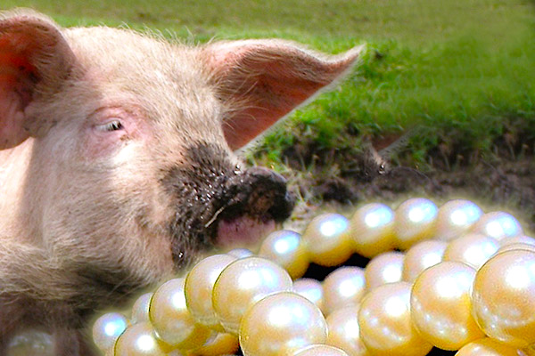
⁶ “Do not give what is holy to the dogs; nor cast your pearls before swine, lest they trample them under their feet, and turn and tear you in pieces.

Slide 17
⁷ “Ask, and it will be given to you; seek, and you will find; knock, and it will be opened to you. ⁸ For everyone who asks receives, and he who seeks finds, and to him who knocks it will be opened.
And whatever we ask we receive from Him, because we keep His commandments and do those things that are pleasing in His sight.
1 John 3:22

Slide 18
⁷ “Ask, and it will be given to you; seek, and you will find; knock, and it will be opened to you. ⁸ For everyone who asks receives, and he who seeks finds, and to him who knocks it will be opened.
Now this is the confidence that we have in Him, that if we ask anything according to His will, He hears us. And if we know that He hears us, whatever we ask, we know that we have the petitions that we have asked of Him.
1 John 5:14-15

Slide 19
⁷ “Ask, and it will be given to you; seek, and you will find; knock, and it will be opened to you. ⁸ For everyone who asks receives, and he who seeks finds, and to him who knocks it will be opened.
If any of you lacks wisdom, let him ask of God, who gives to all liberally and without reproach, and it will be given to him. But let him ask in faith, with no doubting, for he who doubts is like a wave of the sea driven and tossed by the wind.
James 1:5-6

Slide 20
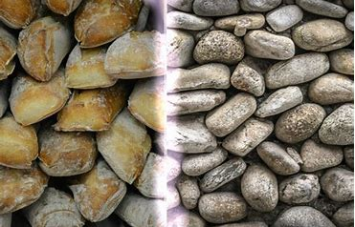
⁹ Or what man is there among you who, if his son asks for bread, will give him a stone? ¹⁰ Or if he asks for a fish, will he give him a serpent? ¹¹ If you then, being evil, know how to give good gifts to your children, how much more will your Father who is in heaven give good things to those who ask Him!

Slide 21
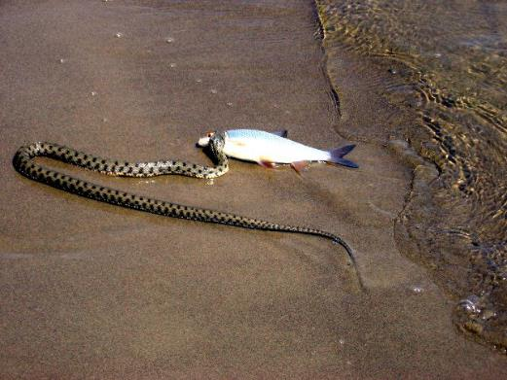
⁹ Or what man is there among you who, if his son asks for bread, will give him a stone? ¹⁰ Or if he asks for a fish, will he give him a serpent? ¹¹ If you then, being evil, know how to give good gifts to your children, how much more will your Father who is in heaven give good things to those who ask Him!

Slide 22
⁹ Or what man is there among you who, if his son asks for bread, will give him a stone? ¹⁰ Or if he asks for a fish, will he give him a serpent? ¹¹ If you then, being evil, know how to give good gifts to your children, how much more will your Father who is in heaven give good things to those who ask Him!
If you then, being evil, know how to give good gifts to your children, how much more will your heavenly Father give the Holy Spirit to those who ask Him!”
Luke 11:13

Slide 23
¹² Therefore, whatever you want men to do to you, do also to them, for this is the Law and the Prophets.

Slide 24
¹² Therefore, whatever you want men to do to you, do also to them, for this is the Law and the Prophets.
² For with what judgment you judge, you will be judged; and with the measure you use, it will be measured back to you.

