Slide 2
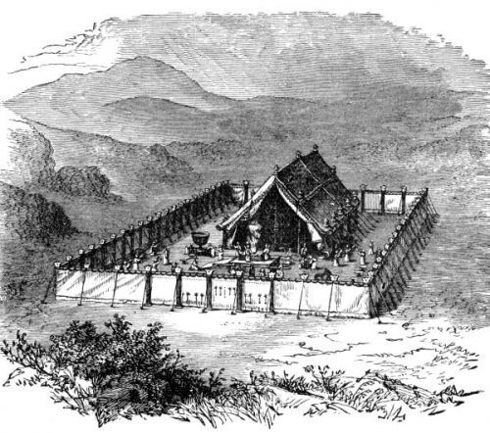
Lasting Laws of Leviticus

Slide 4
And what agreement has the temple of God with idols? For you are the temple of the living God. As God has said:
“I will dwell in them And walk among them. I will be their God, And they shall be My people.”
2 Corinthians 6:16
I will walk among you and be your God, and you shall be My people. Leviticus 26:12

Slide 5
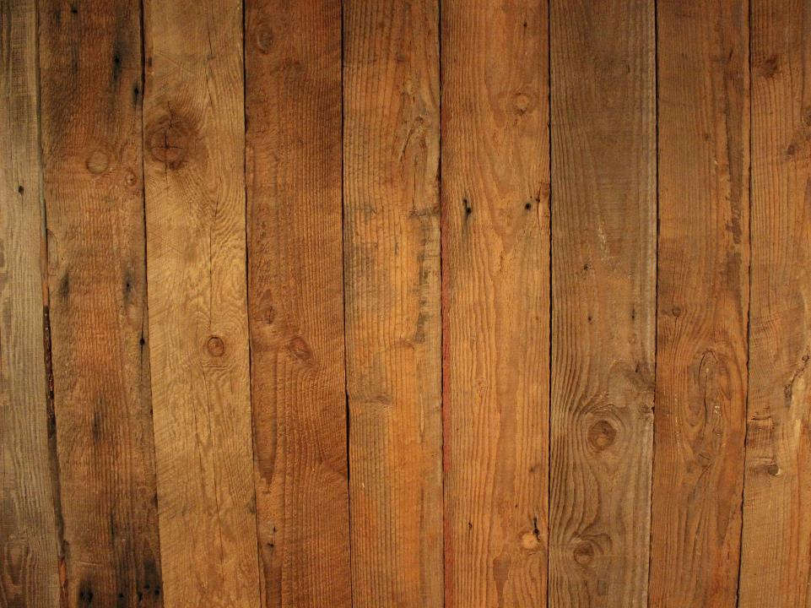
God’s Dwelling Place

Slide 6
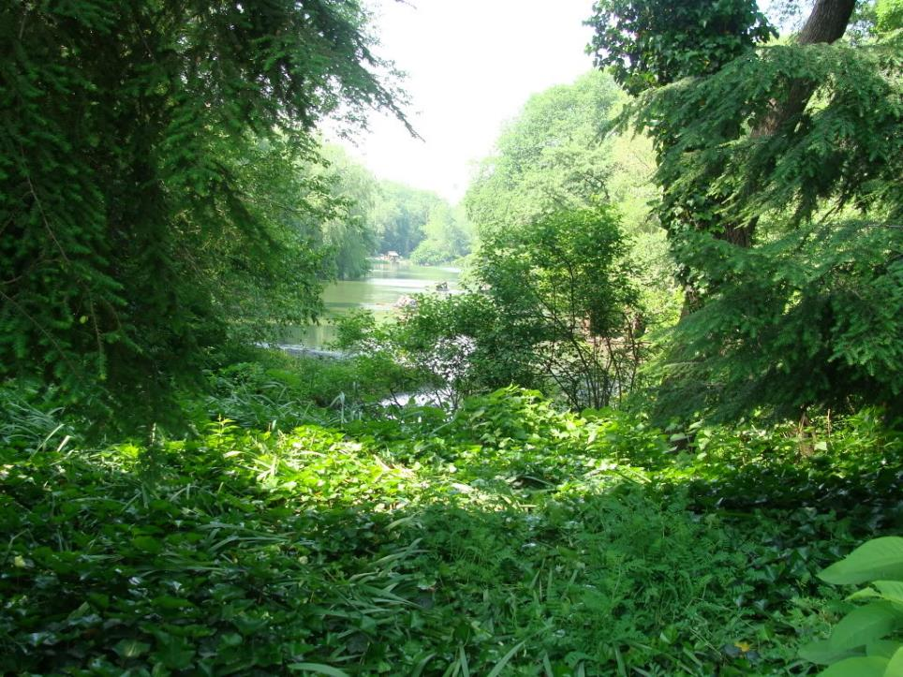
And they heard the sound of the Lord God walking in the garden in the cool of the day, and Adam and his wife hid themselves from the presence of the Lord God among the trees of the garden.
Genesis 3:8

Slide 7
²³ therefore the Lord God sent him out of the garden of Eden to till the ground from which he was taken. ²⁴ So He drove out the man; and He placed cherubim at the east of the garden of Eden, and a flaming sword which turned every way, to guard the way to the tree of life.
Genesis 3:23-24

Slide 8
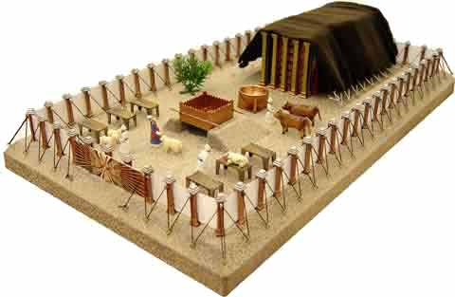
⁴⁴ So I will consecrate the tabernacle of meeting and the altar. I will also consecrate both Aaron and his sons to minister to Me as priests. ⁴⁵ I will dwell among the children of Israel and will be their God. ⁴⁶ And they shall know that I am the Lord their God, who brought them up out of the land of Egypt, that I may dwell among them. I am the Lord their God.
Exodus 29:44-46

Slide 9
For the Lord your God walks in the midst of your camp, to deliver you and give your enemies over to you; therefore your camp shall be holy, that He may see no unclean thing among you, and turn away from you.
Deuteronomy 23:14

Slide 10
² So fire went out from the Lord and devoured them, and they died before the Lord. ³ And Moses said to Aaron, “This is what the Lord spoke, saying:
‘By those who come near Me I must be regarded as holy; And before all the people I must be glorified.’ ”
Leviticus 10:2-3

Slide 11
¹³ And the Lord spoke to Moses, saying, ¹⁴ “Take outside the camp him who has cursed; then let all who heard him lay their hands on his head, and let all the congregation stone him.
Leviticus 24:13-14

Slide 12
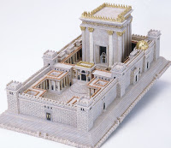
When Solomon had finished praying, fire came down from heaven and consumed the burnt offering and the sacrifices; and the glory of the Lord filled the temple. ² And the priests could not enter the house of the Lord, because the glory of the Lord had filled the Lord’s house. ³ When all the children of Israel saw how the fire came down, and the glory of the Lord on the temple, they bowed their faces to the ground on the pavement, and worshiped and praised the Lord, saying:
“For He is good, For His mercy endures forever.”
2 Chronicles 7:1-3

Slide 13
²³ And Moses and Aaron went into the tabernacle of meeting, and came out and blessed the people. Then the glory of the Lord appeared to all the people, ²⁴ and fire came out from before the Lord and consumed the burnt offering and the fat on the altar. When all the people saw it, they shouted and fell on their faces.
Leviticus 9:23-24

Slide 14
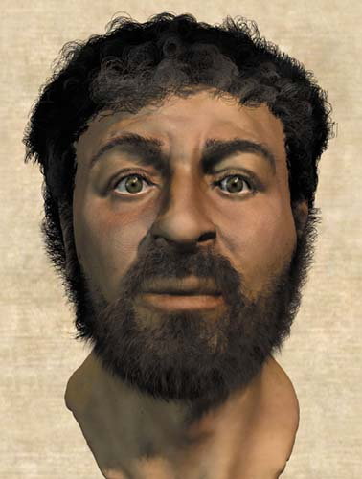
And the Word became flesh and dwelt among us, and we beheld His glory, the glory as of the only begotten of the Father, full of grace and truth.
John 1:14

Slide 15
And the Word became flesh and dwelt among us, and we beheld His glory, the glory as of the only begotten of the Father, full of grace and truth.
John 1:14

Slide 16
¹⁹ Jesus answered and said to them, “Destroy this temple, and in three days I will raise it up.”
²⁰ Then the Jews said, “It has taken forty-six years to build this temple, and will You raise it up in three days?”
²¹ But He was speaking of the temple of His body.
John 2:19-21

Slide 17
¹⁶ Do you not know that you are the temple of God and that the Spirit of God dwells in you? ¹⁷ If anyone defiles the temple of God, God will destroy him. For the temple of God is holy, which temple you are.
1 Corinthians 3:16-17
¹⁹ Or do you not know that your body is the temple of the Holy Spirit who is in you, whom you have from God, and you are not your own? ²⁰ For you were bought at a price; therefore glorify God in your body and in your spirit, which are God’s.
1 Corinthians 6:19-20

Slide 18
¹⁶ Do you not know that you are the temple of God and that the Spirit of God dwells in you? ¹⁷ If anyone defiles the temple of God, God will destroy him. For the temple of God is holy, which temple you are.
1 Corinthians 3:16-17
¹⁹ Or do you not know that your body is the temple of the Holy Spirit who is in you, whom you have from God, and you are not your own? ²⁰ For you were bought at a price; therefore glorify God in your body and in your spirit, which are God’s.
1 Corinthians 6:19-20

Slide 19
¹⁶ Do you not know that you are the temple of God and that the Spirit of God dwells in you? ¹⁷ If anyone defiles the temple of God, God will destroy him. For the temple of God is holy, which temple you are.
1 Corinthians 3:16-17
¹⁹ Or do you not know that your body is the temple of the Holy Spirit who is in you, whom you have from God, and you are not your own? ²⁰ For you were bought at a price; therefore glorify God in your body and in your spirit, which are God’s.
1 Corinthians 6:19-20

Slide 20
¹⁶ Do you not know that you are the temple of God and that the Spirit of God dwells in you? ¹⁷ If anyone defiles the temple of God, God will destroy him. For the temple of God is holy, which temple you are.
1 Corinthians 3:16-17
¹⁹ Or do you not know that your body is the temple of the Holy Spirit who is in you, whom you have from God, and you are not your own? ²⁰ For you were bought at a price; therefore glorify God in your body and in your spirit, which are God’s.
1 Corinthians 6:19-20

Slide 21
And what agreement has the temple of God with idols? For you are the temple of the living God. As God has said:
“I will dwell in them And walk among them. I will be their God, And they shall be My people.”
2 Corinthians 6:16

Slide 22
Now I saw a new heaven and a new earth, for the first heaven and the first earth had passed away. Also there was no more sea. ² Then I, John, saw the holy city, New Jerusalem, coming down out of heaven from God, prepared as a bride adorned for her husband. ³ And I heard a loud voice from heaven saying, “Behold, the tabernacle of God is with men, and He will dwell with them, and they shall be His people. God Himself will be with them and be their God. ⁴ And God will wipe away every tear from their eyes; there shall be no more death, nor sorrow, nor crying. There shall be no more pain, for the former things have passed away.”
Revelation 21:1-4

Slide 23
Now I saw a new heaven and a new earth, for the first heaven and the first earth had passed away. Also there was no more sea. ² Then I, John, saw the holy city, New Jerusalem, coming down out of heaven from God, prepared as a bride adorned for her husband. ³ And I heard a loud voice from heaven saying, “Behold, the tabernacle of God is with men, and He will dwell with them, and they shall be His people. God Himself will be with them and be their God. ⁴ And God will wipe away every tear from their eyes; there shall be no more death, nor sorrow, nor crying. There shall be no more pain, for the former things have passed away.”
Revelation 21:1-4

Slide 24
The New Heavens and New Earth
The Garden
The Tabernacle
The Church
The Temple
The Christ

Slide 25
³⁷ Now when they heard this, they were cut to the heart, and said to Peter and the rest of the apostles, “Men and brethren, what shall we do?”
³⁸ Then Peter said to them, “Repent, and let every one of you be baptized in the name of Jesus Christ for the remission of sins; and you shall receive the gift of the Holy Spirit.
Acts 2:37-38

