Slide 2
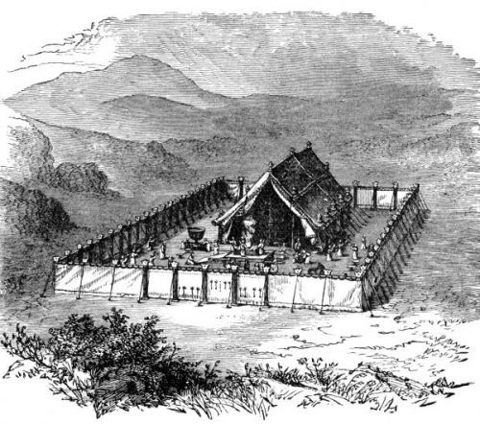
Lasting Laws of Leviticus

Slide 3
¹⁵ but as He who called you is holy, you also be holy in all your conduct, ¹⁶ because it is written, “Be holy, for I am holy.”
1 Peter 1:15-16
⁴⁴ For I am the Lord your God. You shall therefore consecrate yourselves, and you shall be holy; for I am holy. Neither shall you defile yourselves with any creeping thing that creeps on the earth. ⁴⁵ For I am the Lord who brings you up out of the land of Egypt, to be your God. You shall therefore be holy, for I am holy.
Leviticus 11:44-45.

Slide 4
¹⁵ but as He who called you is holy, you also be holy in all your conduct, ¹⁶ because it is written, “Be holy, for I am holy.”
1 Peter 1:15-16
¹ And the Lord spoke to Moses, saying, ² “Speak to all the congregation of the children of Israel, and say to them: ‘You shall be holy, for I the Lord your God am holy.
Leviticus 19:1-2.

Slide 5
¹⁵ but as He who called you is holy, you also be holy in all your conduct, ¹⁶ because it is written, “Be holy, for I am holy.”
1 Peter 1:15-16
Consecrate yourselves therefore, and be holy, for I am the Lord your God. Leviticus 20:7.

Slide 6
¹⁵ but as He who called you is holy, you also be holy in all your conduct, ¹⁶ because it is written, “Be holy, for I am holy.”
1 Peter 1:15-16
And you shall be holy to Me, for I the Lord am holy, and have separated you from the peoples, that you should be Mine. Leviticus 20:26.

Slide 7
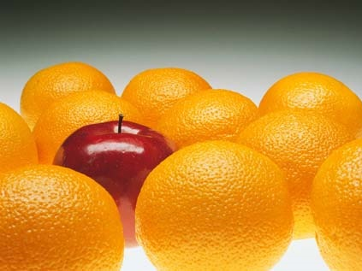
Be Holy

Slide 8
What does the word holy mean?

Slide 9
separate, distinct, unique, set apart
dedicated/consecrated for religious significance
sanctify
saints

Slide 10
How is God holy?

Slide 11
…you shall be holy; for I am holy. …You shall therefore be holy, for I am holy.
Leviticus 11:44-45
…You shall be holy, for I the Lord your God am holy. Leviticus 19:2
Consecrate yourselves therefore, and be holy, for I am the Lord your God. Leviticus 20:7
And you shall be holy to Me, for I the Lord am holy… Leviticus 20:26

Slide 12
1. God is unlike other gods.
Who is like You, O Lord, among the gods? Who is like You, glorious in holiness
Exodus 15:11
I am the Lord your God, who brought you out of the land of Egypt, out of the house of bondage.
Exodus 20:2

Slide 13
1. God is unlike other gods.
2. There is one God who is unlike creation.
I will sing to the Lord as long as I live; I will sing praise to my God while I have my being.
Psalm 104:33

Slide 14
1. God is unlike other gods.
2. There is one God who is unlike creation.
3. God is perfect.
³ For I proclaim the name of the Lord: Ascribe greatness to our God. ⁴ He is the Rock, His work is perfect; For all His ways are justice, A God of truth and without injustice; Righteous and upright is He.
Deuteronomy 32:3-4

Slide 15
How was Israel to be holy?

Slide 16
…you shall be holy; for I am holy. …You shall therefore be holy, for I am holy.
Leviticus 11:44-45
…You shall be holy, for I the Lord your God am holy. Leviticus 19:2
Consecrate yourselves therefore, and be holy, for I am the Lord your God. Leviticus 20:7
And you shall be holy to Me, for I the Lord am holy… Leviticus 20:26

Slide 17
1. Israel was to be unlike the other nations.
⁵ Now therefore, if you will indeed obey My voice and keep My covenant, then you shall be a special treasure to Me above all people; for all the earth is Mine. ⁶ And you shall be to Me a kingdom of priests and a holy nation.’ …
Exodus 19:5-6

Slide 18
1. Israel was to be separate from other nations.
² and when the Lord your God delivers them over to you, you shall conquer them and utterly destroy them. You shall make no covenant with them nor show mercy to them. ³ Nor shall you make marriages with them. You shall not give your daughter to their son, nor take their daughter for your son. ⁴ For they will turn your sons away from following Me, to serve other gods; so the anger of the Lord will be aroused against you and destroy you suddenly.
Deuteronomy 7:2-4

Slide 19
1. Israel was to be separate from other nations.
2. Israel was to be holy in conduct.
The Lord will establish you as a holy people to Himself, just as He has sworn to you, if you keep the commandments of the Lord your God and walk in His ways.
Deuteronomy 28:9

Slide 20
God
Israel
Nations & gods

Slide 21
God
Israel
Nations & gods

Slide 22
God
Israel
Nations & gods

Slide 23
How is the church to be holy?

Slide 24
⁹ But you are a chosen generation, a royal priesthood, a holy nation, His own special people, that you may proclaim the praises of Him who called you out of darkness into His marvelous light; ¹⁰ who once were not a people but are now the people of God, who had not obtained mercy but now have obtained mercy. 1 Peter 2:9-10

Slide 25
¹³ Therefore gird up the loins of your mind, be sober, and rest your hope fully upon the grace that is to be brought to you at the revelation of Jesus Christ; ¹⁴ as obedient children, not conforming yourselves to the former lusts, as in your ignorance; ¹⁵ but as He who called you is holy, you also be holy in all your conduct, ¹⁶ because it is written, “Be holy, for I am holy.”
1 Peter 1:15-16

Slide 26
God
Israel
Nations & gods

Slide 27
Holy Father
Holy Son
Holy Spirit

Slide 28
Holy Father
Holy Son
Holy Spirit
The world

Slide 29
Holy Father
Holy Son
Holy Spirit
Church
The world

