Slide 2
9 statements of blessedness
6 areas of greater righteousness
3 areas of quiet righteousness

Slide 3
Do not store up for yourselves treasures on earth… 6:19
“do not worry”
6:25, 31, 34
Disciples and Possessions

Slide 4
Do not store up for yourselves treasures on earth… 6:19
“do not worry”
6:25, 31, 34
Disciples and Possessions
Disciples and Discernment
Judge not…
7:1
Do not give what is holy to dogs…
7:6

Slide 5
Two gates (7:13-14)
Two trees (7:15-23)
Two houses (7:24-27)

Slide 7
¹³ He answered, “Every plant that my heavenly Father has not planted will be rooted up. ¹⁴ Let them alone; they are blind guides. And if the blind lead the blind, both will fall into a pit.”
Matthew 15:13-14

Slide 8
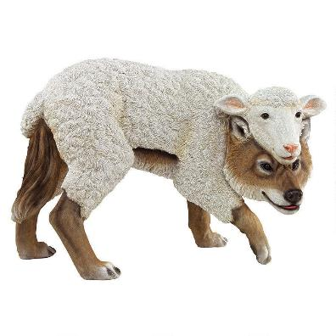
¹⁵ “Beware of false prophets, who come to you in sheep's clothing but inwardly are ravenous wolves.

Slide 9
²⁹ I know that after my departure fierce wolves will come in among you, not sparing the flock; ³⁰ and from among your own selves will arise men speaking twisted things, to draw away the disciples after them.
Acts 20:29-30

Slide 10
³⁰ An appalling and horrible thing has happened in the land: ³¹ the prophets prophesy falsely, and the priests rule at their direction; my people love to have it so, but what will you do when the end comes?
Jeremiah 5:30-31

Slide 11
¹³ “For from the least to the greatest of them, everyone is greedy for unjust gain; and from prophet to priest, everyone deals falsely. ¹⁴ They have healed the wound of my people lightly, saying, ‘Peace, peace,’ when there is no peace. Jeremiah 6:13-14 (8:10-11)

Slide 12
Precisely because they have misled my people, saying, ‘Peace,’ when there is no peace, and because, when the people build a wall, these prophets smear it with whitewash Ezekiel 13:10

Slide 13
But false prophets also arose among the people, just as there will be false teachers among you, who will secretly bring in destructive heresies, even denying the Master who bought them, bringing upon themselves swift destruction.
2 Peter 2:1

Slide 15
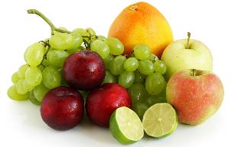
¹⁶ You will recognize them by their fruits.
Are grapes gathered from thornbushes, or figs from thistles? ¹⁷ So, every healthy tree bears good fruit, but the diseased tree bears bad fruit. ¹⁸ A healthy tree cannot bear bad fruit, nor can a diseased tree bear good fruit. ¹⁹ Every tree that does not bear good fruit is cut down and thrown into the fire.
²⁰ Thus you will recognize them by their fruits.

Slide 16
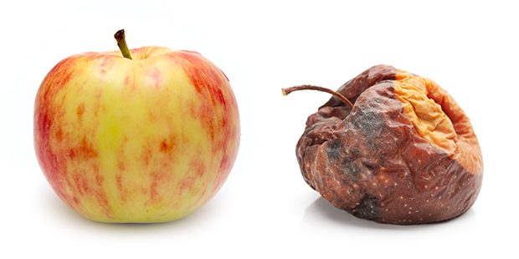
Are grapes gathered from thornbushes, or figs from thistles? ¹⁷ So, every healthy tree bears good fruit, but the diseased tree bears bad fruit. ¹⁸ A healthy tree cannot bear bad fruit, nor can a diseased tree bear good fruit. ¹⁹ Every tree that does not bear good fruit is cut down and thrown into the fire.
Deeds reveal character.

Slide 17
Are grapes gathered from thornbushes, or figs from thistles? ¹⁷ So, every healthy tree bears good fruit, but the diseased tree bears bad fruit. ¹⁸ A healthy tree cannot bear bad fruit, nor can a diseased tree bear good fruit. ¹⁹ Every tree that does not bear good fruit is cut down and thrown into the fire.
Deeds reveal character.

Slide 18
²¹ “Not everyone who says to me, ‘Lord, Lord,’ will enter the kingdom of heaven, but the one who does the will of my Father who is in heaven.

Slide 19
But be doers of the word, and not hearers only, deceiving yourselves. …What good is it, my brothers, if someone says he has faith but does not have works? Can that faith save him? …You see that a person is justified by works and not by faith alone.
James 1:22; 2:14, 24

Slide 20
²² On that day many will say to me, ‘Lord, Lord, did we not prophesy in your name, and cast out demons in your name, and do many mighty works in your name?’ ²³ And then will I declare to them, ‘I never knew you; depart from me, you workers of lawlessness.’
²¹ “Not everyone who says to me, ‘Lord, Lord,’ will enter the kingdom of heaven, but the one who does the will of my Father who is in heaven.

Slide 21
