Slide 2
³⁶ Thus Joseph, who was also called by the apostles Barnabas (which means son of encouragement), a Levite, a native of Cyprus, ³⁷ sold a field that belonged to him and brought the money and laid it at the apostles' feet.
Acts 4:36-37

Slide 3
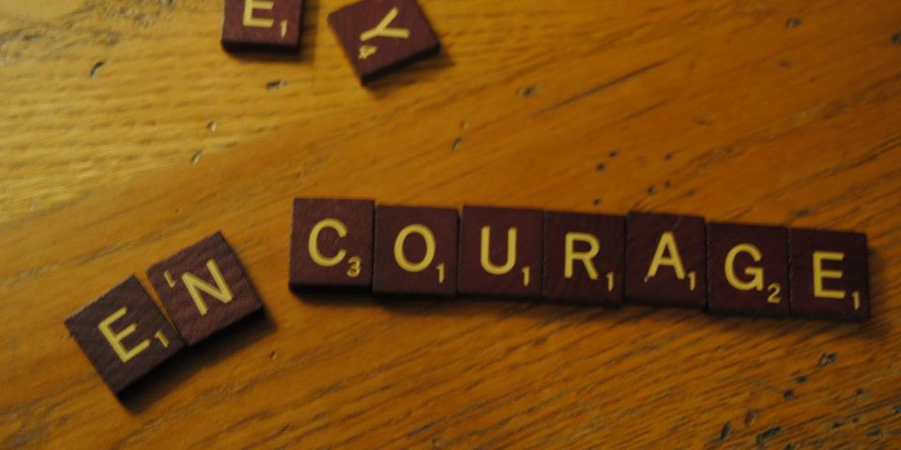
Learning from Barnabas

Slide 4
Be a friend of those in need.

Slide 5
³⁴ There was not a needy person among them, for as many as were owners of lands or houses sold them and brought the proceeds of what was sold ³⁵ and laid it at the apostles' feet, and it was distributed to each as any had need. ³⁶ Thus Joseph, who was also called by the apostles Barnabas (which means son of encouragement), a Levite, a native of Cyprus, ³⁷ sold a field that belonged to him and brought the money and laid it at the apostles' feet. Acts 4:34-37
Be a friend of those in need.

Slide 6
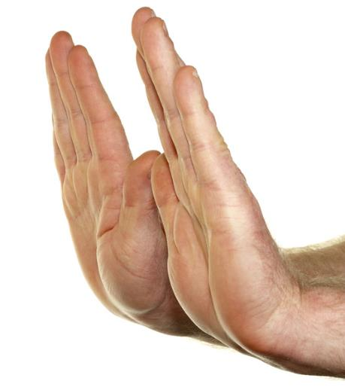
And when he had come to Jerusalem, he attempted to join the disciples. And they were all afraid of him, for they did not believe that he was a disciple.
Acts 9:26
Be a friend of those who are feared.

Slide 7
But Saul was ravaging the church, and entering house after house, he dragged off men and women and committed them to prison.
Acts 8:3
Be a friend of those who are feared.

Slide 8
But Saul, still breathing threats and murder against the disciples of the Lord, went to the high priest and asked him for letters to the synagogues at Damascus, so that if he found any belonging to the Way, men or women, he might bring them bound to Jerusalem.
Acts 9:1-2
Be a friend of those who are feared.

Slide 9
And when he had come to Jerusalem, he attempted to join the disciples. And they were all afraid of him, for they did not believe that he was a disciple. But Barnabas took him and brought him to the apostles and declared to them how on the road he had seen the Lord, who spoke to him, and how at Damascus he had preached boldly in the name of Jesus.
Acts 9:26-27
Be a friend of those who are feared.

Slide 10
And when he had come to Jerusalem, he attempted to join the disciples. And they were all afraid of him, for they did not believe that he was a disciple. But Barnabas took him and brought him to the apostles and declared to them how on the road he had seen the Lord, who spoke to him, and how at Damascus he had preached boldly in the name of Jesus.
Acts 9:26-27
Be a friend of those who are feared.

Slide 11
And when he had come to Jerusalem, he attempted to join the disciples. And they were all afraid of him, for they did not believe that he was a disciple…
So the church throughout all Judea and Galilee and Samaria had peace and was being built up. And walking in the fear of the Lord and in the comfort of the Holy Spirit, it multiplied.
Acts 9:26, 31
Be a friend of those who are feared.

Slide 12
And when he had come to Jerusalem, he attempted to join the disciples. And they were all afraid of him, for they did not believe that he was a disciple…
So the church throughout all Judea and Galilee and Samaria had peace and was being built up. And walking in the fear of the Lord and in the comfort of the Holy Spirit, it multiplied.
Acts 9:26, 31
Be a friend of those who are feared.

Slide 13
¹⁹ Now those who were scattered after the persecution that arose over Stephen traveled as far as Phoenicia, Cyprus, and Antioch, preaching the word to no one but the Jews only. ²⁰ But some of them were men from Cyprus and Cyrene, who, when they had come to Antioch, spoke to the Hellenists, preaching the Lord Jesus. ²¹ And the hand of the Lord was with them, and a great number believed and turned to the Lord.
Acts 11:19-21
Be a friend of the outsider.

Slide 14
²² Then news of these things came to the ears of the church in Jerusalem, and they sent out Barnabas to go as far as Antioch. ²³ When he came and had seen the grace of God, he was glad, and encouraged them all that with purpose of heart they should continue with the Lord. ²⁴ For he was a good man, full of the Holy Spirit and of faith. And a great many people were added to the Lord.
Acts 11:22-24
Be a friend of the outsider.

Slide 15
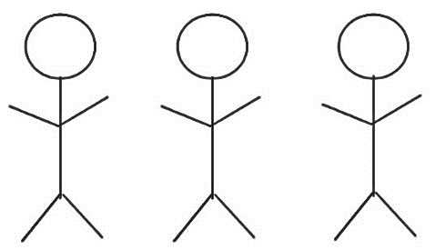
And Barnabas and Saul returned from Jerusalem when they had fulfilled their ministry, and they also took with them John whose surname was Mark.
Acts 12:25
Be a friend of multiple people.

Slide 16
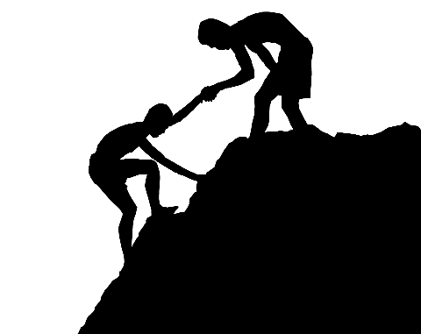
Be a friend of those who need another chance.
³⁶ Then after some days Paul said to Barnabas, “Let us now go back and visit our brethren in every city where we have preached the word of the Lord, and see how they are doing.” ³⁷ Now Barnabas was determined to take with them John called Mark.
Acts 15:36-37

Slide 17
Be a friend of those who need another chance.
³⁸ But Paul insisted that they should not take with them the one who had departed from them in Pamphylia, and had not gone with them to the work. ³⁹ Then the contention became so sharp that they parted from one another. And so Barnabas took Mark and sailed to Cyprus; ⁴⁰ but Paul chose Silas and departed, being commended by the brethren to the grace of God.
Acts 15:38-40

Slide 18
Aristarchus my fellow prisoner greets you, with Mark the cousin of Barnabas (about whom you received instructions: if he comes to you, welcome him)
Colossians 4:10
²³ Epaphras, my fellow prisoner in Christ Jesus, greets you, ²⁴ as do Mark, Aristarchus, Demas, Luke, my fellow laborers. Philemon 23-24
Only Luke is with me. Get Mark and bring him with you, for he is useful to me for ministry.
2 Timothy 4:11

Slide 19
Even encouragers need encouragement.
¹¹ Now when Peter had come to Antioch, I withstood him to his face, because he was to be blamed; ¹² for before certain men came from James, he would eat with the Gentiles; but when they came, he withdrew and separated himself, fearing those who were of the circumcision. ¹³ And the rest of the Jews also played the hypocrite with him, so that even Barnabas was carried away with their hypocrisy.
Galatians 2:11-13

Slide 20
Learning from Barnabas

