Slide 2
9 statements of blessedness
6 areas of greater righteousness
3 areas of quiet righteousness

Slide 3
Do not store up for yourselves treasures on earth… 6:19
“do not worry”
6:25, 31, 34
Disciples and Possessions

Slide 4
Do not store up for yourselves treasures on earth… 6:19
“do not worry”
6:25, 31, 34
Disciples and Possessions
Disciples and Discernment
Judge not…
7:1
Do not give what is holy to dogs…
7:6

Slide 5
Two gates (7:13-14)
Two trees (7:15-23)
Two houses (7:24-27)

Slide 6
⁴⁰ “He who receives you receives Me, and he who receives Me receives Him who sent Me. ⁴¹ He who receives a prophet in the name of a prophet shall receive a prophet’s reward. And he who receives a righteous man in the name of a righteous man shall receive a righteous man’s reward. ⁴² And whoever gives one of these little ones only a cup of cold water in the name of a disciple, assuredly, I say to you, he shall by no means lose his reward.”
Matthew 10:40-42

Slide 7
⁴⁷ “Again, the kingdom of heaven is like a dragnet that was cast into the sea and gathered some of every kind, ⁴⁸ which, when it was full, they drew to shore; and they sat down and gathered the good into vessels, but threw the bad away. ⁴⁹ So it will be at the end of the age. The angels will come forth, separate the wicked from among the just, ⁵⁰ and cast them into the furnace of fire. There will be wailing and gnashing of teeth.” Matthew 13:47-50

Slide 8
Then the King will say to those on His right hand, ‘Come, you blessed of My Father, inherit the kingdom prepared for you from the foundation of the world…Then He will also say to those on the left hand, ‘Depart from Me, you cursed, into the everlasting fire prepared for the devil and his angels…And these will go away into everlasting punishment, but the righteous into eternal life.” Matthew 25:34, 41, 46

Slide 10
¹³ “Enter by the narrow gate;
for wide is the gate and broad is the way that leads to destruction, and there are many who go in by it.
¹⁴ Because narrow is the gate and difficult is the way which leads to life, and there are few who find it.

Slide 11
²⁶ “Behold, I set before you today a blessing and a curse: ²⁷ the blessing, if you obey the commandments of the Lord your God which I command you today; ²⁸ and the curse, if you do not obey the commandments of the Lord your God, but turn aside from the way which I command you today, to go after other gods which you have not known.
Deuteronomy 11:26-28.

Slide 12
“Now you shall say to this people, ‘Thus says the Lord: “Behold, I set before you the way of life and the way of death.
Jeremiah 20:8.

Slide 13
¹³ “Enter by the narrow gate;
for wide is the gate and broad is the way that leads to destruction, and there are many who go in by it.
¹⁴ Because narrow is the gate and difficult is the way which leads to life, and there are few who find it.

Slide 14
Two Gates

Slide 15
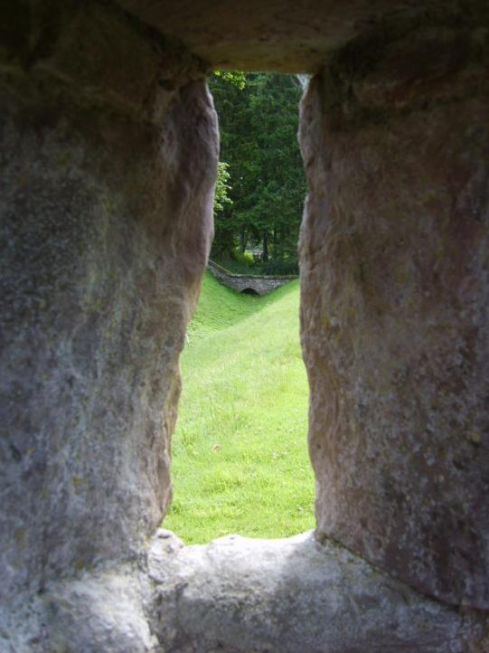
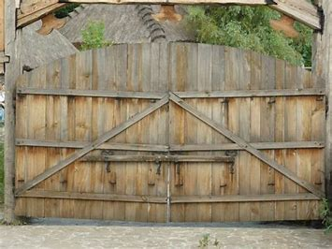
Two Gates
Narrow/Small
Wide

Slide 16
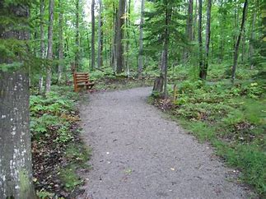
Two Paths
Narrow/Difficult
Broad/Easy

Slide 17
Two Destinations
Life
Destruction

Slide 18
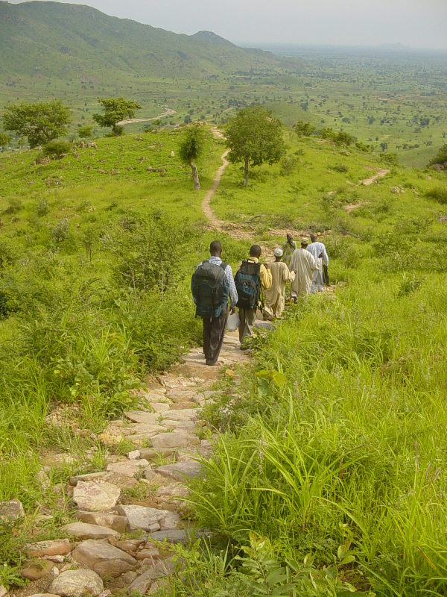
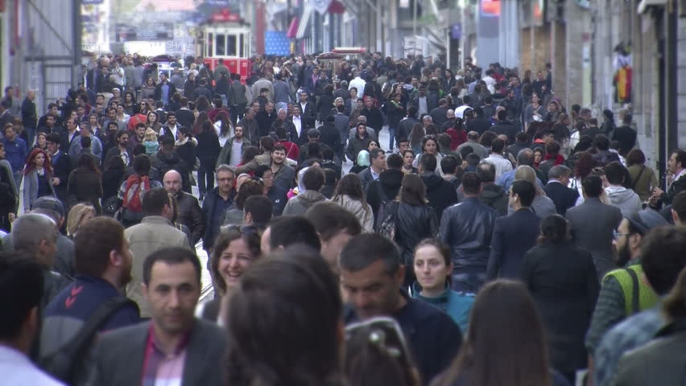
Few
Many

Slide 19
Life
Narrow Gate
Difficult Way
Few People
Destruction
Wide Gate
Broad Way
Many People

