Slide 2
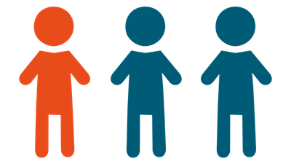

Slide 3
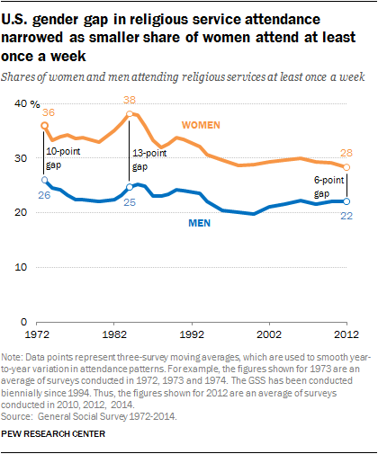

Slide 4
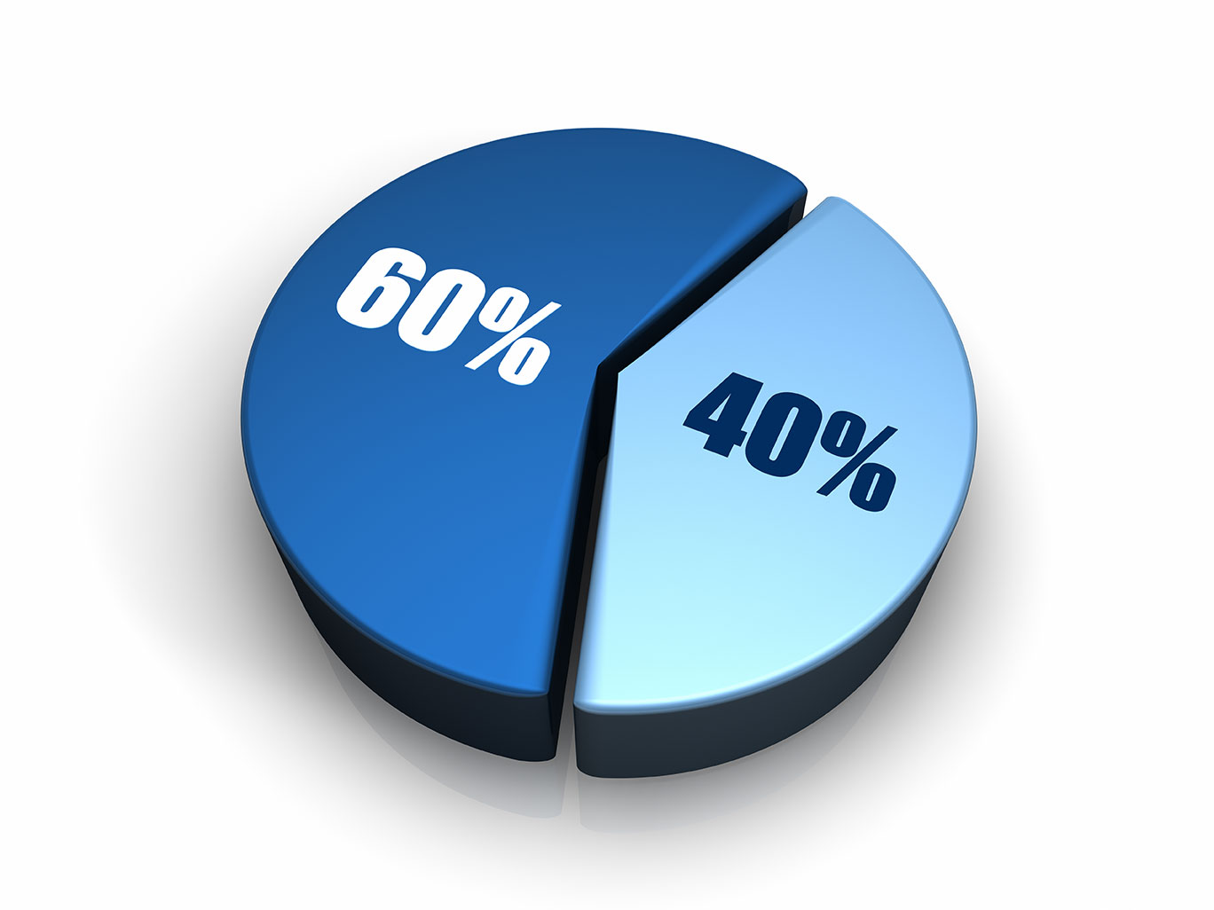
female
male

Slide 5
Examining the Relationship of Paul and Timothy

Slide 6
Then he came to Derbe and Lystra. And behold, a certain disciple was there, named Timothy, the son of a certain Jewish woman who believed, but his father was Greek.
Acts 16:1

Slide 7
Then he came to Derbe and Lystra. And behold, a certain disciple was there, named Timothy, the son of a certain Jewish woman who believed, but his father was Greek.
Acts 16:1

Slide 8
Then he came to Derbe and Lystra. And behold, a certain disciple was there, named Timothy, the son of a certain Jewish woman who believed, but his father was Greek.
Acts 16:1

Slide 9
Then he came to Derbe and Lystra. And behold, a certain disciple was there, named Timothy, the son of a certain Jewish woman who believed, but his father was Greek.
Acts 16:1

Slide 10
³ I thank God … ⁵ when I call to remembrance the genuine faith that is in you, which dwelt first in your grandmother Lois and your mother Eunice, and I am persuaded is in you also. 2 Timothy 1:3, 5

Slide 11
³ I thank God … ⁵ when I call to remembrance the genuine faith that is in you, which dwelt first in your grandmother Lois and your mother Eunice, and I am persuaded is in you also. 2 Timothy 1:3, 5

Slide 12
¹⁴ But you must continue in the things which you have learned and been assured of, knowing from whom you have learned them, ¹⁵ and that from childhood you have known the Holy Scriptures, which are able to make you wise for salvation through faith which is in Christ Jesus.
2 Timothy 3:14-15

Slide 13
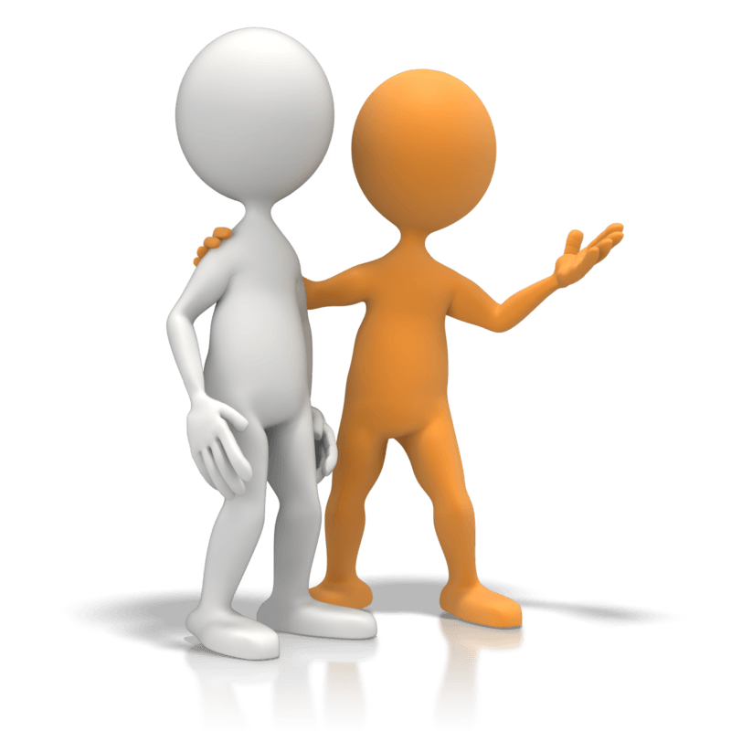
For this reason I have sent Timothy to you, who is my beloved and faithful son in the Lord, who will remind you of my ways in Christ, as I teach everywhere in every church.
1 Corinthians 4:17

Slide 14
To Timothy, a true son in the faith:
Grace, mercy, and peace from God our Father and Jesus Christ our Lord. …This charge I commit to you, son Timothy, according to the prophecies previously made concerning you, that by them you may wage the good warfare
1 Timothy 1:2, 18

Slide 15
To Timothy, a beloved son:
Grace, mercy, and peace from God the Father and Christ Jesus our Lord. …You therefore, my son, be strong in the grace that is in Christ Jesus.
2 Timothy 1:2; 2:1

Slide 16
But you know his proven character, that as a son with his father he served with me in the gospel.
Philippians 2:22

Slide 18
Paul wanted to have him go on with him. And he took him and circumcised him because of the Jews who were in that region, for they all knew that his father was Greek.
Acts 16:3

Slide 19
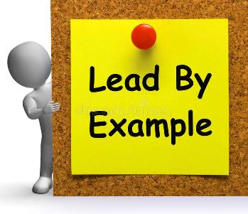
¹⁰ But you have carefully followed my doctrine, manner of life, purpose, faith, longsuffering, love, perseverance, ¹¹ persecutions, afflictions, which happened to me at Antioch, at Iconium, at Lystra—what persecutions I endured. And out of them all the Lord delivered me.
2 Timothy 3:10-11

Slide 20
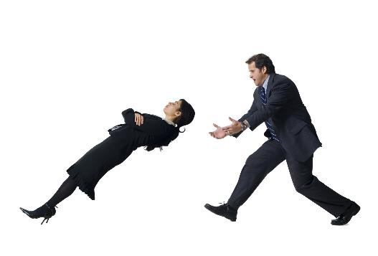
Therefore, when we could no longer endure it, we thought it good to be left in Athens alone, and sent Timothy, our brother and minister of God, and our fellow laborer in the gospel of Christ, to establish you and encourage you concerning your faith.
1 Thessalonians 3:1-2

Slide 21
So he sent into Macedonia two of those who ministered to him, Timothy and Erastus, but he himself stayed in Asia for a time.
Acts 19:22

Slide 22
¹⁶ Therefore I urge you, imitate me. ¹⁷ For this reason I have sent Timothy to you, who is my beloved and faithful son in the Lord, who will remind you of my ways in Christ, as I teach everywhere in every church. 1 Corinthians 4:16-17

Slide 23
But I trust in the Lord Jesus to send Timothy to you shortly, that I also may be encouraged when I know your state.
Philippians 2:19

Slide 24
²⁰ For I have no one like-minded, who will sincerely care for your state. ²¹ For all seek their own, not the things which are of Christ Jesus. ²² But you know his proven character, that as a son with his father he served with me in the gospel. Philippians 2:20-22

Slide 25
¹ Therefore, when we could no longer endure it, we thought it good to be left in Athens alone, ² and sent Timothy, our brother and minister of God, and our fellow laborer in the gospel of Christ, to establish you and encourage you concerning your faith. 1 Thessalonians 3:1-2

Slide 26
Paul, an apostle of Jesus Christ by the will of God, and Timothy our brother…
2 Corinthians 1:1 (Colossians 1:1)

Slide 27
Paul and Timothy, bondservants of Jesus Christ… Philippians 1:1 (also 1 and 2 Thessalonians)

Slide 28
…Timothy, my fellow worker…
Romans 16:21

Slide 29
Expectations
Example
Entrust
Encouragment
Equality
Examining the Relationship of Paul and Timothy

