Slide 2
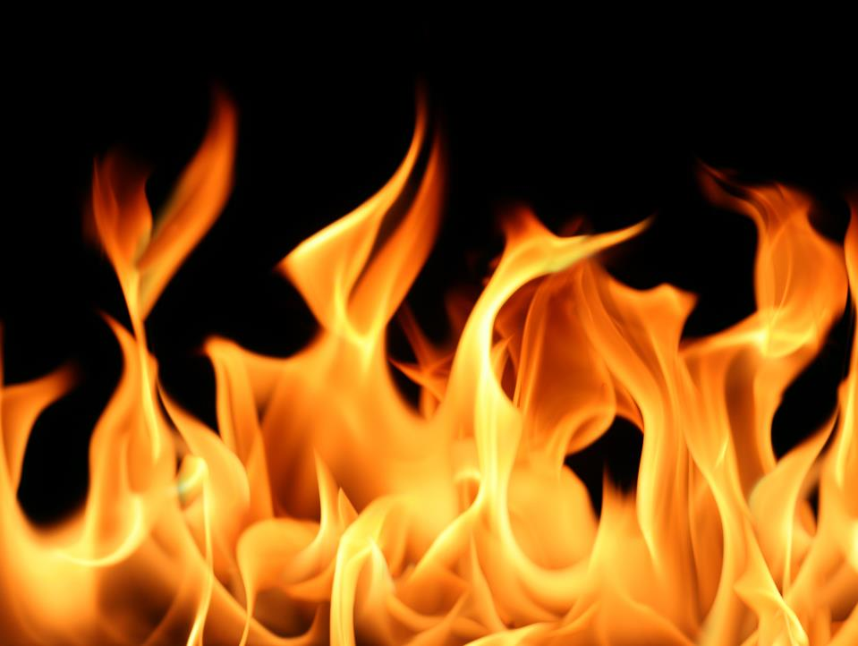
Playing
Fire
with
Nadab and Abihu

Slide 4
Leviticus
Chapters 1-7: Sacrifices
Chapters 8-10: Inauguration of the Tabernacle
Chapters 11-16: Impurity
Chapters 17-27: Holiness

Slide 5
² These are the names of the sons of Aaron: Nadab the firstborn, and Abihu, Eleazar, and Ithamar. ³ These are the names of the sons of Aaron, the anointed priests, whom he ordained to serve as priests. ⁴ But Nadab and Abihu died before the Lord when they offered unauthorized fire before the Lord in the wilderness of Sinai, and they had no children. So Eleazar and Ithamar served as priests in the lifetime of Aaron their father.
Numbers 3:2-4

Slide 6
⁶⁰ And to Aaron were born Nadab, Abihu, Eleazar, and Ithamar. ⁶¹ But Nadab and Abihu died when they offered unauthorized fire before the Lord. Numbers 26:60-61

Slide 7
¹ The divisions of the sons of Aaron were these. The sons of Aaron: Nadab, Abihu, Eleazar, and Ithamar. ² But Nadab and Abihu died before their father and had no children, so Eleazar and Ithamar became the priests.
1 Chronicles 24:1-2

Slide 8
Leviticus
Chapters 1-7: Sacrifices
Chapters 8-10: Inauguration of the Tabernacle
Chapters 11-16: Impurity
Chapters 17-27: Holiness

Slide 9
And he set the turban on his head, and on the turban, in front, he set the golden plate, the holy crown, as the Lord commanded Moses.
Leviticus 8:9

Slide 10
And Moses brought Aaron's sons and clothed them with coats and tied sashes around their waists and bound caps on them, as the Lord commanded Moses. Leviticus 8:13

Slide 11
He washed the entrails and the legs with water, and Moses burned the whole ram on the altar. It was a burnt offering with a pleasing aroma, a food offering for the Lord, as the Lord commanded Moses. Leviticus 8:21

Slide 12
And Moses took the breast and waved it for a wave offering before the Lord. It was Moses' portion of the ram of ordination, as the Lord commanded Moses. Leviticus 8:29

Slide 13
As has been done today, the Lord has commanded to be done to make atonement for you. Leviticus 8:34

Slide 14
And Aaron and his sons did all the things that the Lord commanded by Moses. Leviticus 8:36

Slide 15
Then Moses said to Aaron, “Draw near to the altar and offer your sin offering and your burnt offering and make atonement for yourself and for the people, and bring the offering of the people and make atonement for them, as the Lord has commanded.” Leviticus 9:7

Slide 16
²³ And Moses and Aaron went into the tent of meeting, and when they came out they blessed the people, and the glory of the Lord appeared to all the people. ²⁴ And fire came out from before the Lord and consumed the burnt offering and the pieces of fat on the altar, and when all the people saw it, they shouted and fell on their faces. Leviticus 9:23-24

Slide 17
Now Nadab and Abihu, the sons of Aaron, each took his censer and put fire in it and laid incense on it…
Leviticus 10:1
¹ The Lord spoke to Moses, saying, ² “Take Aaron and his sons with him, and the garments and the anointing oil and the bull of the sin offering and the two rams and the basket of unleavened bread.
Leviticus 8:1-2
² and he said to Aaron, “Take for yourself a bull calf for a sin offering and a ram for a burnt offering, both without blemish, and offer them before the Lord. …⁶ And Moses said, “This is the thing that the Lord commanded… Leviticus 9:2, 6

Slide 18
Now Nadab and Abihu, the sons of Aaron, each took his censer and put fire in it and laid incense on it and offered unauthorized fire before the Lord, which he had not commanded them. ² And fire came out from before the Lord and consumed them, and they died before the Lord.
Leviticus 10:1-2

Slide 19
Then he said to Moses, “Come up to the Lord, you and Aaron, Nadab, and Abihu, and seventy of the elders of Israel, and worship from afar. …⁹ Then Moses and Aaron, Nadab, and Abihu, and seventy of the elders of Israel went up, ¹⁰ and they saw the God of Israel. There was under his feet as it were a pavement of sapphire stone, like the very heaven for clearness. ¹¹ And he did not lay his hand on the chief men of the people of Israel; they beheld God, and ate and drank. Exodus 24:1, 9-11

Slide 20
²³ And Moses and Aaron went into the tent of meeting, and when they came out they blessed the people, and the glory of the Lord appeared to all the people. ²⁴ And fire came out from before the Lord and consumed the burnt offering and the pieces of fat on the altar, and when all the people saw it, they shouted and fell on their faces. Leviticus 9:23-24

Slide 21
²³ And Moses and Aaron went into the tent of meeting, and when they came out they blessed the people, and the glory of the Lord appeared to all the people. ²⁴ And fire came out from before the Lord and consumed the burnt offering and the pieces of fat on the altar, and when all the people saw it, they shouted and fell on their faces. Leviticus 9:23-24

Slide 22
²³ And Moses and Aaron went into the tent of meeting, and when they came out they blessed the people, and the glory of the Lord appeared to all the people. ²⁴ And fire came out from before the Lord and consumed the burnt offering and the pieces of fat on the altar, and when all the people saw it, they shouted and fell on their faces. Leviticus 9:23-24

Slide 23
²³ And Moses and Aaron went into the tent of meeting, and when they came out they blessed the people, and the glory of the Lord appeared to all the people. ²⁴ And fire came out from before the Lord and consumed the burnt offering and the pieces of fat on the altar, and when all the people saw it, they shouted and fell on their faces. Leviticus 9:23-24

Slide 25
²⁴ And fire came out from before the Lord and consumed the burnt offering and the pieces of fat on the altar, and when all the people saw it, they shouted and fell on their faces.
¹ Now Nadab and Abihu, the sons of Aaron, each took his censer and put fire in it and laid incense on it and offered unauthorized fire before the Lord, which he had not commanded them. ² And fire came out from before the Lord and consumed them, and they died before the Lord.
Leviticus 9:24-10:2

Slide 26
²⁴ And fire came out from before the Lord and consumed the burnt offering and the pieces of fat on the altar, and when all the people saw it, they shouted and fell on their faces.
¹ Now Nadab and Abihu, the sons of Aaron, each took his censer and put fire in it and laid incense on it and offered unauthorized fire before the Lord, which he had not commanded them. ² And fire came out from before the Lord and consumed them, and they died before the Lord.
Leviticus 9:24-10:2

Slide 27
²⁴ And fire came out from before the Lord and consumed the burnt offering and the pieces of fat on the altar, and when all the people saw it, they shouted and fell on their faces.
¹ Now Nadab and Abihu, the sons of Aaron, each took his censer and put fire in it and laid incense on it and offered unauthorized fire before the Lord, which he had not commanded them. ² And fire came out from before the Lord and consumed them, and they died before the Lord.
Leviticus 9:24-10:2

Slide 28
²⁴ And fire came out from before the Lord and consumed the burnt offering and the pieces of fat on the altar, and when all the people saw it, they shouted and fell on their faces.
¹ Now Nadab and Abihu, the sons of Aaron, each took his censer and put fire in it and laid incense on it and offered unauthorized fire before the Lord, which he had not commanded them. ² And fire came out from before the Lord and consumed them, and they died before the Lord.
Leviticus 9:24-10:2

Slide 30
²³ Take care, lest you forget the covenant of the Lord your God, which he made with you, and make a carved image, the form of anything that the Lord your God has forbidden you. ²⁴ For the Lord your God is a consuming fire, a jealous God.
Deuteronomy 4:23-24
²⁸ Therefore let us be grateful for receiving a kingdom that cannot be shaken, and thus let us offer to God acceptable worship, with reverence and awe, ²⁹ for our God is a consuming fire. Hebrews 12:28-29

