Slide 2
In speaking of a new covenant, he makes the first one obsolete. And what is becoming obsolete and growing old is ready to vanish away.
Hebrews 8:13

Slide 3
Therefore he is the mediator of a new covenant, so that those who are called may receive the promised eternal inheritance, since a death has occurred that redeems them from the transgressions committed under the first covenant. Hebrews 9:15

Slide 4
…He does away with the first in order to establish the second. And by that will we have been sanctified through the offering of the body of Jesus Christ once for all. Hebrews 10:9-10

Slide 5
For Christ is the end of the law for righteousness to everyone who believes. Romans 10:4

Slide 6
²⁴ So then, the law was our guardian until Christ came, in order that we might be justified by faith. ²⁵ But now that faith has come, we are no longer under a guardian, ²⁶ for in Christ Jesus you are all sons of God, through faith. Galatians 3:24-26
tutor/schoolmaster

Slide 7
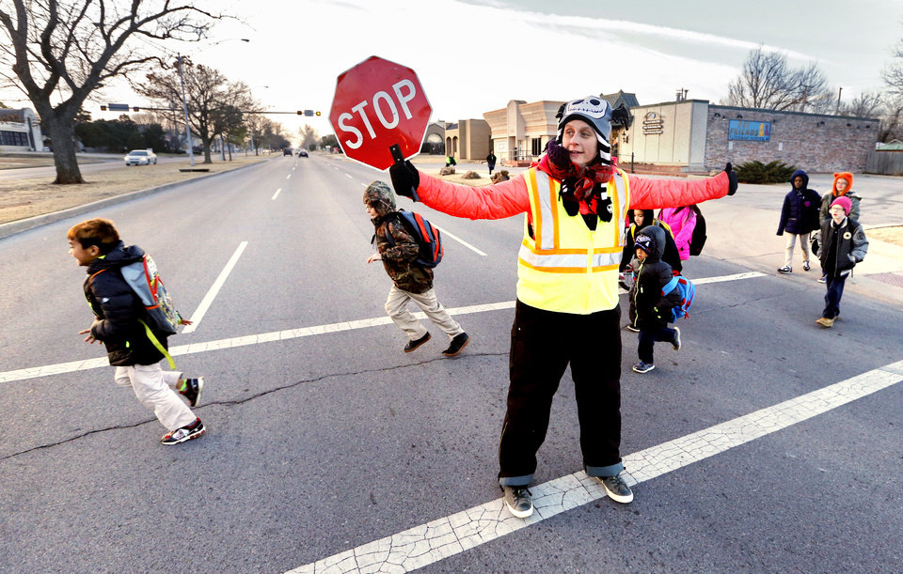

Slide 8
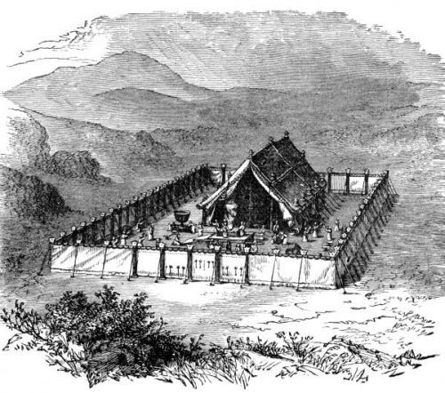
Lasting Laws of Leviticus

Slide 9
The Law
vs.
the laws

Slide 10
¹⁶ And behold, a man came up to him, saying, “Teacher, what good deed must I do to have eternal life?” ¹⁷ And he said to him, “Why do you ask me about what is good? There is only one who is good. If you would enter life, keep the commandments.”
¹⁸ He said to him, “Which ones?” And Jesus said, “You shall not murder, You shall not commit adultery, You shall not steal, You shall not bear false witness, ¹⁹ Honor your father and mother, and,
You shall love your neighbor as yourself.”
Matthew 19:16-19

Slide 11
¹⁶ And behold, a man came up to him, saying, “Teacher, what good deed must I do to have eternal life?” ¹⁷ And he said to him, “Why do you ask me about what is good? There is only one who is good. If you would enter life, keep the commandments.”
¹⁸ He said to him, “Which ones?” And Jesus said, “You shall not murder, You shall not commit adultery, You shall not steal, You shall not bear false witness, ¹⁹ Honor your father and mother, and,
You shall love your neighbor as yourself.”
Matthew 19:16-19

Slide 12
¹⁶ And behold, a man came up to him, saying, “Teacher, what good deed must I do to have eternal life?” ¹⁷ And he said to him, “Why do you ask me about what is good? There is only one who is good. If you would enter life, keep the commandments.”
¹⁸ He said to him, “Which ones?” And Jesus said, “You shall not murder, You shall not commit adultery, You shall not steal, You shall not bear false witness, ¹⁹ Honor your father and mother, and,
You shall love your neighbor as yourself.”
Matthew 19:16-19

Slide 13
You shall not take vengeance or bear a grudge against the sons of your own people, but you shall love your neighbor as yourself: I am the Lord.
Leviticus 19:18

Slide 14
You shall not take vengeance or bear a grudge against the sons of your own people, but you shall love your neighbor as yourself: I am the Lord.
Leviticus 19:18

Slide 15
You shall not take vengeance or bear a grudge against the sons of your own people, but you shall love your neighbor as yourself: I am the Lord.
Leviticus 19:18
¹ O Lord, God of vengeance, O God of vengeance, shine forth! ² Rise up, O judge of the earth; repay to the proud what they deserve!
Psalm 94:1-2

Slide 16
You shall not take vengeance or bear a grudge against the sons of your own people, but you shall love your neighbor as yourself: I am the Lord.
Leviticus 19:18

Slide 17
³⁴ But when the Pharisees heard that he had silenced the Sadducees, they gathered together. ³⁵ And one of them, a lawyer, asked him a question to test him. ³⁶ “Teacher, which is the great commandment in the Law?” ³⁷ And he said to him, “You shall love the Lord your God with all your heart and with all your soul and with all your mind. ³⁸ This is the great and first commandment. ³⁹ And a second is like it: You shall love your neighbor as yourself. ⁴⁰ On these two commandments depend all the Law and the Prophets.”
Matthew 22:34-40

Slide 18
³⁴ But when the Pharisees heard that he had silenced the Sadducees, they gathered together. ³⁵ And one of them, a lawyer, asked him a question to test him. ³⁶ “Teacher, which is the great commandment in the Law?” ³⁷ And he said to him, “You shall love the Lord your God with all your heart and with all your soul and with all your mind. ³⁸ This is the great and first commandment. ³⁹ And a second is like it: You shall love your neighbor as yourself. ⁴⁰ On these two commandments depend all the Law and the Prophets.”
Matthew 22:34-40

Slide 19
³⁴ But when the Pharisees heard that he had silenced the Sadducees, they gathered together. ³⁵ And one of them, a lawyer, asked him a question to test him. ³⁶ “Teacher, which is the great commandment in the Law?” ³⁷ And he said to him, “You shall love the Lord your God with all your heart and with all your soul and with all your mind. ³⁸ This is the great and first commandment. ³⁹ And a second is like it: You shall love your neighbor as yourself. ⁴⁰ On these two commandments depend all the Law and the Prophets.”
Matthew 22:34-40

Slide 20
³⁴ But when the Pharisees heard that he had silenced the Sadducees, they gathered together. ³⁵ And one of them, a lawyer, asked him a question to test him. ³⁶ “Teacher, which is the great commandment in the Law?” ³⁷ And he said to him, “You shall love the Lord your God with all your heart and with all your soul and with all your mind. ³⁸ This is the great and first commandment. ³⁹ And a second is like it: You shall love your neighbor as yourself. ⁴⁰ On these two commandments depend all the Law and the Prophets.”
Matthew 22:34-40

Slide 21
³⁴ But when the Pharisees heard that he had silenced the Sadducees, they gathered together. ³⁵ And one of them, a lawyer, asked him a question to test him. ³⁶ “Teacher, which is the great commandment in the Law?” ³⁷ And he said to him, “You shall love the Lord your God with all your heart and with all your soul and with all your mind. ³⁸ This is the great and first commandment. ³⁹ And a second is like it: You shall love your neighbor as yourself. ⁴⁰ On these two commandments depend all the Law and the Prophets.”
Matthew 22:34-40

Slide 22
²⁸ And one of the scribes came up and heard them disputing with one another, and seeing that he answered them well, asked him, “Which commandment is the most important of all?” ²⁹ Jesus answered, “The most important is, ‘Hear, O Israel: The Lord our God, the Lord is one. ³⁰ And you shall love the Lord your God with all your heart and with all your soul and with all your mind and with all your strength.’ ³¹ The second is this: ‘You shall love your neighbor as yourself.’ There is no other commandment greater than these.” Mark 12:28-31

Slide 23
⁸ Owe no one anything, except to love each other, for the one who loves another has fulfilled the law. ⁹ For the commandments, “You shall not commit adultery, You shall not murder, You shall not steal, You shall not covet,” and any other commandment, are summed up in this word: “You shall love your neighbor as yourself.” ¹⁰ Love does no wrong to a neighbor; therefore love is the fulfilling of the law. Romans 13:8-10

Slide 24
⁸ Owe no one anything, except to love each other, for the one who loves another has fulfilled the law. ⁹ For the commandments, “You shall not commit adultery, You shall not murder, You shall not steal, You shall not covet,” and any other commandment, are summed up in this word: “You shall love your neighbor as yourself.” ¹⁰ Love does no wrong to a neighbor; therefore love is the fulfilling of the law. Romans 13:8-10

Slide 25
⁸ Owe no one anything, except to love each other, for the one who loves another has fulfilled the law. ⁹ For the commandments, “You shall not commit adultery, You shall not murder, You shall not steal, You shall not covet,” and any other commandment, are summed up in this word: “You shall love your neighbor as yourself.” ¹⁰ Love does no wrong to a neighbor; therefore love is the fulfilling of the law. Romans 13:8-10

Slide 26
¹³ For you were called to freedom, brothers. Only do not use your freedom as an opportunity for the flesh, but through love serve one another. ¹⁴ For the whole law is fulfilled in one word: “You shall love your neighbor as yourself.” ¹⁵ But if you bite and devour one another, watch out that you are not consumed by one another. Galatians 5:13-15

Slide 27
¹³ For you were called to freedom, brothers. Only do not use your freedom as an opportunity for the flesh, but through love serve one another. ¹⁴ For the whole law is fulfilled in one word: “You shall love your neighbor as yourself.” ¹⁵ But if you bite and devour one another, watch out that you are not consumed by one another. Galatians 5:13-15

Slide 28
⁸ If you really fulfill the royal law according to the Scripture, “You shall love your neighbor as yourself,” you are doing well. ⁹ But if you show partiality, you are committing sin and are convicted by the law as transgressors. James 2:8-9

Slide 29
⁸ If you really fulfill the royal law according to the Scripture, “You shall love your neighbor as yourself,” you are doing well. ⁹ But if you show partiality, you are committing sin and are convicted by the law as transgressors. James 2:8-9

Slide 30
“You have heard that it was said, ‘You shall love your neighbor and hate your enemy.’ Matthew 5:43
You shall not take vengeance or bear a grudge against the sons of your own people, but you shall love your neighbor as yourself: I am the Lord.
Leviticus 19:18
You shall treat the stranger who sojourns with you as the native among you, and you shall love him as yourself, for you were strangers in the land of Egypt: I am the Lord your God.
Leviticus 19:34

Slide 31
²⁵ And behold, a lawyer stood up to put him to the test, saying, “Teacher, what shall I do to inherit eternal life?” ²⁶ He said to him, “What is written in the Law? How do you read it?” ²⁷ And he answered, “You shall love the Lord your God with all your heart and with all your soul and with all your strength and with all your mind, and your neighbor as yourself.” ²⁸ And he said to him, “You have answered correctly; do this, and you will live.”
Luke 10:25-28

Slide 32
²⁵ And behold, a lawyer stood up to put him to the test, saying, “Teacher, what shall I do to inherit eternal life?” ²⁶ He said to him, “What is written in the Law? How do you read it?” ²⁷ And he answered, “You shall love the Lord your God with all your heart and with all your soul and with all your strength and with all your mind, and your neighbor as yourself.” ²⁸ And he said to him, “You have answered correctly; do this, and you will live.”
Luke 10:25-28
But he, desiring to justify himself, said to Jesus, “And who is my neighbor?”
Luke 10:29

Slide 33
³⁰ Jesus replied, “A man was going down from Jerusalem to Jericho, and he fell among robbers, who stripped him and beat him and departed, leaving him half dead. ³¹ Now by chance a priest was going down that road, and when he saw him he passed by on the other side. ³² So likewise a Levite, when he came to the place and saw him, passed by on the other side. ³³ But a Samaritan, as he journeyed, came to where he was, and when he saw him, he had compassion. ³⁴ He went to him and bound up his wounds, pouring on oil and wine. Then he set him on his own animal and brought him to an inn and took care of him. ³⁵ And the next day he took out two denarii and gave them to the innkeeper, saying, ‘Take care of him, and whatever more you spend, I will repay you when I come back.’ Luke 10:30-35

Slide 34
³⁰ Jesus replied, “A man was going down from Jerusalem to Jericho, and he fell among robbers, who stripped him and beat him and departed, leaving him half dead. ³¹ Now by chance a priest was going down that road, and when he saw him he passed by on the other side. ³² So likewise a Levite, when he came to the place and saw him, passed by on the other side. ³³ But a Samaritan, as he journeyed, came to where he was, and when he saw him, he had compassion. ³⁴ He went to him and bound up his wounds, pouring on oil and wine. Then he set him on his own animal and brought him to an inn and took care of him. ³⁵ And the next day he took out two denarii and gave them to the innkeeper, saying, ‘Take care of him, and whatever more you spend, I will repay you when I come back.’ Luke 10:30-35

Slide 35
³⁰ Jesus replied, “A man was going down from Jerusalem to Jericho, and he fell among robbers, who stripped him and beat him and departed, leaving him half dead. ³¹ Now by chance a priest was going down that road, and when he saw him he passed by on the other side. ³² So likewise a Levite, when he came to the place and saw him, passed by on the other side. ³³ But a Samaritan, as he journeyed, came to where he was, and when he saw him, he had compassion. ³⁴ He went to him and bound up his wounds, pouring on oil and wine. Then he set him on his own animal and brought him to an inn and took care of him. ³⁵ And the next day he took out two denarii and gave them to the innkeeper, saying, ‘Take care of him, and whatever more you spend, I will repay you when I come back.’ Luke 10:30-35

Slide 36
³⁰ Jesus replied, “A man was going down from Jerusalem to Jericho, and he fell among robbers, who stripped him and beat him and departed, leaving him half dead. ³¹ Now by chance a priest was going down that road, and when he saw him he passed by on the other side. ³² So likewise a Levite, when he came to the place and saw him, passed by on the other side. ³³ But a Samaritan, as he journeyed, came to where he was, and when he saw him, he had compassion. ³⁴ He went to him and bound up his wounds, pouring on oil and wine. Then he set him on his own animal and brought him to an inn and took care of him. ³⁵ And the next day he took out two denarii and gave them to the innkeeper, saying, ‘Take care of him, and whatever more you spend, I will repay you when I come back.’ Luke 10:30-35

Slide 37
³⁰ Jesus replied, “A man was going down from Jerusalem to Jericho, and he fell among robbers, who stripped him and beat him and departed, leaving him half dead. ³¹ Now by chance a priest was going down that road, and when he saw him he passed by on the other side. ³² So likewise a Levite, when he came to the place and saw him, passed by on the other side. ³³ But a Samaritan, as he journeyed, came to where he was, and when he saw him, he had compassion. ³⁴ He went to him and bound up his wounds, pouring on oil and wine. Then he set him on his own animal and brought him to an inn and took care of him. ³⁵ And the next day he took out two denarii and gave them to the innkeeper, saying, ‘Take care of him, and whatever more you spend, I will repay you when I come back.’ Luke 10:30-35

Slide 38
³⁰ Jesus replied, “A man was going down from Jerusalem to Jericho, and he fell among robbers, who stripped him and beat him and departed, leaving him half dead. ³¹ Now by chance a priest was going down that road, and when he saw him he passed by on the other side. ³² So likewise a Levite, when he came to the place and saw him, passed by on the other side. ³³ But a Samaritan, as he journeyed, came to where he was, and when he saw him, he had compassion. ³⁴ He went to him and bound up his wounds, pouring on oil and wine. Then he set him on his own animal and brought him to an inn and took care of him. ³⁵ And the next day he took out two denarii and gave them to the innkeeper, saying, ‘Take care of him, and whatever more you spend, I will repay you when I come back.’ Luke 10:30-35

Slide 39
³⁰ Jesus replied, “A man was going down from Jerusalem to Jericho, and he fell among robbers, who stripped him and beat him and departed, leaving him half dead. ³¹ Now by chance a priest was going down that road, and when he saw him he passed by on the other side. ³² So likewise a Levite, when he came to the place and saw him, passed by on the other side. ³³ But a Samaritan, as he journeyed, came to where he was, and when he saw him, he had compassion. ³⁴ He went to him and bound up his wounds, pouring on oil and wine. Then he set him on his own animal and brought him to an inn and took care of him. ³⁵ And the next day he took out two denarii and gave them to the innkeeper, saying, ‘Take care of him, and whatever more you spend, I will repay you when I come back.’ Luke 10:30-35

Slide 40
³⁰ Jesus replied, “A man was going down from Jerusalem to Jericho, and he fell among robbers, who stripped him and beat him and departed, leaving him half dead. ³¹ Now by chance a priest was going down that road, and when he saw him he passed by on the other side. ³² So likewise a Levite, when he came to the place and saw him, passed by on the other side. ³³ But a Samaritan, as he journeyed, came to where he was, and when he saw him, he had compassion. ³⁴ He went to him and bound up his wounds, pouring on oil and wine. Then he set him on his own animal and brought him to an inn and took care of him. ³⁵ And the next day he took out two denarii and gave them to the innkeeper, saying, ‘Take care of him, and whatever more you spend, I will repay you when I come back.’ Luke 10:30-35

Slide 42
