Slide 2
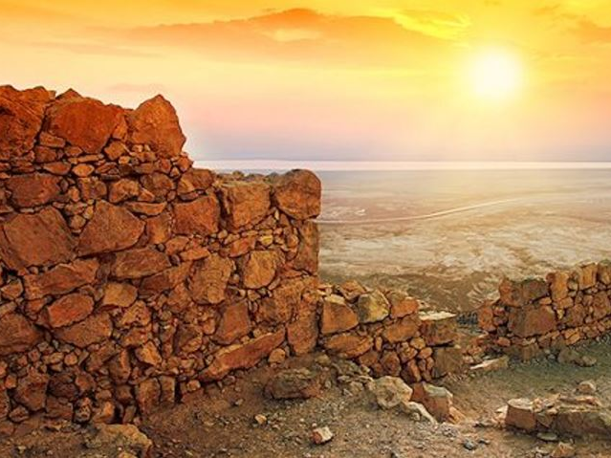
The Case
of
Shelomith’s Son

Slide 3
¹⁰ Now an Israelite woman's son, whose father was an Egyptian, went out among the people of Israel. And the Israelite woman's son and a man of Israel fought in the camp, ¹¹ and the Israelite woman's son blasphemed the Name, and cursed. Then they brought him to Moses. His mother's name was Shelomith, the daughter of Dibri, of the tribe of Dan.
Leviticus 24:10-11

Slide 4
¹⁰ Now an Israelite woman's son, whose father was an Egyptian, went out among the people of Israel. And the Israelite woman's son and a man of Israel fought in the camp, ¹¹ and the Israelite woman's son blasphemed the Name, and cursed. Then they brought him to Moses. His mother's name was Shelomith, the daughter of Dibri, of the tribe of Dan.
Leviticus 24:10-11

Slide 5
¹⁰ Now an Israelite woman's son, whose father was an Egyptian, went out among the people of Israel. And the Israelite woman's son and a man of Israel fought in the camp, ¹¹ and the Israelite woman's son blasphemed the Name, and cursed. Then they brought him to Moses. His mother's name was Shelomith, the daughter of Dibri, of the tribe of Dan.
Leviticus 24:10-11

Slide 6
¹⁰ Now an Israelite woman's son, whose father was an Egyptian, went out among the people of Israel. And the Israelite woman's son and a man of Israel fought in the camp, ¹¹ and the Israelite woman's son blasphemed the Name, and cursed. Then they brought him to Moses. His mother's name was Shelomith, the daughter of Dibri, of the tribe of Dan.
Leviticus 24:10-11

Slide 7
¹⁰ Now an Israelite woman's son, whose father was an Egyptian, went out among the people of Israel. And the Israelite woman's son and a man of Israel fought in the camp, ¹¹ and the Israelite woman's son blasphemed the Name, and cursed. Then they brought him to Moses. His mother's name was Shelomith, the daughter of Dibri, of the tribe of Dan.
Leviticus 24:10-11

Slide 8
¹⁰ Now an Israelite woman's son, whose father was an Egyptian, went out among the people of Israel. And the Israelite woman's son and a man of Israel fought in the camp, ¹¹ and the Israelite woman's son blasphemed the Name, and cursed. Then they brought him to Moses. His mother's name was Shelomith, the daughter of Dibri, of the tribe of Dan.
Leviticus 24:10-11

Slide 9
¹⁰ Now an Israelite woman's son, whose father was an Egyptian, went out among the people of Israel. And the Israelite woman's son and a man of Israel fought in the camp, ¹¹ and the Israelite woman's son blasphemed the Name, and cursed. Then they brought him to Moses. His mother's name was Shelomith, the daughter of Dibri, of the tribe of Dan.
Leviticus 24:10-11

Slide 10
And they put him in custody, till the will of the Lord should be clear to them.
Leviticus 24:12

Slide 11
¹³ Then the Lord spoke to Moses, saying, ¹⁴ “Bring out of the camp the one who cursed, and let all who heard him lay their hands on his head, and let all the congregation stone him. Leviticus 24:13-14

Slide 12
¹³ Then the Lord spoke to Moses, saying, ¹⁴ “Bring out of the camp the one who cursed, and let all who heard him lay their hands on his head, and let all the congregation stone him. ¹⁵ And speak to the people of Israel, saying, Whoever curses his God shall bear his sin. ¹⁶ Whoever blasphemes the name of the Lord shall surely be put to death. All the congregation shall stone him. The sojourner as well as the native, when he blasphemes the Name, shall be put to death. ¹⁷ “Whoever takes a human life shall surely be put to death. ¹⁸ Whoever takes an animal's life shall make it good, life for life. ¹⁹ If anyone injures his neighbor, as he has done it shall be done to him, ²⁰ fracture for fracture, eye for eye, tooth for tooth; whatever injury he has given a person shall be given to him. ²¹ Whoever kills an animal shall make it good, and whoever kills a person shall be put to death. ²² You shall have the same rule for the sojourner and for the native, for I am the Lord your God.” ²³ So Moses spoke to the people of Israel, and they brought out of the camp the one who had cursed and stoned him with stones. Thus the people of Israel did as the Lord commanded Moses.
Leviticus 24:13-23

Slide 13
¹³ Then the Lord spoke to Moses, saying, ¹⁴ “Bring out of the camp the one who cursed, and let all who heard him lay their hands on his head, and let all the congregation stone him. ¹⁵ And speak to the people of Israel, saying, Whoever curses his God shall bear his sin. ¹⁶ Whoever blasphemes the name of the Lord shall surely be put to death. All the congregation shall stone him. The sojourner as well as the native, when he blasphemes the Name, shall be put to death. ¹⁷ “Whoever takes a human life shall surely be put to death. ¹⁸ Whoever takes an animal's life shall make it good, life for life. ¹⁹ If anyone injures his neighbor, as he has done it shall be done to him, ²⁰ fracture for fracture, eye for eye, tooth for tooth; whatever injury he has given a person shall be given to him. ²¹ Whoever kills an animal shall make it good, and whoever kills a person shall be put to death. ²² You shall have the same rule for the sojourner and for the native, for I am the Lord your God.” ²³ So Moses spoke to the people of Israel, and they brought out of the camp the one who had cursed and stoned him with stones. Thus the people of Israel did as the Lord commanded Moses.
Leviticus 24:13-23

Slide 14
¹³ Then the Lord spoke to Moses, saying, ¹⁴ “Bring out of the camp the one who cursed, and let all who heard him lay their hands on his head, and let all the congregation stone him. ¹⁵ And speak to the people of Israel, saying, Whoever curses his God shall bear his sin. ¹⁶ Whoever blasphemes the name of the Lord shall surely be put to death. All the congregation shall stone him. The sojourner as well as the native, when he blasphemes the Name, shall be put to death. ¹⁷ “Whoever takes a human life shall surely be put to death. ¹⁸ Whoever takes an animal's life shall make it good, life for life. ¹⁹ If anyone injures his neighbor, as he has done it shall be done to him, ²⁰ fracture for fracture, eye for eye, tooth for tooth; whatever injury he has given a person shall be given to him. ²¹ Whoever kills an animal shall make it good, and whoever kills a person shall be put to death. ²² You shall have the same rule for the sojourner and for the native, for I am the Lord your God.” ²³ So Moses spoke to the people of Israel, and they brought out of the camp the one who had cursed and stoned him with stones. Thus the people of Israel did as the Lord commanded Moses.
Leviticus 24:13-23

Slide 15
Stone the Blasphemer 24:13-14
The rule applies to everyone 24:15-16
The treatment of others 24:17-21
The rule applies to everyone 24:22
Stone the Blasphemer 24:23

Slide 16
¹⁷ “Whoever takes a human life shall surely be put to death. …²¹ Whoever kills an animal shall make it good, and whoever kills a person shall be put to death.
Leviticus 24:17, 21

Slide 17
²⁶ Then God said, “Let us make man in our image, after our likeness. And let them have dominion over the fish of the sea and over the birds of the heavens and over the livestock and over all the earth and over every creeping thing that creeps on the earth.”
²⁷ So God created man in his own image, in the image of God he created him; male and female he created them.
Genesis 1:26-27

Slide 18
Whoever sheds man’s blood, By man his blood shall be shed, For in the image of God He made man. Genesis 9:6

Slide 19
¹⁰ Now an Israelite woman's son, whose father was an Egyptian, went out among the people of Israel. And the Israelite woman's son and a man of Israel fought in the camp, ¹¹ and the Israelite woman's son blasphemed the Name, and cursed. Then they brought him to Moses. His mother's name was Shelomith, the daughter of Dibri, of the tribe of Dan.
Leviticus 24:10-11

Slide 20
You shall have no other gods before Me
You shall not make for yourself an idol
You shall not take the name of the Lord your God in vain
Remember the sabbath day, to keep it holy.
Honor your father and your mother
You shall not murder
You shall not commit adultery
You shall not steal
You shall not bear false witness against your neighbor
You shall not covet

Slide 21
With respect to this they are surprised when you do not join them in the same flood of debauchery, and they malign you 1 Peter 4:4

Slide 22
¹ Remind them to be subject to rulers, to authorities, to be obedient, to be ready for every good deed, ² to malign no one, to be peaceable, gentle, showing every consideration for all men.
Titus 3:1-2

Slide 23
⁷ For every kind of beast and bird, of reptile and sea creature, can be tamed and has been tamed by mankind, ⁸ but no human being can tame the tongue. It is a restless evil, full of deadly poison. ⁹ With it we bless our Lord and Father, and with it we curse people who are made in the likeness of God. ¹⁰ From the same mouth come blessing and cursing. My brothers, these things ought not to be so. James 3:7-10

Slide 24
⁷ For every kind of beast and bird, of reptile and sea creature, can be tamed and has been tamed by mankind, ⁸ but no human being can tame the tongue. It is a restless evil, full of deadly poison. ⁹ With it we bless our Lord and Father, and with it we curse people who are made in the likeness of God. ¹⁰ From the same mouth come blessing and cursing. My brothers, these things ought not to be so. James 3:7-10

