Slide 2
Poor in spirit
Mourn
Meek
Hunger and thirst for righteousness
Merciful
Pure in heart
Peacemakers
Persecuted
Reviled and persecuted
The Disciples’ Identity
Matt 5:3-12

Slide 3
1.
2.
3.
4.
5.
6.
Murder
Adultery
Greater Righteousness
Divorce
Matt 5:20-48
Oaths
For I tell you, unless your righteousness exceeds that of the scribes and Pharisees, you will never enter the kingdom of heaven. 5:20
Retaliation
Love

Slide 4
when you give
1.
2.
3.
Quiet Righteousness
when you pray
Matt 6:1-18
when you fast
Beware of practicing your righteousness before other people in order to be seen by them, for then you will have no reward from your Father who is in heaven.
Matthew 6:1

Slide 5
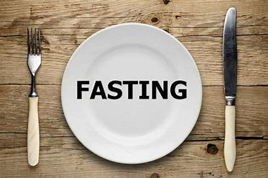
Fasting-abstinence from food for a specific period of time.

Slide 6
*Spiritual contemplation and dependence on God.
He humbled you and let you be hungry, and fed you with manna which you did not know, nor did your fathers know, that He might make you understand that man does not live by bread alone, but man lives by everything that proceeds out of the mouth of the Lord.
Deuteronomy 8:3

Slide 7
*Spiritual contemplation and dependence on God.
²⁷ And the Lord said to Moses, “Write these words, for in accordance with these words I have made a covenant with you and with Israel.” ²⁸ So he was there with the Lord forty days and forty nights. He neither ate bread nor drank water. And he wrote on the tablets the words of the covenant, the Ten Commandments. Exodus 34:27-28

Slide 8
*Spiritual contemplation and dependence on God.
And after He had fasted forty days and forty nights, He then became hungry. Matthew 4:2

Slide 9
*Spiritual contemplation and dependence on God.
² Then some came and reported to Jehoshaphat, saying, “A great multitude is coming against you from beyond the sea, out of Aram and behold, they are in Hazazon-tamar (that is Engedi).” ³ Jehoshaphat was afraid and turned his attention to seek the Lord, and proclaimed a fast throughout all Judah.
2 Chronicles 20:2-3

Slide 10
*Spiritual contemplation and dependence on God.
²¹ Then I proclaimed a fast there at the river of Ahava, that we might humble ourselves before our God to seek from Him a safe journey for us, our little ones, and all our possessions. ²² For I was ashamed to request from the king troops and horsemen to protect us from the enemy on the way, because we had said to the king, “The hand of our God is favorably disposed to all those who seek Him, but His power and His anger are against all those who forsake Him.” ²³ So we fasted and sought our God concerning this matter, and He listened to our entreaty. Ezra 8:21-23

Slide 11
*Spiritual contemplation and dependence on God.
⁴ When I heard these words, I sat down and wept and mourned for days; and I was fasting and praying before the God of heaven. ⁵ I said, “I beseech You, O Lord God of heaven, the great and awesome God, who preserves the covenant and lovingkindness for those who love Him and keep His commandments, ⁶ let Your ear now be attentive and Your eyes open to hear the prayer of Your servant which I am praying before You now, day and night, on behalf of the sons of Israel Your servants, confessing the sins of the sons of Israel which we have sinned against You; I and my father’s house have sinned. Nehemiah 1:4-6

Slide 12
*Spiritual contemplation and dependence on God.
²⁷ It came about when Ahab heard these words, that he tore his clothes and put on sackcloth and fasted, and he lay in sackcloth and went about despondently. ²⁸ Then the word of the Lord came to Elijah the Tishbite, saying, ²⁹ “Do you see how Ahab has humbled himself before Me? Because he has humbled himself before Me, I will not bring the evil in his days, but I will bring the evil upon his house in his son’s days.” 1 Kings 21:27-29

Slide 13
*Spiritual contemplation and dependence on God.
…Then the Lord struck the child that Uriah’s widow bore to David, so that he was very sick. ¹⁶ David therefore inquired of God for the child; and David fasted and went and lay all night on the ground. 2 Samuel 12:15-16

Slide 14
*Spiritual contemplation and dependence on God.
³ So I gave my attention to the Lord God to seek Him by prayer and supplications, with fasting, sackcloth and ashes. ⁴ I prayed to the Lord my God and confessed and said, “Alas, O Lord, the great and awesome God, who keeps His covenant and lovingkindness for those who love Him and keep His commandments, ⁵ we have sinned, committed iniquity, acted wickedly and rebelled, even turning aside from Your commandments and ordinances. Daniel 9:3-5

Slide 15
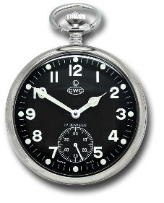
They mourned and wept and fasted until evening for Saul and his son Jonathan and for the people of the Lord and the house of Israel, because they had fallen by the sword.
2 Samuel 1:12

Slide 16
¹⁵ Then Esther told them to reply to Mordecai, ¹⁶ “Go, assemble all the Jews who are found in Susa, and fast for me; do not eat or drink for three days, night or day. I and my maidens also will fast in the same way. And thus I will go in to the king, which is not according to the law; and if I perish, I perish.”
Esther 4:15-16

Slide 17
¹¹ When all Jabesh-gilead heard all that the Philistines had done to Saul, ¹² all the valiant men arose and took away the body of Saul and the bodies of his sons and brought them to Jabesh, and they buried their bones under the oak in Jabesh, and fasted seven days 1 Chronicles 10:11-12

Slide 18
³ ‘Why have we fasted and You do not see? Why have we humbled ourselves and You do not notice? …
⁶ “Is this not the fast which I choose, To loosen the bonds of wickedness, To undo the bands of the yoke, And to let the oppressed go free And break every yoke? ⁷ “Is it not to divide your bread with the hungry And bring the homeless poor into the house; When you see the naked, to cover him; And not to hide yourself from your own flesh?
Isaiah 58:3, 6-7

Slide 19
⁵ “Say to all the people of the land and to the priests, ‘When you fasted and mourned in the fifth and seventh months these seventy years, was it actually for Me that you fasted? … ⁸ Then the word of the Lord came to Zechariah saying, ⁹ “Thus has the Lord of hosts said, ‘Dispense true justice and practice kindness and compassion each to his brother; ¹⁰ and do not oppress the widow or the orphan, the stranger or the poor; and do not devise evil in your hearts against one another.’
Zechariah 7:5, 8-10

Slide 20
¹¹ So the Lord said to me, “Do not pray for the welfare of this people. ¹² When they fast, I am not going to listen to their cry; and when they offer burnt offering and grain offering, I am not going to accept them. Rather I am going to make an end of them by the sword, famine and pestilence.”
Jeremiah 14:11-12

Slide 21
¹² “Yet even now,” declares the Lord, “Return to Me with all your heart, And with fasting, weeping and mourning; ¹³ And rend your heart and not your garments.” Now return to the Lord your God, For He is gracious and compassionate, Slow to anger, abounding in lovingkindness And relenting of evil.
Joel 2:12-13

Slide 22
⁹ He also told this parable to some who trusted in themselves that they were righteous, and treated others with contempt: ¹⁰ “Two men went up into the temple to pray, one a Pharisee and the other a tax collector. ¹¹ The Pharisee, standing by himself, prayed thus: ‘God, I thank you that I am not like other men, extortioners, unjust, adulterers, or even like this tax collector. ¹² I fast twice a week; I give tithes of all that I get.’
Luke 18:9-12

Slide 23
⁹ He also told this parable to some who trusted in themselves that they were righteous, and treated others with contempt: ¹⁰ “Two men went up into the temple to pray, one a Pharisee and the other a tax collector. ¹¹ The Pharisee, standing by himself, prayed thus: ‘God, I thank you that I am not like other men, extortioners, unjust, adulterers, or even like this tax collector. ¹² I fast twice a week; I give tithes of all that I get.’
Luke 18:9-12

Slide 24
⁹ He also told this parable to some who trusted in themselves that they were righteous, and treated others with contempt: ¹⁰ “Two men went up into the temple to pray, one a Pharisee and the other a tax collector. ¹¹ The Pharisee, standing by himself, prayed thus: ‘God, I thank you that I am not like other men, extortioners, unjust, adulterers, or even like this tax collector. ¹² I fast twice a week; I give tithes of all that I get.’
Luke 18:9-12

Slide 25
The Pious Act
¹⁶ “And when you fast…
Matthew 6:16
¹⁴ Then the disciples of John came to Him, asking, “Why do we and the Pharisees fast, but Your disciples do not fast?” ¹⁵ And Jesus said to them, “The attendants of the bridegroom cannot mourn as long as the bridegroom is with them, can they? But the days will come when the bridegroom is taken away from them, and then they will fast.
Matthew 9:14-15

Slide 26
The Pious Act
¹⁶ “And when you fast…
Matthew 6:16
¹ Now there were in the church at Antioch prophets and teachers, Barnabas, Simeon who was called Niger, Lucius of Cyrene, Manaen a lifelong friend of Herod the tetrarch, and Saul. ² While they were worshiping the Lord and fasting, the Holy Spirit said, “Set apart for me Barnabas and Saul for the work to which I have called them.” ³ Then after fasting and praying they laid their hands on them and sent them off. Acts 13:1-3

Slide 27
The Pious Act
¹⁶ “And when you fast…
Matthew 6:16
And when they had appointed elders for them in every church, with prayer and fasting they committed them to the Lord in whom they had believed. Acts 14:23

Slide 28
Prohibition
¹⁶ “And when you fast, do not look gloomy like the hypocrites, for they disfigure their faces that their fasting may be seen by others. Truly, I say to you, they have received their reward. Matthew 6:16

Slide 29
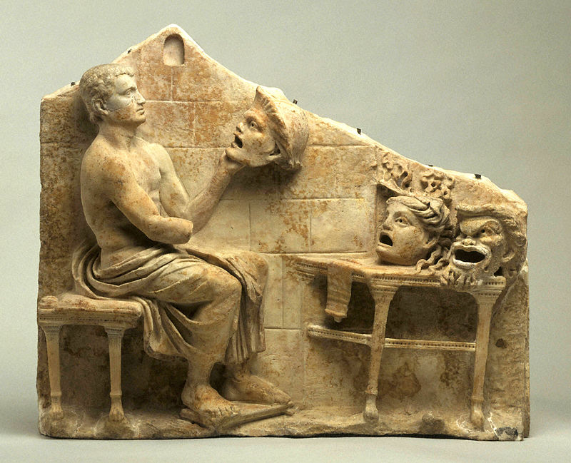
Prohibition
¹⁶ “And when you fast, do not look gloomy like the hypocrites, for they disfigure their faces that their fasting may be seen by others. Truly, I say to you, they have received their reward. Matthew 6:16

Slide 30
Prescription
¹⁷ But when you fast, anoint your head and wash your face, ¹⁸ that your fasting may not be seen by others but by your Father who is in secret. And your Father who sees in secret will reward you. Matthew 6:17-18

Slide 31
When you ______________
do not ________________.
But when you ___________, _____________________.

