Slide 2
“Honor your father and your mother, that your days may be long upon the land which the Lord your God is giving you.
Exodus 20:12
¹ Children, obey your parents in the Lord, for this is right. ² “Honor your father and mother,” which is the first commandment with promise: ³ “that it may be well with you and you may live long on the earth.”
Ephesians 6:1-3

Slide 4
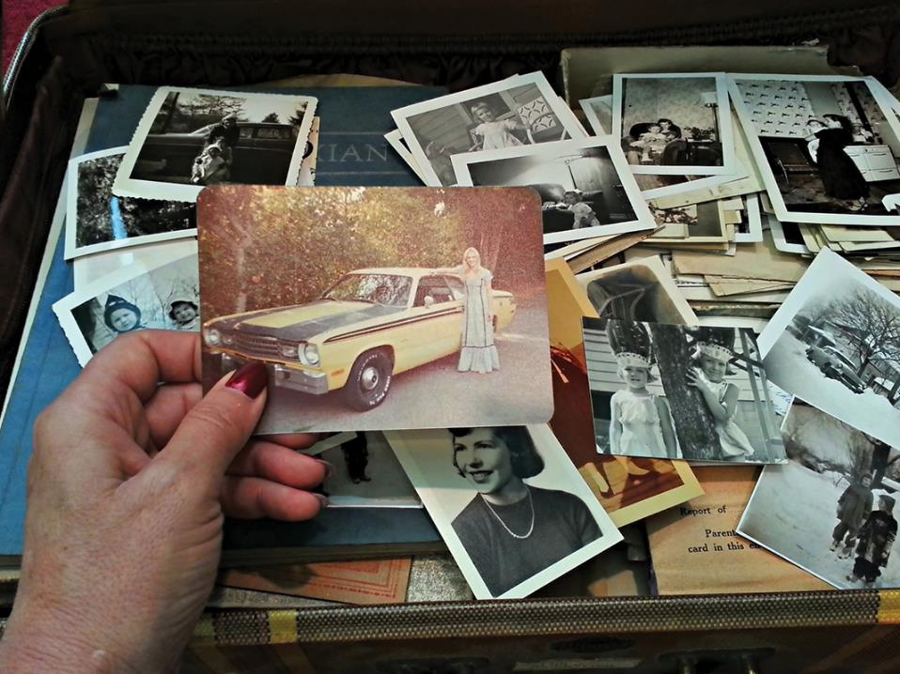
Memories
Of
Mother

Slide 5
³⁰ Then the angel said to her, “Do not be afraid, Mary, for you have found favor with God. ³¹ And behold, you will conceive in your womb and bring forth a Son, and shall call His name Jesus. ³² He will be great, and will be called the Son of the Highest; and the Lord God will give Him the throne of His father David. ³³ And He will reign over the house of Jacob forever, and of His kingdom there will be no end.”
Luke 1:30-33

Slide 6
⁴⁶ And Mary said:
“My soul magnifies the Lord, ⁴⁷ And my spirit has rejoiced in God my Savior. ⁴⁸ For He has regarded the lowly state of His maidservant; For behold, henceforth all generations will call me blessed. ⁴⁹ For He who is mighty has done great things for me, And holy is His name. ⁵⁰ And His mercy is on those who fear Him From generation to generation.
Luke 1:46-50

Slide 7
⁵¹ He has shown strength with His arm; He has scattered the proud in the imagination of their hearts. ⁵² He has put down the mighty from their thrones, And exalted the lowly. ⁵³ He has filled the hungry with good things, And the rich He has sent away empty. ⁵⁴ He has helped His servant Israel, In remembrance of His mercy, ⁵⁵ As He spoke to our fathers, To Abraham and to his seed forever.” Luke 1:51-55

Slide 9
And she brought forth her firstborn Son, and wrapped Him in swaddling cloths, and laid Him in a manger, because there was no room for them in the inn. Luke 2:7

Slide 11
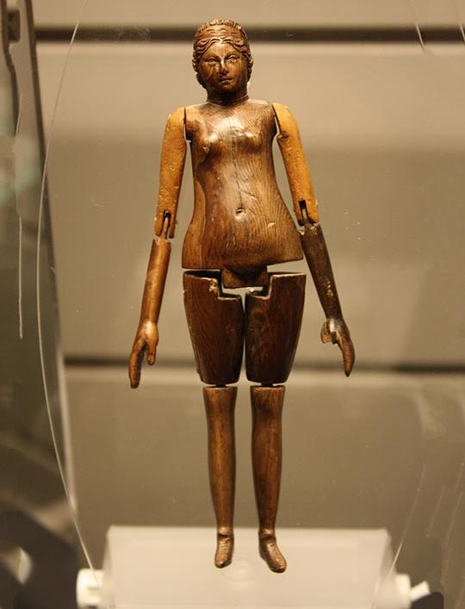

Slide 12
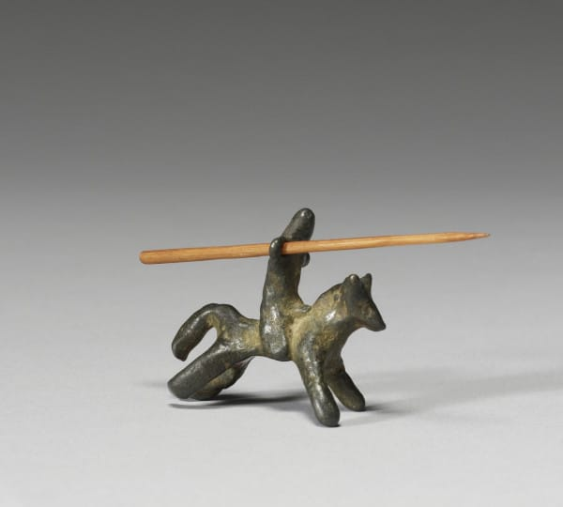

Slide 13
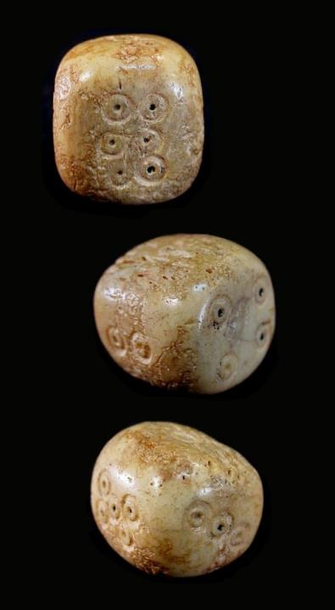

Slide 14
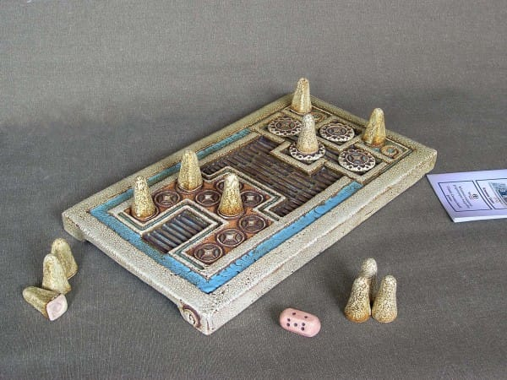

Slide 16
⁴² And when He was twelve years old, they went up to Jerusalem according to the custom of the feast. ⁴³ When they had finished the days, as they returned, the Boy Jesus lingered behind in Jerusalem. And Joseph and His mother did not know it; ⁴⁴ but supposing Him to have been in the company, they went a day’s journey, and sought Him among their relatives and acquaintances. ⁴⁵ So when they did not find Him, they returned to Jerusalem, seeking Him. ⁴⁶ Now so it was that after three days they found Him in the temple, sitting in the midst of the teachers, both listening to them and asking them questions.
Luke 2:42-46

Slide 17
⁴⁷ And all who heard Him were astonished at His understanding and answers. ⁴⁸ So when they saw Him, they were amazed; and His mother said to Him, “Son, why have You done this to us? Look, Your father and I have sought You anxiously.”
⁴⁹ And He said to them, “Why did you seek Me? Did you not know that I must be about My Father’s business?” ⁵⁰ But they did not understand the statement which He spoke to them.
Luke 2:47-50

Slide 18
⁴⁷ And all who heard Him were astonished at His understanding and answers. ⁴⁸ So when they saw Him, they were amazed; and His mother said to Him, “Son, why have You done this to us? Look, Your father and I have sought You anxiously.”
⁴⁹ And He said to them, “Why did you seek Me? Did you not know that I must be about My Father’s business?” ⁵⁰ But they did not understand the statement which He spoke to them.
Luke 2:47-50

Slide 19
⁴⁷ And all who heard Him were astonished at His understanding and answers. ⁴⁸ So when they saw Him, they were amazed; and His mother said to Him, “Son, why have You done this to us? Look, Your father and I have sought You anxiously.”
⁴⁹ And He said to them, “Why did you seek Me? Did you not know that I must be about My Father’s business?” ⁵⁰ But they did not understand the statement which He spoke to them.
Luke 2:47-50

Slide 21
³ And when they ran out of wine, the mother of Jesus said to Him, “They have no wine.”
⁴ Jesus said to her, “Woman, what does your concern have to do with Me? My hour has not yet come.”
⁵ His mother said to the servants, “Whatever He says to you, do it.”
John 2:3-5

Slide 23
¹⁹ Then His mother and brothers came to Him, and could not approach Him because of the crowd. ²⁰ And it was told Him by some, who said, “Your mother and Your brothers are standing outside, desiring to see You.”
²¹ But He answered and said to them, “My mother and My brothers are these who hear the word of God and do it.”
Luke 8:19-21

Slide 25
²⁵ Now there stood by the cross of Jesus His mother, and His mother’s sister, Mary the wife of Clopas, and Mary Magdalene. ²⁶ When Jesus therefore saw His mother, and the disciple whom He loved standing by, He said to His mother, “Woman, behold your son!” ²⁷ Then He said to the disciple, “Behold your mother!” And from that hour that disciple took her to his own home.
John 19:25-27

Slide 27
¹³ And when they had entered, they went up into the upper room where they were staying: Peter, James, John, and Andrew; Philip and Thomas; Bartholomew and Matthew; James the son of Alphaeus and Simon the Zealot; and Judas the son of James. ¹⁴ These all continued with one accord in prayer and supplication, with the women and Mary the mother of Jesus, and with His brothers. Acts 1:13-14

