Slide 2
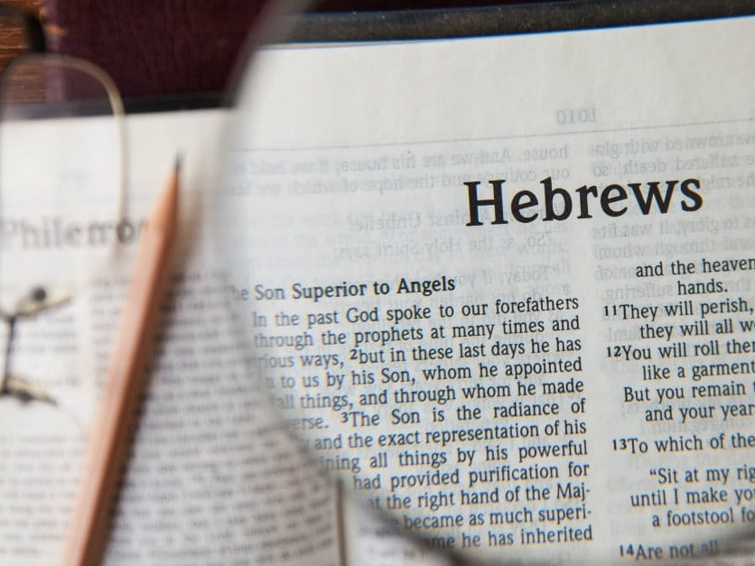

Slide 3
³² But recall the former days when, after you were enlightened, you endured a hard struggle with sufferings, ³³ sometimes being publicly exposed to reproach and affliction, and sometimes being partners with those so treated. ³⁴ For you had compassion on those in prison, and you joyfully accepted the plundering of your property, since you knew that you yourselves had a better possession and an abiding one. ³⁵ Therefore do not throw away your confidence, which has a great reward. ³⁶ For you have need of endurance, so that when you have done the will of God you may receive what is promised.
Hebrews 10:32-36

Slide 4
³² But recall the former days when, after you were enlightened, you endured a hard struggle with sufferings, ³³ sometimes being publicly exposed to reproach and affliction, and sometimes being partners with those so treated. ³⁴ For you had compassion on those in prison, and you joyfully accepted the plundering of your property, since you knew that you yourselves had a better possession and an abiding one. ³⁵ Therefore do not throw away your confidence, which has a great reward. ³⁶ For you have need of endurance, so that when you have done the will of God you may receive what is promised.
Hebrews 10:32-36

Slide 5
³² But recall the former days when, after you were enlightened, you endured a hard struggle with sufferings, ³³ sometimes being publicly exposed to reproach and affliction, and sometimes being partners with those so treated. ³⁴ For you had compassion on those in prison, and you joyfully accepted the plundering of your property, since you knew that you yourselves had a better possession and an abiding one. ³⁵ Therefore do not throw away your confidence, which has a great reward. ³⁶ For you have need of endurance, so that when you have done the will of God you may receive what is promised.
Hebrews 10:32-36

Slide 6
³² But recall the former days when, after you were enlightened, you endured a hard struggle with sufferings, ³³ sometimes being publicly exposed to reproach and affliction, and sometimes being partners with those so treated. ³⁴ For you had compassion on those in prison, and you joyfully accepted the plundering of your property, since you knew that you yourselves had a better possession and an abiding one. ³⁵ Therefore do not throw away your confidence, which has a great reward. ³⁶ For you have need of endurance, so that when you have done the will of God you may receive what is promised.
Hebrews 10:32-36

Slide 7
In your struggle against sin you have not yet resisted to the point of shedding your blood. Hebrews 12:4

Slide 8
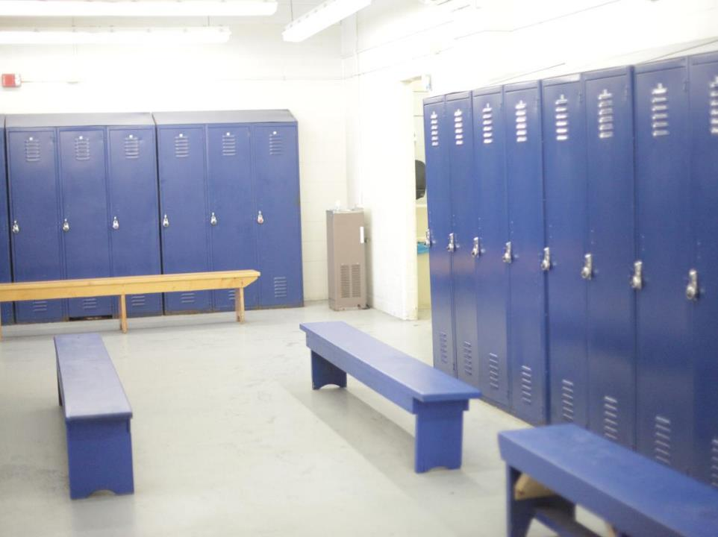
“we must pay much closer attention to what we have heard, lest we drift away from it.” Hebrews 2:1

Slide 9
“Take care, brothers, lest there be in any of you an evil, unbelieving heart, leading you to fall away from the living God.” Hebrews 3:12

Slide 10
“while the promise of entering his rest still stands, let us fear lest any of you should seem to have failed to reach it.” Hebrews 4:1

Slide 11
“For though by this time you ought to be teachers, you need someone to teach you again the basic principles of the oracles of God. You need milk, not solid food” Hebrews 5:12

Slide 12
“For it is impossible, in the case of those who have once been enlightened, who have tasted the heavenly gift, and have shared in the Holy Spirit, and have tasted the goodness of the word of God and the powers of the age to come, and then have fallen away, to restore them again to repentance, since they are crucifying once again the Son of God to their own harm and holding him up to contempt.” Hebrews 6:4-6

Slide 13
“let us consider how to stir up one another to love and good works”
Hebrews 10:24

Slide 15
³² And what more shall I say? For time would fail me to tell of Gideon, Barak, Samson, Jephthah, of David and Samuel and the prophets— ³³ who through faith conquered kingdoms, enforced justice, obtained promises, stopped the mouths of lions, ³⁴ quenched the power of fire, escaped the edge of the sword, were made strong out of weakness, became mighty in war, put foreign armies to flight.
Hebrews 11:32-34

Slide 16
³⁵ Women received back their dead by resurrection. Some were tortured, refusing to accept release, so that they might rise again to a better life. ³⁶ Others suffered mocking and flogging, and even chains and imprisonment. ³⁷ They were stoned, they were sawn in two, they were killed with the sword. They went about in skins of sheep and goats, destitute, afflicted, mistreated— ³⁸ of whom the world was not worthy—wandering about in deserts and mountains, and in dens and caves of the earth.
Hebrews 11:35-38

Slide 17
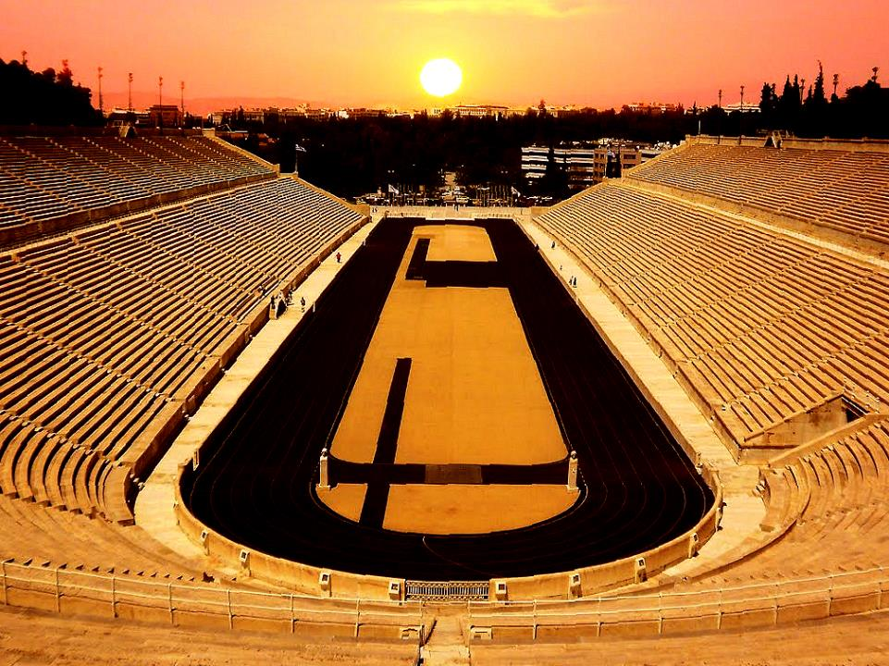
Living by Faith
Listening and Looking

Slide 18
Therefore, since we are surrounded by so great a cloud of witnesses, let us also lay aside every weight, and sin which clings so closely, and let us run with endurance the race that is set before us
Hebrews 12:1

Slide 19
Therefore, since we are surrounded by so great a cloud of witnesses, let us also lay aside every weight, and sin which clings so closely, and let us run with endurance the race that is set before us
Hebrews 12:1

Slide 20
Therefore, since we are surrounded by so great a cloud of witnesses, let us also lay aside every weight, and sin which clings so closely, and let us run with endurance the race that is set before us
Hebrews 12:1

Slide 21
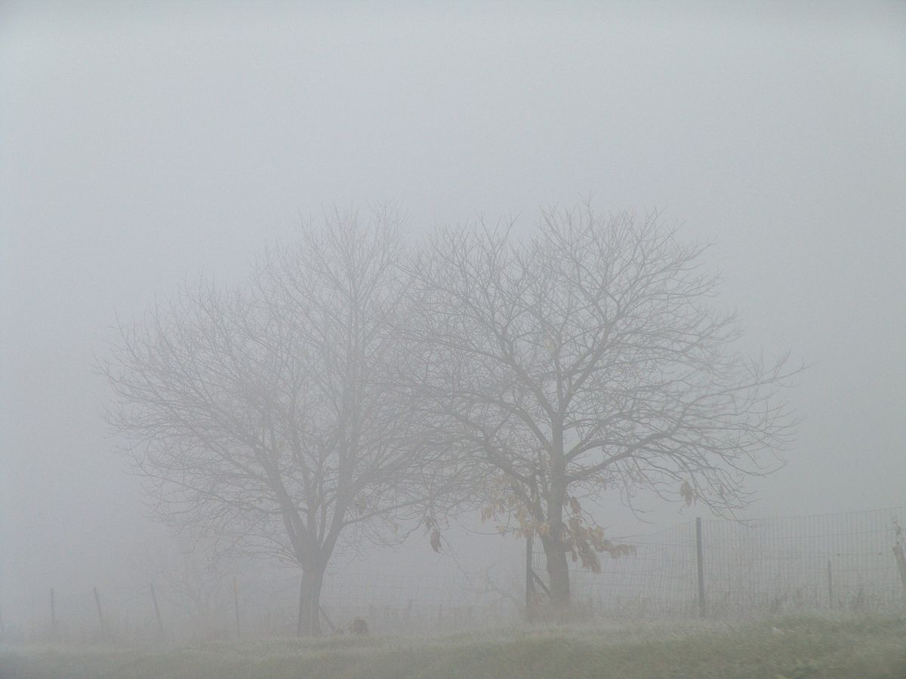

Slide 22
Therefore, since we are surrounded by so great a cloud of witnesses, let us also lay aside every weight, and sin which clings so closely, and let us run with endurance the race that is set before us
Hebrews 12:1

Slide 23
Therefore, since we are surrounded by so great a cloud of witnesses, let us also lay aside every weight, and sin which clings so closely, and let us run with endurance the race that is set before us
Hebrews 12:1

Slide 24
looking to Jesus, the founder and perfecter of our faith, who for the joy that was set before him endured the cross, despising the shame, and is seated at the right hand of the throne of God. Hebrews 12:2

Slide 25
looking to Jesus, the founder and perfecter of our faith, who for the joy that was set before him endured the cross, despising the shame, and is seated at the right hand of the throne of God. Hebrews 12:2

Slide 26
Since then we have a great high priest who has passed through the heavens, Jesus, the Son of God, let us hold fast our confession. For we do not have a high priest who is unable to sympathize with our weaknesses, but one who in every respect has been tempted as we are, yet without sin. Let us then with confidence draw near to the throne of grace, that we may receive mercy and find grace to help in time of need. Hebrews 4:14-16

