Slide 2
Do not love the world or the things in the world. If anyone loves the world, the love of the Father is not in him. For all that is in the world—the desires of the flesh and the desires of the eyes and pride of life—is not from the Father but is from the world. And the world is passing away along with its desires, but whoever does the will of God abides forever.
1 John 2:15-17

Slide 3
Do not love the world or the things in the world. If anyone loves the world, the love of the Father is not in him. For all that is in the world—the desires of the flesh and the desires of the eyes and pride of life—is not from the Father but is from the world. And the world is passing away along with its desires, but whoever does the will of God abides forever.
1 John 2:15-17
For God so loved the world, that He gave His only Son, that whoever believes in Him should not perish but have eternal life.
John 3:16

Slide 4
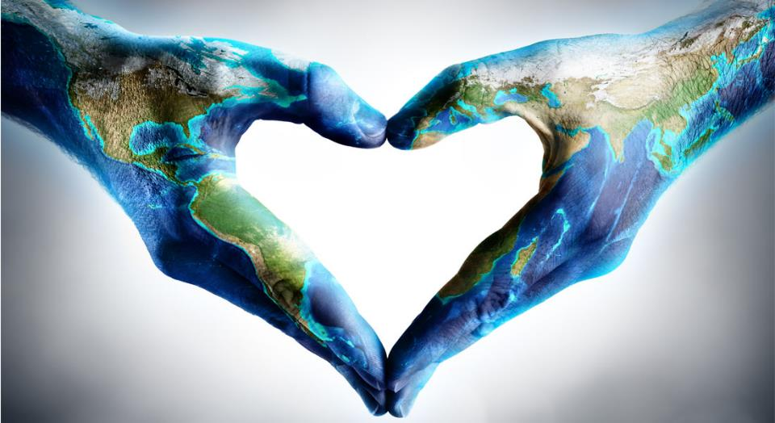
Love the World
without
Loving the World

Slide 5
“world”
Matthew- 9 times
Mark- 3 times
Luke/Acts- 3 times
Gospel of John/1 John- 101 times

Slide 7
Light
Darkness

Slide 8
The light shines in the darkness, and the darkness has not overcome it.
John 1:5

Slide 9
Light
Darkness
Spirit
Flesh

Slide 10
That which is born of the flesh is flesh, and that which is born of the Spirit is spirit. John 3:6

Slide 11
Light
Darkness
Spirit
Flesh
Eternal Life
Wrath of God

Slide 12
Whoever believes in the Son has eternal life; whoever does not obey the Son shall not see life, but the wrath of God remains on him. John 3:36

Slide 13
Light
Darkness
Spirit
Flesh
Eternal Life
Wrath of God
Truth
Lies

Slide 14
You are of your father the devil, and your will is to do your father's desires. He was a murderer from the beginning, and does not stand in the truth, because there is no truth in him. When he lies, he speaks out of his own character, for he is a liar and the father of lies. But because I tell the truth, you do not believe me. John 8:44-45

Slide 15
Light
Darkness
Spirit
Flesh
Eternal Life
Wrath of God
Truth
Lies

Slide 16
When a woman is giving birth, she has sorrow because her hour has come, but when she has delivered the baby, she no longer remembers the anguish, for joy that a human being has been born into the world.
John 16:21

Slide 18
As you sent me into the world, so I have sent them into the world.
John 17:18

Slide 19
And I am no longer in the world, but they are in the world, and I am coming to you. …
John 17:11
I have given them your word, and the world has hated them because they are not of the world, just as I am not of the world.
John 17:14

Slide 20
And I am no longer in the world, but they are in the world, and I am coming to you. …
John 17:11
I have given them your word, and the world has hated them because they are not of the world, just as I am not of the world.
John 17:14

Slide 21
Joy
Love the World
without
Loving the World

Slide 22
But now I am coming to you, and these things I speak in the world, that they may have my joy fulfilled in themselves. John 17:13
These things I have spoken to you, that my joy may be in you, and that your joy may be full. John 15:11

Slide 23
Joy
God’s Word
Love the World
without
Loving the World

Slide 24
Sanctify them in the truth; your word is truth. John 17:17
For I have given them the words that you gave me, and they have received them and have come to know in truth that I came from you; and they have believed that you sent me.
John 17:8

Slide 25
Joy
God’s Word
Separation
Love the World
without
Loving the World

Slide 26
Sanctify them in the truth; your word is truth. John 17:17
And I am no longer in the world, but they are in the world, and I am coming to you. Holy Father, keep them in your name…
John 17:11
And for their sake I consecrate myself, that they also may be sanctified in truth.
John 17:19

Slide 27
Joy
God’s Word
Separation
Truth
Love the World
without
Loving the World

Slide 28
Sanctify them in the truth; your word is truth. John 17:17
And for their sake I consecrate myself, that they also may be sanctified in truth.
John 17:19

Slide 29
Joy
God’s Word
Separation
Truth
Unity
Love the World
without
Loving the World

Slide 30
I do not ask for these only, but also for those who will believe in me through their word, that they may all be one, just as you, Father, are in me, and I in you, that they also may be in us, so that the world may believe that you have sent me. The glory that you have given me I have given to them, that they may be one even as we are one, I in them and you in me, that they may become perfectly one, so that the world may know that you sent me and loved them even as you loved me.
John 17:20-23

Slide 31
I do not ask for these only, but also for those who will believe in me through their word, that they may all be one, just as you, Father, are in me, and I in you, that they also may be in us, so that the world may believe that you have sent me. The glory that you have given me I have given to them, that they may be one even as we are one, I in them and you in me, that they may become perfectly one, so that the world may know that you sent me and loved them even as you loved me.
John 17:20-23

Slide 32
Joy
God’s Word
Separation
Truth
Unity
Love the World
without
Loving the World

