Slide 2
Poor in spirit
Mourn
Meek
Hunger and thirst for righteousness
Merciful
Pure in heart
Peacemakers
Persecuted
Reviled and persecuted
The Disciples’ Identity
Matt 5:3-12

Slide 3
1.
2.
3.
4.
5.
6.
Murder
Adultery
Greater Righteousness
Divorce
Matt 5:20-48
Oaths
For I tell you, unless your righteousness exceeds that of the scribes and Pharisees, you will never enter the kingdom of heaven. 5:20
Retaliation
Love

Slide 4
1.
2.
3.
Quiet Righteousness
Matt 6:1-18
Beware of practicing your righteousness before other people in order to be seen by them, for then you will have no reward from your Father who is in heaven.
Matthew 6:1

Slide 5
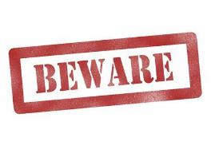
1.
2.
3.
Quiet Righteousness
Matt 6:1-18
Beware of practicing your righteousness before other people in order to be seen by them, for then you will have no reward from your Father who is in heaven.
Matthew 6:1

Slide 6
1.
2.
3.
Quiet Righteousness
Matt 6:1-18
Beware of practicing your righteousness before other people in order to be seen by them, for then you will have no reward from your Father who is in heaven.
Matthew 6:1

Slide 7
⁵ They do all their deeds to be seen by others.
For they make their phylacteries broad and their fringes long, ⁶ and they love the place of honor at feasts and the best seats in the synagogues ⁷ and greetings in the marketplaces and being called rabbi by others.
Matthew 23:5

Slide 8
when you give
1.
2.
3.
Quiet Righteousness
Matt 6:1-18
Beware of practicing your righteousness before other people in order to be seen by them, for then you will have no reward from your Father who is in heaven.
Matthew 6:1

Slide 9
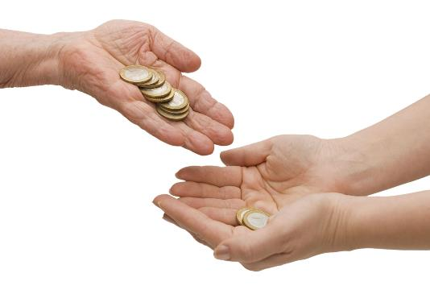
The Pious Act
² “Thus, when you give to the needy…
Matthew 6:2
For six years you shall sow your land and gather in its yield, but the seventh year you shall let it rest and lie fallow, that the poor of your people may eat…
Exodus 23:10-11

Slide 10
The Pious Act
² “Thus, when you give to the needy…
Matthew 6:2
When you reap the harvest of your land, you shall not reap your field right up to its edge, neither shall you gather the gleanings after your harvest. …You shall leave them for the poor… Leviticus 19:9-10

Slide 11
The Pious Act
² “Thus, when you give to the needy…
Matthew 6:2
“If among you, one of your brothers should become poor, in any of your towns within your land that the Lord your God is giving you, you shall not harden your heart or shut your hand against your poor brother, but you shall open your hand to him and lend him sufficient for his need, whatever it may be. Deuteronomy 15:7-8

Slide 12
The Pious Act
² “Thus, when you give to the needy…
Matthew 6:2
And a man lame from birth was being carried, whom they laid daily at the gate of the temple that is called the Beautiful Gate to ask alms of those entering the temple. Seeing Peter and John about to go into the temple, he asked to receive alms. Acts 3:2-3

Slide 13
The Pious Act
² “Thus, when you give to the needy…
Matthew 6:2
Now there was in Joppa a disciple named Tabitha, which, translated, means Dorcas. She was full of good works and acts of charity.
Acts 9:6

Slide 14
The Pious Act
² “Thus, when you give to the needy…
Matthew 6:2
At Caesarea there was a man named Cornelius, a centurion of what was known as the Italian Cohort, a devout man who feared God with all his household, gave alms generously to the people, and prayed continually to God. Acts 10:1-2

Slide 15
The Prohibition
…sound no trumpet before you, as the hypocrites do in the synagogues and in the streets, that they may be praised by others. Truly, I say to you, they have received their reward.
Matthew 6:2

Slide 16
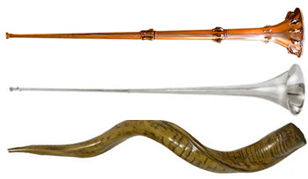
The Prohibition
…sound no trumpet before you, as the hypocrites do in the synagogues and in the streets, that they may be praised by others. Truly, I say to you, they have received their reward.
Matthew 6:2

Slide 17
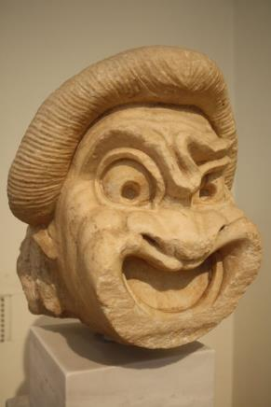
The Prohibition
…sound no trumpet before you, as the hypocrites do in the synagogues and in the streets, that they may be praised by others. Truly, I say to you, they have received their reward.
Matthew 6:2

Slide 18
The Prohibition
…sound no trumpet before you, as the hypocrites do in the synagogues and in the streets, that they may be praised by others. Truly, I say to you, they have received their reward.
Matthew 6:2

Slide 19
The Prescription
But when you give to the needy, do not let your left hand know what your right hand is doing, so that your giving may be in secret. And your Father who sees in secret will reward you. Matthew 6:3-4

Slide 20
The Prescription
But when you give to the needy, do not let your left hand know what your right hand is doing, so that your giving may be in secret. And your Father who sees in secret will reward you. Matthew 6:3-4

Slide 21
The Prescription
But when you give to the needy, do not let your left hand know what your right hand is doing, so that your giving may be in secret. And your Father who sees in secret will reward you. Matthew 6:3-4

Slide 22
The Prescription
But when you give to the needy, do not let your left hand know what your right hand is doing, so that your giving may be in secret. And your Father who sees in secret will reward you. Matthew 6:3-4

Slide 23
