Slide 2
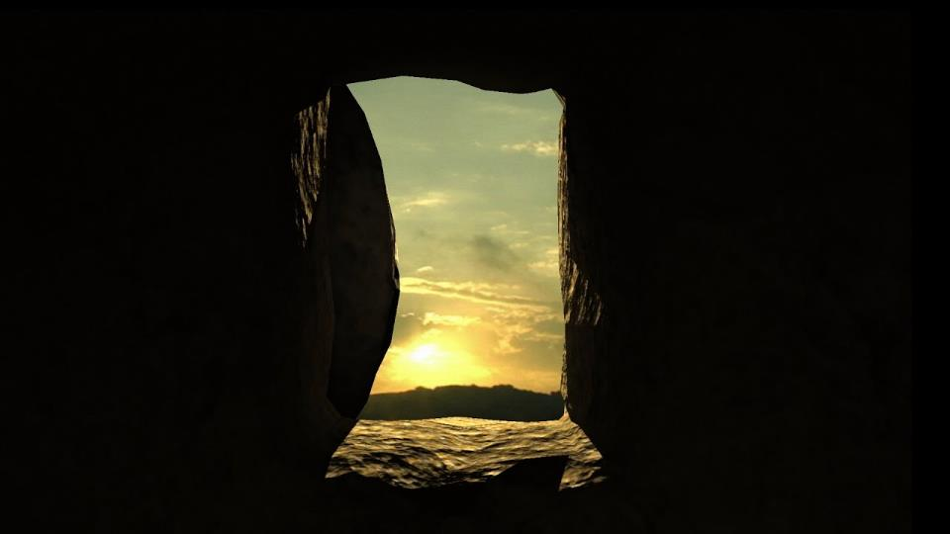
The
Holy Spirit
Resurrection
&

Slide 3
Hebrew-ruach
Greek-pneuma
breath or wind
activity, movement, vitality

Slide 4
SPIRIT=LIFE

Slide 5
We have a spirit.

Slide 6
And Jesus cried out again with a loud voice and yielded up his spirit. Matthew 27:50
When Jesus had received the sour wine, he said, “It is finished,” and he bowed his head and gave up his spirit. John 19:30
And as they were stoning Stephen, he called out, “Lord Jesus, receive my spirit.” Acts 7:59
But taking her by the hand he called, saying, “Child, arise.” And her spirit returned, and she got up at once. And he directed that something should be given her to eat. Luke 8:54-55

Slide 7
God has a Spirit which creates and sustains.

Slide 8
The earth was without form and void, and darkness was over the face of the deep. And the Spirit of God was hovering over the face of the waters. Genesis 1:2

Slide 9
as long as my breath is in me, and the spirit of God is in my nostrils, my lips will not speak falsehood, and my tongue will not utter deceit.
Job 27:3-4

Slide 10
The Spirit of God has made me, and the breath of the Almighty gives me life. Job 33:4

Slide 11
When you hide your face, they are dismayed; when you take away their breath, they die and return to their dust. When you send forth your Spirit, they are created, and you renew the face of the ground. Psalm 104:29-30

Slide 13
Then the Lord said, “My Spirit shall not abide in man forever, for he is flesh: his days shall be 120 years.” Genesis 6:3

Slide 14
And they fell on their faces and said, “O God, the God of the spirits of all flesh, shall one man sin, and will you be angry with all the congregation?” Numbers 16:22
Let the Lord, the God of the spirits of all flesh, appoint a man over the congregation Numbers 27:16

Slide 15
SPIRIT=LIFE
SPIRIT & RESURRECTION

Slide 16
Adam

Slide 17
then the Lord God formed the man of dust from the ground and breathed into his nostrils the breath of life, and the man became a living creature. Genesis 2:7

Slide 18
Adam
Israel

Slide 19
¹ The hand of the Lord was upon me, and he brought me out in the Spirit of the Lord and set me down in the middle of the valley; it was full of bones. ² And he led me around among them, and behold, there were very many on the surface of the valley, and behold, they were very dry. ³ And he said to me, “Son of man, can these bones live?” And I answered, “O Lord God, you know.” ⁴ Then he said to me, “Prophesy over these bones, and say to them, O dry bones, hear the word of the Lord. ⁵ Thus says the Lord God to these bones: Behold, I will cause breath to enter you, and you shall live. Ezekiel 37:1-5

Slide 20
⁶ And I will lay sinews upon you, and will cause flesh to come upon you, and cover you with skin, and put breath in you, and you shall live, and you shall know that I am the Lord.”⁷ So I prophesied as I was commanded. And as I prophesied, there was a sound, and behold, a rattling, and the bones came together, bone to its bone. ⁸ And I looked, and behold, there were sinews on them, and flesh had come upon them, and skin had covered them. But there was no breath in them. Ezekiel 37:6-8

Slide 21
⁹ Then he said to me, “Prophesy to the breath; prophesy, son of man, and say to the breath, Thus says the Lord God: Come from the four winds, O breath, and breathe on these slain, that they may live.” ¹⁰ So I prophesied as he commanded me, and the breath came into them, and they lived and stood on their feet, an exceedingly great army.
¹¹ Then he said to me, “Son of man, these bones are the whole house of Israel. Behold, they say, ‘Our bones are dried up, and our hope is lost; we are indeed cut off.’
Ezekiel 37:9-11

Slide 22
¹² Therefore prophesy, and say to them, Thus says the Lord God: Behold, I will open your graves and raise you from your graves, O my people. And I will bring you into the land of Israel. ¹³ And you shall know that I am the Lord, when I open your graves, and raise you from your graves, O my people. ¹⁴ And I will put my Spirit within you, and you shall live, and I will place you in your own land. Then you shall know that I am the Lord; I have spoken, and I will do it, declares the Lord.”
Ezekiel 37:12-14

Slide 23
Adam
Israel

Slide 24
Adam
Israel
Christ

Slide 25
If the Spirit of him who raised Jesus from the dead… Romans 8:11
and was declared to be the Son of God in power according to the Spirit of holiness by his resurrection from the dead, Jesus Christ our Lord Romans 1:4

Slide 26
Adam
Israel
Christ

Slide 27
Adam
Israel
Christ
Me

Slide 28
¹ And you were dead in the trespasses and sins ² in which you once walked, following the course of this world, following the prince of the power of the air, the spirit that is now at work in the sons of disobedience— ³ among whom we all once lived in the passions of our flesh, carrying out the desires of the body and the mind, and were by nature children of wrath, like the rest of mankind. Ephesians 2:1-3

Slide 29
⁴ But God, being rich in mercy, because of the great love with which he loved us, ⁵ even when we were dead in our trespasses, made us alive together with Christ—by grace you have been saved— ⁶ and raised us up with him and seated us with him in the heavenly places in Christ Jesus Ephesians 2:4-6

Slide 30
⁹ You, however, are not in the flesh but in the Spirit, if in fact the Spirit of God dwells in you. Anyone who does not have the Spirit of Christ does not belong to him. ¹⁰ But if Christ is in you, although the body is dead because of sin, the Spirit is life because of righteousness. ¹¹ If the Spirit of him who raised Jesus from the dead dwells in you, he who raised Christ Jesus from the dead will also give life to your mortal bodies through his Spirit who dwells in you. Romans 8:9-11

Slide 31
³ Do you not know that all of us who have been baptized into Christ Jesus were baptized into his death? ⁴ We were buried therefore with him by baptism into death, in order that, just as Christ was raised from the dead by the glory of the Father, we too might walk in newness of life. ⁵ For if we have been united with him in a death like his, we shall certainly be united with him in a resurrection like his. … ⁸ Now if we have died with Christ, we believe that we will also live with him.
Romans 6:3-5, 8

Slide 32
Adam
Israel
Christ
Me

