Slide 2
Poor in spirit
Mourn
Meek
Hunger and thirst for righteousness
Merciful
Pure in heart
Peacemakers
Persecuted
Reviled and persecuted
The Disciples’ Identity
Matt 5:3-12

Slide 3
Poor in spirit
Mourn
Meek
Hunger and thirst for righteousness
Merciful
Pure in heart
Peacemakers
Persecuted
Reviled and persecuted
The Disciples’ Identity
Matt 5:3-12
Salt and Light
Matt 5:13-16

Slide 4
Fulfill the Law, not destroy
Jesus’ Identity
Matt 5:17-18
Attitude toward God’s commandments
Matt 5:19

Slide 5
1.
2.
3.
4.
5.
6.
Murder
Adultery
Greater Righteousness
Divorce
Matt 5:20-48
Oaths
Retaliation
Love

Slide 6
⁴³ “You have heard that it was said,
‘You shall love your neighbor
and hate your enemy.’ Matthew 5:43

Slide 7
⁴³ “You have heard that it was said,
‘You shall love your neighbor
and hate your enemy.’ Matthew 5:43
You shall not take vengeance or bear a grudge against the sons of your own people, but you shall love your neighbor as yourself: I am the Lord. Leviticus 19:18

Slide 8
⁴³ “You have heard that it was said,
‘You shall love your neighbor
and hate your enemy.’ Matthew 5:43
when the Lord your God gives them over to you, and you defeat them, then you must devote them to complete destruction. You shall make no covenant with them and show no mercy to them. Deuteronomy 7:2

Slide 9
⁴³ “You have heard that it was said,
‘You shall love your neighbor
and hate your enemy.’ Matthew 5:43
I hate the assembly of evildoers, and I will not sit with the wicked. Psalm 26:5

Slide 10
⁴³ “You have heard that it was said,
‘You shall love your neighbor
and hate your enemy.’ Matthew 5:43
²¹ Do I not hate those who hate you, O Lord? And do I not loathe those who rise up against you? ²² I hate them with complete hatred;
I count them my enemies. Psalm 139:21-22

Slide 11
⁴³ “You have heard that it was said,
‘You shall love your neighbor
and hate your enemy.’ Matthew 5:43
²¹ Do I not hate those who hate you, O Lord? And do I not loathe those who rise up against you?
²² I hate them with complete hatred;
I count them my enemies.
²³ Search me, O God, and know my heart! Try me and know my thoughts! ²⁴ And see if there be any grievous way in me, and lead me in the way everlasting! Psalm 139:21-24

Slide 12
Gentile
Jews

Slide 13
Gentile
Jews

Slide 14
Gentile
Jews

Slide 15
⁴⁴ But I say to you,
Love your enemies
and pray for those who persecute you Matthew 5:44

Slide 16
⁴⁴ But I say to you,
Love your enemies
and pray for those who persecute you Matthew 5:44
⁴ “If you meet your enemy's ox or his donkey going astray, you shall bring it back to him. ⁵ If you see the donkey of one who hates you lying down under its burden, you shall refrain from leaving him with it; you shall rescue it with him. Exodus 23:4-5

Slide 17
⁴⁴ But I say to you,
Love your enemies
and pray for those who persecute you Matthew 5:44
If your enemy is hungry, give him bread to eat, and if he is thirsty, give him water to drink. Proverbs 25:21

Slide 18
⁴⁵ so that you may be sons of your Father who is in heaven. … Matthew 5:45

Slide 19
⁴⁵ so that you may be sons of your Father who is in heaven. … Matthew 5:45

Slide 20
⁴⁵ so that you may be sons of your Father who is in heaven.
For he makes his sun rise on the evil and on the good, and sends rain on the just and on the unjust. Matthew 5:45

Slide 21
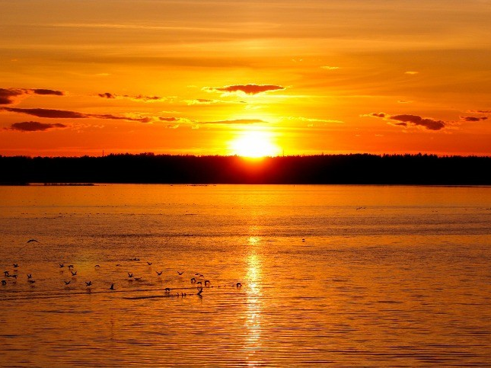

Slide 22
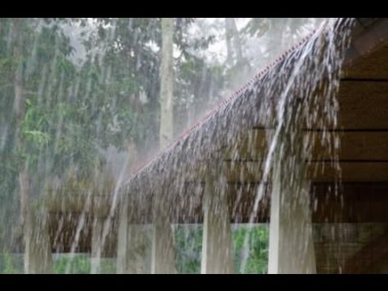

Slide 23
⁴⁵ so that you may be sons of your Father who is in heaven.
For he makes his sun rise on the evil and on the good, and sends rain on the just and on the unjust. Matthew 5:45
⁹ The Lord is good to all, and his mercy is over all that he has made. Psalm 145:9

Slide 24
⁴⁶ For if you love those who love you, what reward do you have?
Do not even the tax collectors do the same?
⁴⁷ And if you greet only your brothers, what more are you doing than others?
Do not even the Gentiles do the same? Matthew 5:46-47

Slide 25
Gentile
Tax-Collector
Jews

Slide 26
⁴⁸ You therefore must be perfect, as your heavenly Father is perfect.
Matthew 5:48

Slide 27
⁴⁸ You therefore must be perfect, as your heavenly Father is perfect.
Matthew 5:48

Slide 28
⁴⁸ You therefore must be perfect, as your heavenly Father is perfect.
Matthew 5:48
⁴⁴ For I am the Lord your God. Consecrate yourselves therefore, and be holy, for I am holy. You shall not defile yourselves with any swarming thing that crawls on the ground. ⁴⁵ For I am the Lord who brought you up out of the land of Egypt to be your God. You shall therefore be holy, for I am holy.”
Leviticus 11:44-45

Slide 29
⁴⁸ You therefore must be perfect, as your heavenly Father is perfect.
Matthew 5:48
¹ And the Lord spoke to Moses, saying, ² “Speak to all the congregation of the people of Israel and say to them, You shall be holy, for I the Lord your God am holy.
Leviticus 19:1-2

Slide 30
Gentile
Jews

