Slide 1
container
controlled + restrained

Slide 2
container
content

Slide 3
6 Principles of Contentment

Slide 4
Contentment Principle #1

Slide 5
Contentment Principle #1
Contentment is learned.
¹¹ Not that I am speaking of being in need, for I have learned in whatever situation I am to be content. ¹² I know how to be brought low, and I know how to abound. In any and every circumstance, I have learned the secret of facing plenty and hunger, abundance and need.
Philippians 4:11-12

Slide 6
Contentment Principle #1
Contentment is learned.
¹³ I can do all things through him who strengthens me. Philippians 4:13

Slide 7
Contentment Principle #2

Slide 8
Contentment Principle #2
Contentment is not based on circumstances and situations.
¹¹ Not that I am speaking of being in need, for I have learned in whatever situation I am to be content. ¹² I know how to be brought low, and I know how to abound. In any and every circumstance, I have learned the secret of facing plenty and hunger, abundance and need.
Philippians 4:11-12

Slide 9
Contentment Principle #3

Slide 10
Contentment Principle #3
Godliness + Contentment=Great Gain
⁵ and constant friction among people who are depraved in mind and deprived of the truth, imagining that godliness is a means of gain. ⁶ But godliness with contentment is great gain,
1 Timothy 6:5-6

Slide 11
Contentment Principle #4

Slide 12
Contentment Principle #4
Contentment comes from realizing my limitations.
⁷ for we brought nothing into the world, and we cannot take anything out of the world. ⁸ But if we have food and clothing, with these we will be content.
1 Timothy 6:7-8

Slide 13
Contentment Principle #4
Contentment comes from realizing my limitations.
²⁰ Then Job arose and tore his robe and shaved his head and fell on the ground and worshiped. ²¹ And he said, “Naked I came from my mother's womb, and naked shall I return. The Lord gave, and the Lord has taken away; blessed be the name of the Lord.” Job 1:20-21

Slide 14
Contentment Principle #4
Contentment comes from realizing my limitations.
¹⁵ As he came from his mother's womb he shall go again, naked as he came, and shall take nothing for his toil that he may carry away in his hand. Ecclesiastes 5:15

Slide 15
Contentment Principle #4
Contentment comes from realizing my limitations.
⁷ for we brought nothing into the world, and we cannot take anything out of the world. ⁸ But if we have food and clothing, with these we will be content.
1 Timothy 6:7-8

Slide 16
Contentment Principle #5

Slide 17
Contentment Principle #5
Contentment comes from the right pursuits.

Slide 18
Contentment Principle #5
Contentment comes from the right pursuits.
⁹ But those who desire to be rich fall into temptation, into a snare, into many senseless and harmful desires that plunge people into ruin and destruction. ¹⁰ For the love of money is a root of all kinds of evils. It is through this craving that some have wandered away from the faith and pierced themselves with many pangs.
1 Timothy 6:9-10

Slide 19
Contentment Principle #5
Contentment comes from the right pursuits.
¹¹ But as for you, O man of God, flee these things. Pursue righteousness, godliness, faith, love, steadfastness, gentleness. 1 Timothy 6:11

Slide 20
Contentment Principle #6

Slide 21
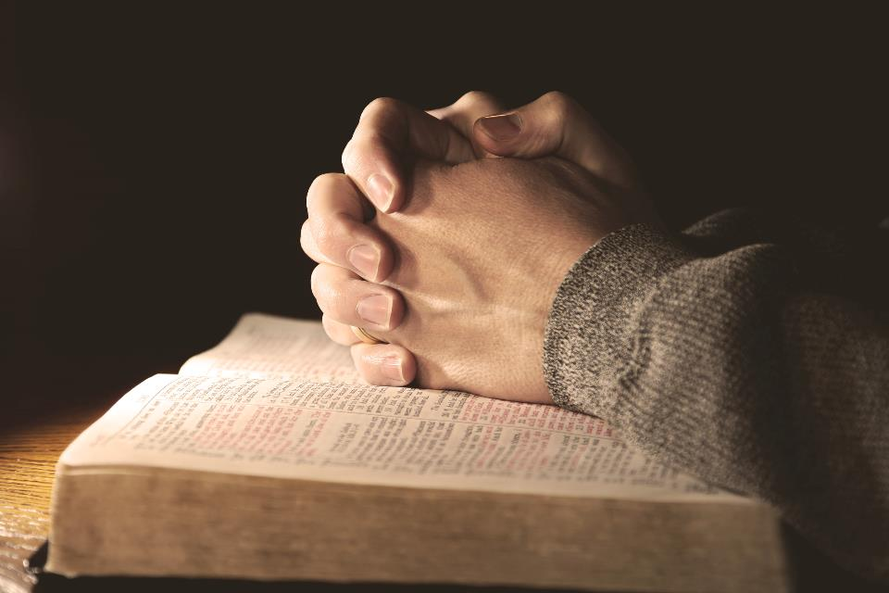
Contentment Principle #6
Contentment comes from a relationship with God.
⁵ Keep your life free from love of money, and be content with what you have, for he has said, “I will never leave you nor forsake you.” Hebrews 13:5

Slide 22
Contentment Principle #6
Contentment comes from a relationship with God.
¹⁵ Behold, I am with you and will keep you wherever you go, and will bring you back to this land. For I will not leave you until I have done what I have promised you. Genesis 28:15

Slide 23
Contentment Principle #6
Contentment comes from a relationship with God.
⁶ Be strong and courageous. Do not fear or be in dread of them, for it is the Lord your God who goes with you. He will not leave you or forsake you. Deuteronomy 31:6

Slide 24
Contentment Principle #6
Contentment comes from a relationship with God.
⁵ Keep your life free from love of money, and be content with what you have, for he has said, “I will never leave you nor forsake you.” Hebrews 13:5

Slide 25
1. Contentment is learned.
2. Contentment is not based on circumstances.
3. Godliness + Contentment = Great Gain.
4. Contentment comes from realizing my limitations.
5. Contentment comes from the right pursuits.
6. Contentment comes from a relationship with God.

