Slide 2
Poor in spirit
Mourn
Meek
Hunger and thirst for righteousness
Merciful
Pure in heart
Peacemakers
Persecuted
Reviled and persecuted
The Disciples’ Identity
Matt 5:3-12

Slide 3
Poor in spirit
Mourn
Meek
Hunger and thirst for righteousness
Merciful
Pure in heart
Peacemakers
Persecuted
Reviled and persecuted
The Disciples’ Identity
Matt 5:3-12
Salt and Light
Matt 5:13-16

Slide 4
Fulfill the Law, not destroy
Jesus’ Identity
Matt 5:17-18
Attitude toward God’s commandments
Matt 5:19

Slide 5
Murder
1.
2.
3.
4.
5.
6.
Adultery
Greater Righteousness
Matt 5:20-48

Slide 6
“You have heard that it was said,
‘You shall not commit adultery.’
Matt 5:27
You shall not commit adultery.
Ex 20:14

Slide 7
“You have heard that it was said,
‘You shall not commit adultery.’
Matt 5:27
You shall not commit adultery.
Ex 20:14

Slide 9
“You have heard that it was said,
‘You shall not commit adultery.’
Matt 5:27
You shall not commit adultery.
Ex 20:14

Slide 10
But I say to you
that everyone who looks at a woman with lustful intent has already committed adultery with her in his heart.
Matt 5:28

Slide 11
But I say to you
that everyone who looks at a woman with lustful intent has already committed adultery with her in his heart.
Matt 5:28

Slide 12
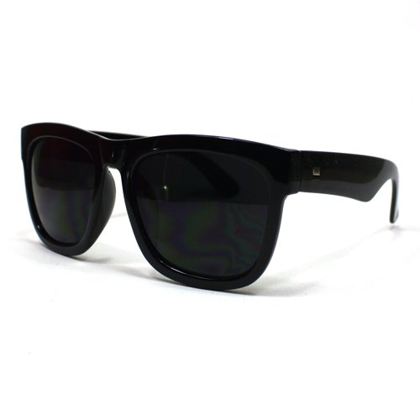

Slide 13
But I say to you
that everyone who looks at a woman with lustful intent has already committed adultery with her in his heart.
Matt 5:28

Slide 14
But I say to you
that everyone who looks at a woman with lustful intent has already committed adultery with her in his heart.
Matt 5:28
“You shall not covet your neighbor's house; you shall not covet your neighbor's wife, or his male servant, or his female servant, or his ox, or his donkey, or anything that is your neighbor’s.”
Ex 20:17

Slide 15
But I say to you
that everyone who looks at a woman with lustful intent has already committed adultery with her in his heart.
Matt 5:28
Desire
“You shall not covet your neighbor's house; you shall not covet your neighbor's wife, or his male servant, or his female servant, or his ox, or his donkey, or anything that is your neighbor’s.”
Ex 20:17

Slide 16
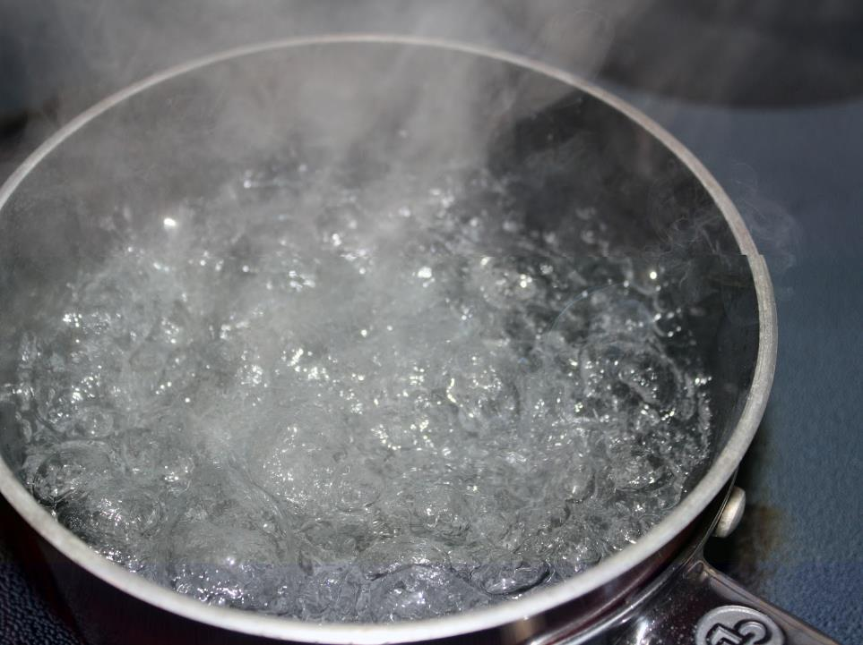

Slide 17
But I say to you
that everyone who looks at a woman with lustful intent has already committed adultery with her
in his heart.
Matt 5:28
For out of the heart come evil thoughts, murder, adultery, sexual immorality, theft, false witness, slander.
Matt 15:19

Slide 18
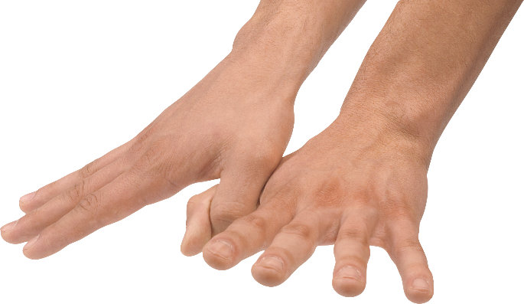

Slide 19
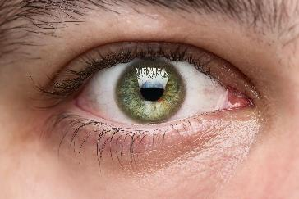
If your right eye causes you to sin, tear it out and throw it away. For it is better that you lose one of your members than that your whole body be thrown into hell.
Matt 5:29

Slide 20
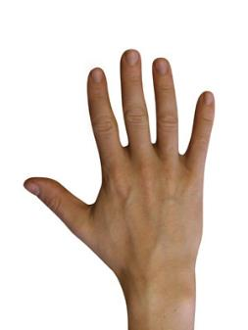
If your right eye causes you to sin, tear it out and throw it away. For it is better that you lose one of your members than that your whole body be thrown into hell.
Matt 5:29
And if your right hand causes you to sin, cut it off and throw it away. For it is better that you lose one of your members than that your whole body go into hell.
Matt 5:30

Slide 21
If your right eye causes you to sin, tear it out and throw it away. For it is better that you lose one of your members than that your whole body be thrown into hell.
Matt 5:29
And if your right hand causes you to sin, cut it off and throw it away. For it is better that you lose one of your members than that your whole body go into hell.
Matt 5:30

Slide 22
If your right eye causes you to sin, tear it out and throw it away. For it is better that you lose one of your members than that your whole body be thrown into hell.
Matt 5:29
And if your right hand causes you to sin, cut it off and throw it away. For it is better that you lose one of your members than that your whole body go into hell. Matt 5:30

Slide 23
whole
wholly
holy

Slide 24
Woe to the world for temptations to sin! For it is necessary that temptations come, but woe to the one by whom the temptation comes! And if your hand or your foot causes you to sin, cut it off and throw it away. It is better for you to enter life crippled or lame than with two hands or two feet to be thrown into the eternal fire. And if your eye causes you to sin, tear it out and throw it away. It is better for you to enter life with one eye than with two eyes to be thrown into the hell of fire.
Matt 18:7-9

Slide 25
If your right eye causes you to sin, tear it out and throw it away. For it is better that you lose one of your members than that your whole body be thrown into hell.
Matt 5:29
And if your right hand causes you to sin, cut it off and throw it away. For it is better that you lose one of your members than that your whole body go into hell. Matt 5:30

