Slide 1
Technology
&
The Bible

Slide 2
“Technology includes all tools, machines, utensils, weapons, instruments, housing, clothing, communicating and transporting devices and the skills by which we produce and use them.”

Slide 3
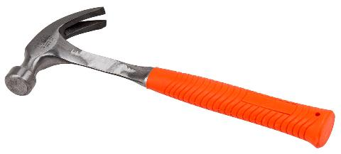
“Technology includes all tools, machines, utensils, weapons, instruments, housing, clothing, communicating and transporting devices and the skills by which we produce and use them.”

Slide 4
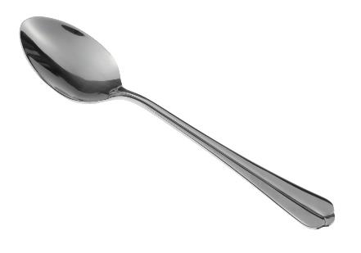
“Technology includes all tools, machines, utensils, weapons, instruments, housing, clothing, communicating and transporting devices and the skills by which we produce and use them.”

Slide 5
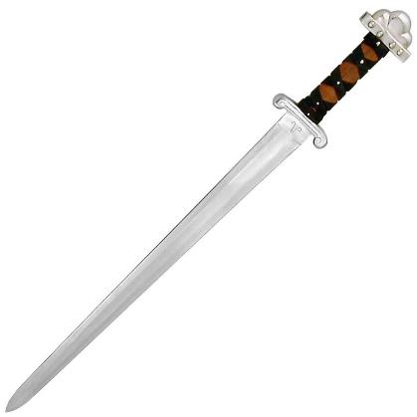
“Technology includes all tools, machines, utensils, weapons, instruments, housing, clothing, communicating and transporting devices and the skills by which we produce and use them.”

Slide 6
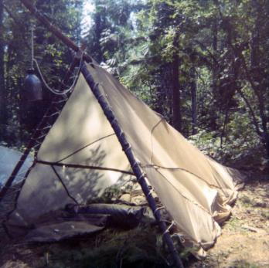
“Technology includes all tools, machines, utensils, weapons, instruments, housing, clothing, communicating and transporting devices and the skills by which we produce and use them.”

Slide 7
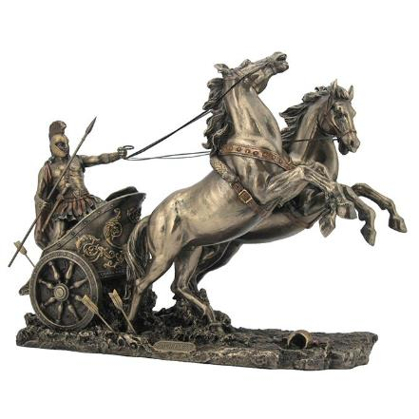
“Technology includes all tools, machines, utensils, weapons, instruments, housing, clothing, communicating and transporting devices and the skills by which we produce and use them.”

Slide 9
3 Principles of Technology from Genesis
1. We are created to create..
²⁶ Then God said, “Let us make man in our image, after our likeness. And let them have dominion over the fish of the sea and over the birds of the heavens and over the livestock and over all the earth and over every creeping thing that creeps on the earth.”
²⁷ So God created man in his own image, in the image of God he created him; male and female he created them.
Genesis 1:26-27

Slide 10
3 Principles of Technology from Genesis
1. We are created to create..
And God blessed them. And God said to them, “Be fruitful and multiply and fill the earth and subdue it, and have dominion over the fish of the sea and over the birds of the heavens and over every living thing that moves on the earth.”
Genesis 1:28

Slide 11
3 Principles of Technology from Genesis
1. We are created to create..
Now out of the ground the Lord God had formed every beast of the field and every bird of the heavens and brought them to the man to see what he would call them. And whatever the man called every living creature, that was its name. Genesis 2:19

Slide 12
3 Principles of Technology from Genesis
1. We are created to create..
Then the eyes of both were opened, and they knew that they were naked. And they sewed fig leaves together and made themselves loincloths. Genesis 3:7

Slide 13
3 Principles of Technology from Genesis
1. We are created to create..
2. Technology can be used to save..
¹³ And God said to Noah, “I have determined to make an end of all flesh, for the earth is filled with violence through them. Behold, I will destroy them with the earth. ¹⁴ Make yourself an ark of gopher wood. Make rooms in the ark, and cover it inside and out with pitch. ¹⁵ This is how you are to make it: the length of the ark 300 cubits, its breadth 50 cubits, and its height 30 cubits. ¹⁶ Make a roof for the ark, and finish it to a cubit above, and set the door of the ark in its side. Make it with lower, second, and third decks. Genesis 6:13-16

Slide 14
3 Principles of Technology from Genesis
1. We are created to create..
2. Technology can be used to save..
¹³ And God said to Noah, “I have determined to make an end of all flesh, for the earth is filled with violence through them. Behold, I will destroy them with the earth. ¹⁴ Make yourself an ark of gopher wood. Make rooms in the ark, and cover it inside and out with pitch. ¹⁵ This is how you are to make it: the length of the ark 300 cubits, its breadth 50 cubits, and its height 30 cubits. ¹⁶ Make a roof for the ark, and finish it to a cubit above, and set the door of the ark in its side. Make it with lower, second, and third decks. Genesis 6:13-16

Slide 15
3 Principles of Technology from Genesis
1. We are created to create..
2. Technology can be used to save..
¹³ And God said to Noah, “I have determined to make an end of all flesh, for the earth is filled with violence through them. Behold, I will destroy them with the earth. ¹⁴ Make yourself an ark of gopher wood. Make rooms in the ark, and cover it inside and out with pitch. ¹⁵ This is how you are to make it: the length of the ark 300 cubits, its breadth 50 cubits, and its height 30 cubits. ¹⁶ Make a roof for the ark, and finish it to a cubit above, and set the door of the ark in its side. Make it with lower, second, and third decks. Genesis 6:13-16

Slide 16
3 Principles of Technology from Genesis
1. We are created to create..
2. Technology can be used to save..
¹³ And God said to Noah, “I have determined to make an end of all flesh, for the earth is filled with violence through them. Behold, I will destroy them with the earth. ¹⁴ Make yourself an ark of gopher wood. Make rooms in the ark, and cover it inside and out with pitch. ¹⁵ This is how you are to make it: the length of the ark 300 cubits, its breadth 50 cubits, and its height 30 cubits. ¹⁶ Make a roof for the ark, and finish it to a cubit above, and set the door of the ark in its side. Make it with lower, second, and third decks. Genesis 6:13-16

Slide 17
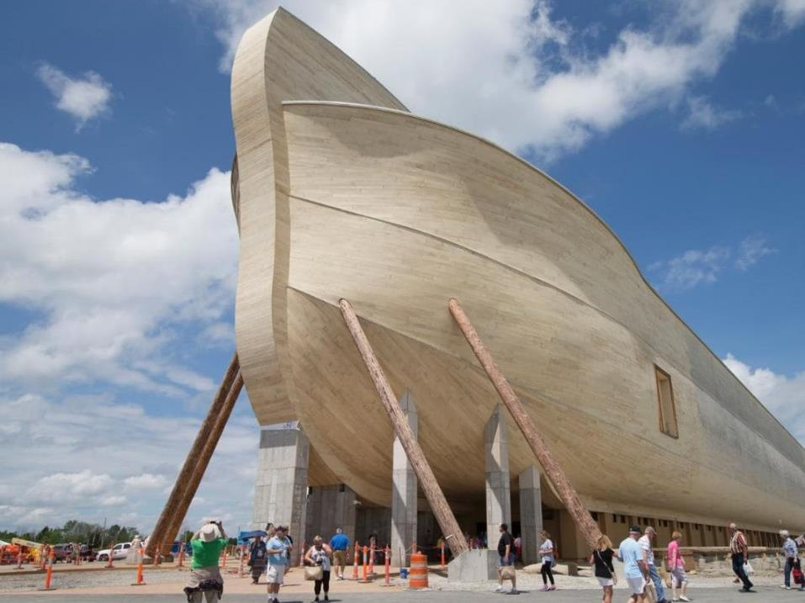

Slide 18
3 Principles of Technology from Genesis
1. We are created to create..
2. Technology can be used to save..
3. Technology can be used for evil..
¹ Now the whole earth had one language and the same words. ² And as people migrated from the east, they found a plain in the land of Shinar and settled there. ³ And they said to one another, “Come, let us make bricks, and burn them thoroughly.” And they had brick for stone, and bitumen for mortar. ⁴ Then they said, “Come, let us build ourselves a city and a tower with its top in the heavens, and let us make a name for ourselves, lest we be dispersed over the face of the whole earth.” Gen 11:1-4

Slide 19
3 Principles of Technology from Genesis
1. We are created to create..
2. Technology can be used to save..
3. Technology can be used for evil..
¹ Now the whole earth had one language and the same words. ² And as people migrated from the east, they found a plain in the land of Shinar and settled there. ³ And they said to one another, “Come, let us make bricks, and burn them thoroughly.” And they had brick for stone, and bitumen for mortar. ⁴ Then they said, “Come, let us build ourselves a city and a tower with its top in the heavens, and let us make a name for ourselves, lest we be dispersed over the face of the whole earth.” Gen 11:1-4

Slide 20
3 Principles of Technology from Genesis
1. We are created to create..
2. Technology can be used to save..
3. Technology can be used for evil..
¹ Now the whole earth had one language and the same words. ² And as people migrated from the east, they found a plain in the land of Shinar and settled there. ³ And they said to one another, “Come, let us make bricks, and burn them thoroughly.” And they had brick for stone, and bitumen for mortar. ⁴ Then they said, “Come, let us build ourselves a city and a tower with its top in the heavens, and let us make a name for ourselves, lest we be dispersed over the face of the whole earth.” Gen 11:1-4

Slide 21
3 Principles of Technology from Genesis
1. We are created to create..
2. Technology can be used to save..
3. Technology can be used for evil..
¹ Now the whole earth had one language and the same words. ² And as people migrated from the east, they found a plain in the land of Shinar and settled there. ³ And they said to one another, “Come, let us make bricks, and burn them thoroughly.” And they had brick for stone, and bitumen for mortar. ⁴ Then they said, “Come, let us build ourselves a city and a tower with its top in the heavens, and let us make a name for ourselves, lest we be dispersed over the face of the whole earth.” Gen 11:1-4

Slide 22
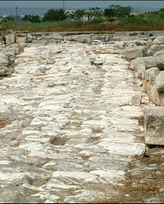
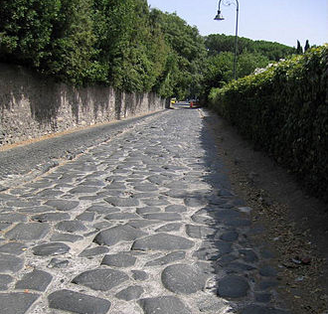
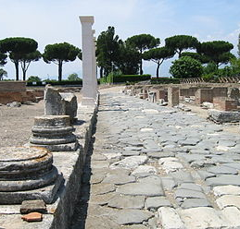

Slide 23
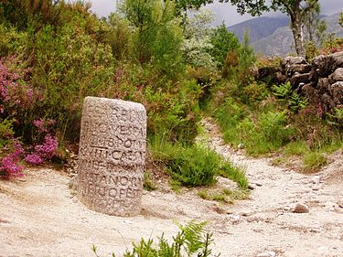

Slide 24
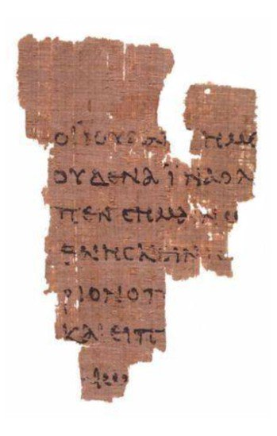

Slide 25
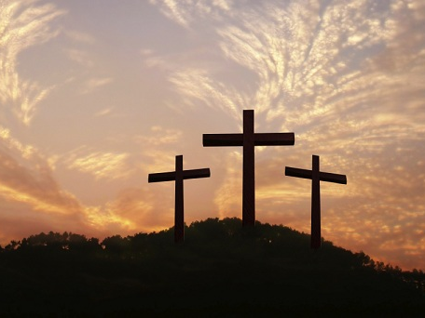
²³ this Jesus, delivered up according to the definite plan and foreknowledge of God, you crucified and killed by the hands of lawless men. ²⁴ God raised him up, loosing the pangs of death, because it was not possible for him to be held by it.
Acts 2:23-24

Slide 26
¹³ And you, who were dead in your trespasses and the uncircumcision of your flesh, God made alive together with him, having forgiven us all our trespasses, ¹⁴ by canceling the record of debt that stood against us with its legal demands. This he set aside, nailing it to the cross. ¹⁵ He disarmed the rulers and authorities and put them to open shame, by triumphing over them in him. Colossians 2:13-15

Slide 27
²¹ For to this you have been called, because Christ also suffered for you, leaving you an example, so that you might follow in his steps. ²² He committed no sin, neither was deceit found in his mouth. ²³ When he was reviled, he did not revile in return; when he suffered, he did not threaten, but continued entrusting himself to him who judges justly. ²⁴ He himself bore our sins in his body on the tree, that we might die to sin and live to righteousness. By his wounds you have been healed. ²⁵ For you were straying like sheep, but have now returned to the Shepherd and Overseer of your souls. 1 Peter 2:21-25

Slide 28
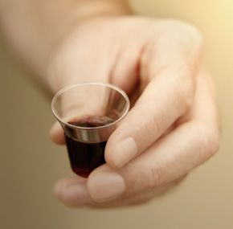
²⁶ Now as they were eating, Jesus took bread, and after blessing it broke it and gave it to the disciples, and said, “Take, eat; this is my body.” ²⁷ And he took a cup, and when he had given thanks he gave it to them, saying, “Drink of it, all of you, ²⁸ for this is my blood of the covenant, which is poured out for many for the forgiveness of sins. Matthew 26:26-28

