Slide 2
Poor in spirit
Mourn
Meek
Hunger and thirst for righteousness
Merciful
Pure in heart
Peacemakers
Persecuted
Reviled and persecuted
The Disciples’ Identity
Matt 5:3-12

Slide 3
Poor in spirit
Mourn
Meek
Hunger and thirst for righteousness
Merciful
Pure in heart
Peacemakers
Persecuted
Reviled and persecuted
The Disciples’ Identity
Matt 5:3-12
Salt and Light
Matt 5:13-16

Slide 4
Fulfill the Law, not destroy
Jesus’ Identity
Matt 5:17-18
Attitude toward God’s commandments
Matt 5:19

Slide 5
Murder
1.
2.
3.
4.
5.
6.
Adultery
Greater Righteousness
Divorce
Matt 5:20-48
Oaths
Retaliation

Slide 6
1. (Murder) Angry with brother
2. (Adultery) Coveting your brother’s wife
3. (Divorce) adultery/keeping the marriage covenant
4. (Oath) dishonesty comes from evil
5. (Retaliation) responding to evil

Slide 7
“You have heard that it was said, ‘An eye for an eye and a tooth for a tooth.’
Matthew 5:38
But if there is harm, then you shall pay life for life, eye for eye, tooth for tooth, hand for hand, foot for foot, burn for burn, wound for wound, stripe for stripe.
Exodus 21:23-25

Slide 8
“You have heard that it was said, ‘An eye for an eye and a tooth for a tooth.’
Matthew 5:38
Whoever takes a human life shall surely be put to death. Whoever takes an animal's life shall make it good, life for life. If anyone injures his neighbor, as he has done it shall be done to him, fracture for fracture, eye for eye, tooth for tooth; whatever injury he has given a person shall be given to him. Leviticus 24:17-20

Slide 9
“You have heard that it was said, ‘An eye for an eye and a tooth for a tooth.’
Matthew 5:38
The judges shall inquire diligently, and if the witness is a false witness and has accused his brother falsely, then you shall do to him as he had meant to do to his brother. So you shall purge the evil from your midst. And the rest shall hear and fear, and shall never again commit any such evil among you. Your eye shall not pity. It shall be life for life, eye for eye, tooth for tooth, hand for hand, foot for foot. Deut 19:18-21

Slide 10
Lex talionis

Slide 11
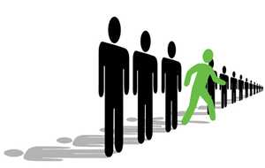

Slide 12
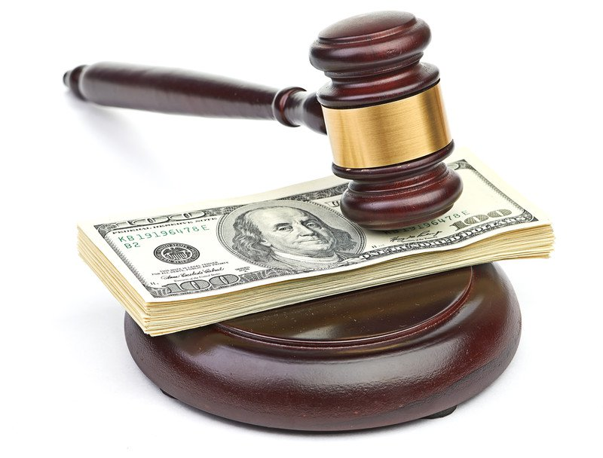

Slide 13
But I say to you,
Do not resist the one who is evil. … Matthew 5:39

Slide 14
But I say to you,
Do not resist the one who is evil. … Matthew 5:39
Submit yourselves therefore to God. Resist the devil, and he will flee from you. James 4:7

Slide 15
But I say to you,
Do not resist the one who is evil. … Matthew 5:39
anthístēmi ("oppose fully") means to forcefully declare one's personal conviction (where they unswervingly stand); to keep one's possession; ardently withstand, without giving up (letting go).
anthístēmi was a military term in classical Greek (used by Thucydides, etc.) meaning "to strongly resist an opponent" ("take a firm stand against").

Slide 16
But I say to you,
Do not resist the one who is evil.
1. But if anyone slaps you on the right cheek, turn to him the other also.
Matthew 5:39

Slide 17
But I say to you,
Do not resist the one who is evil.
1. But if anyone slaps you on the right cheek, turn to him the other also.
Matthew 5:39

Slide 18
But I say to you,
Do not resist the one who is evil.
1. But if anyone slaps you on the right cheek, turn to him the other also.
Matthew 5:39
2. And if anyone would sue you and take your tunic, let him have your cloak as well.
Matthew 5:40

Slide 19
But I say to you,
Do not resist the one who is evil.
1. But if anyone slaps you on the right cheek, turn to him the other also.
Matthew 5:39
2. And if anyone would sue you and take your tunic, let him have your cloak as well.
Matthew 5:40

Slide 20
But I say to you,
Do not resist the one who is evil.
1. But if anyone slaps you on the right cheek, turn to him the other also.
Matthew 5:39
2. And if anyone would sue you and take your tunic, let him have your cloak as well.
Matthew 5:40

Slide 21
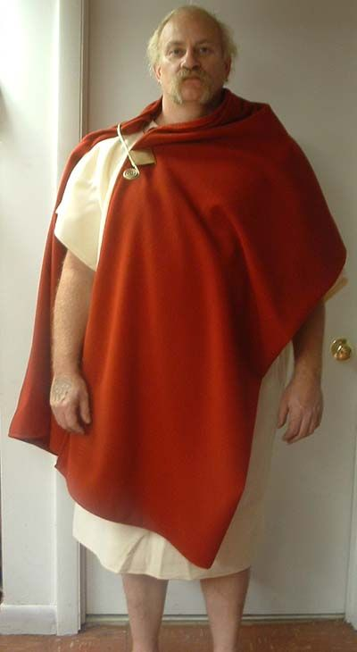
tunic=inner garment
cloak=outer garment

Slide 22
If ever you take your neighbor's cloak in pledge, you shall return it to him before the sun goes down, for that is his only covering, and it is his cloak for his body; in what else shall he sleep? And if he cries to me, I will hear, for I am compassionate.
Exodus 22:26-27

Slide 23
But I say to you,
Do not resist the one who is evil.
1. But if anyone slaps you on the right cheek, turn to him the other also.
Matthew 5:39
2. And if anyone would sue you and take your tunic, let him have your cloak as well.
Matthew 5:40
3. And if anyone forces you to go one mile, go with him two miles. Matthew 5:41

Slide 24
As they went out, they found a man of Cyrene, Simon by name. They compelled this man to carry his cross.
Matthew 27:32

Slide 25
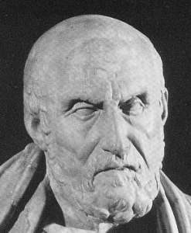
“If a soldier commandeers your donkey, let it go. Do not resist or grumble. If you do, you will get a beating and lose your little donkey all the same.” Epictetus, Greek Philosopher, AD 55-135

Slide 26
But I say to you,
Do not resist the one who is evil.
1. But if anyone slaps you on the right cheek, turn to him the other also.
Matthew 5:39
2. And if anyone would sue you and take your tunic, let him have your cloak as well.
Matthew 5:40
3. And if anyone forces you to go one mile, go with him two miles. Matthew 5:41

Slide 27
But I say to you,
Do not resist the one who is evil.
1. But if anyone slaps you on the right cheek, turn to him the other also.
Matthew 5:39
2. And if anyone would sue you and take your tunic, let him have your cloak as well.
Matthew 5:40
3. And if anyone forces you to go one mile, go with him two miles. Matthew 5:41
4. Give to the one who begs from you, and do not refuse the one who would borrow from you. Matthew 5:42

Slide 28
But I say to you,
Do not resist the one who is evil.
5. And if anyone ______________________.

Slide 29
You shall not take vengeance or bear a grudge against the sons of your own people, but you shall love your neighbor as yourself: I am the Lord.
Leviticus 19:18
Do not say, “I will repay evil”; wait for the Lord, and he will deliver you.
Proverbs 20:22

Slide 30
Repay no one evil for evil, but give thought to do what is honorable in the sight of all. If possible, so far as it depends on you, live peaceably with all. Beloved, never avenge yourselves, but leave it to the wrath of God, for it is written, “Vengeance is mine, I will repay, says the Lord.” Romans 12:17-19

Slide 31
See that no one repays anyone evil for evil, but always seek to do good to one another and to everyone. 1 Thessalonians 5:15
Do not repay evil for evil or reviling for reviling, but on the contrary, bless, for to this you were called, that you may obtain a blessing.
1 Peter 3:9

