Slide 2
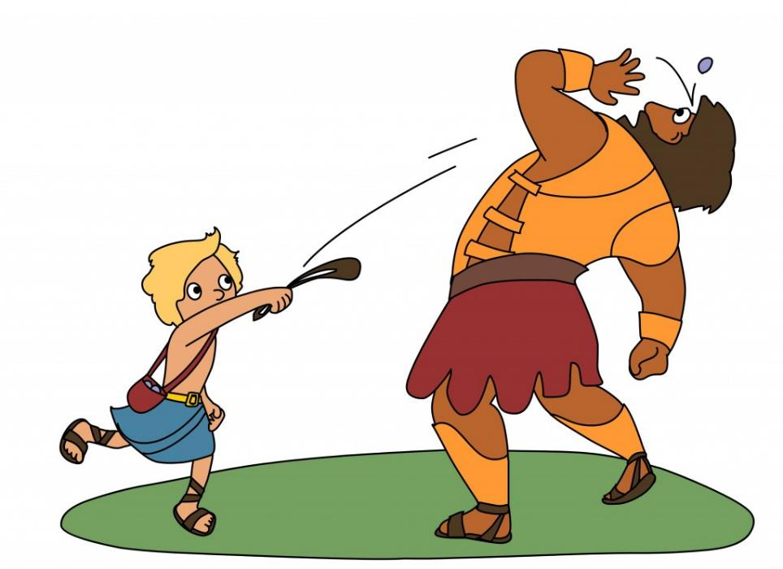

Slide 3
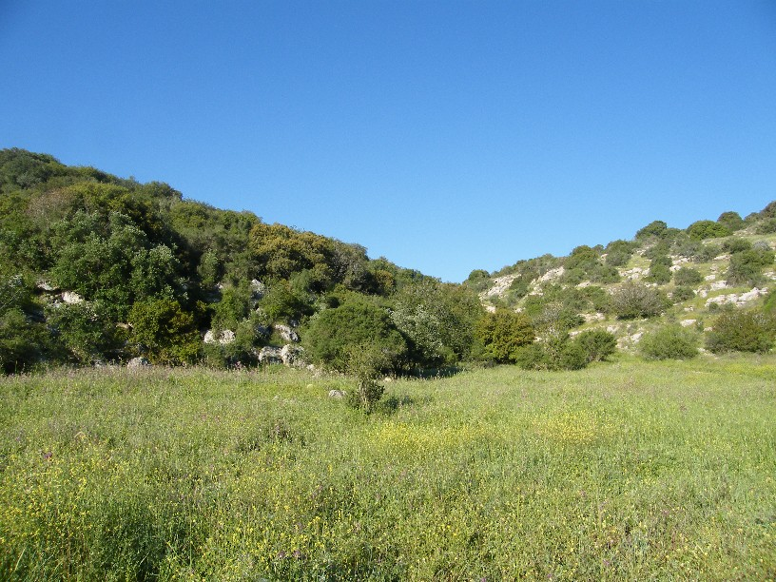
Battle in the Valley
David vs. Goliath

Slide 4
The word of the Lord came to Samuel: “I regret that I have made Saul king, for he has turned back from following me and has not performed my commandments.” …And the Lord regretted that he had made Saul king over Israel.
1 Samuel 15:10-11, 35

Slide 5
The Lord said to Samuel, “How long will you grieve over Saul, since I have rejected him from being king over Israel? Fill your horn with oil, and go. I will send you to Jesse the Bethlehemite, for I have provided for myself a king among his sons.” 1 Samuel 16:1

Slide 6
Then Samuel took the horn of oil and anointed him in the midst of his brothers. And the Spirit of the Lord rushed upon David from that day forward. And Samuel rose up and went to Ramah. Now the Spirit of the Lord departed from Saul, and a harmful spirit from the Lord tormented him. 1 Samuel 16:13-14

Slide 7
Now the Philistines gathered their armies for battle. And they were gathered at Socoh, which belongs to Judah, and encamped between Socoh and Azekah, in Ephes-dammim. And Saul and the men of Israel were gathered, and encamped in the Valley of Elah, and drew up in line of battle against the Philistines. And the Philistines stood on the mountain on the one side, and Israel stood on the mountain on the other side, with a valley between them.
1 Samuel 17:1-3

Slide 8
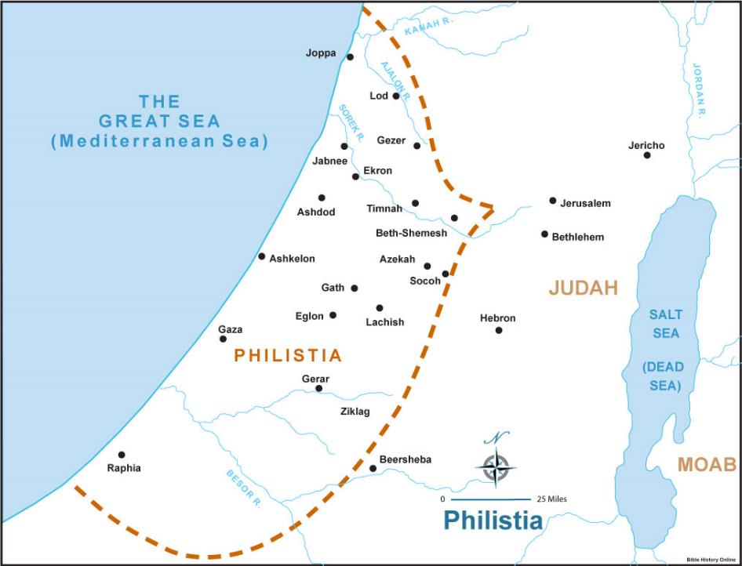

Slide 9
And there came out from the camp of the Philistines a champion named Goliath of Gath, whose height was six cubits and a span. He had a helmet of bronze on his head, and he was armed with a coat of mail, and the weight of the coat was five thousand shekels of bronze. And he had bronze armor on his legs, and a javelin of bronze slung between his shoulders. The shaft of his spear was like a weaver's beam, and his spear's head weighed six hundred shekels of iron. And his shield-bearer went before him.
1 Samuel 17:4-7

Slide 10
And there came out from the camp of the Philistines a champion named Goliath of Gath, whose height was six cubits and a span. He had a helmet of bronze on his head, and he was armed with a coat of mail, and the weight of the coat was five thousand shekels of bronze. And he had bronze armor on his legs, and a javelin of bronze slung between his shoulders. The shaft of his spear was like a weaver's beam, and his spear's head weighed six hundred shekels of iron. And his shield-bearer went before him.
1 Samuel 17:4-7

Slide 11
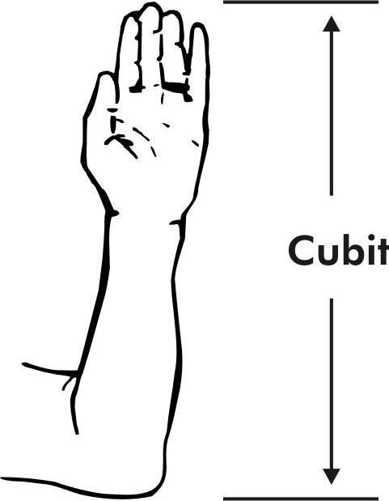
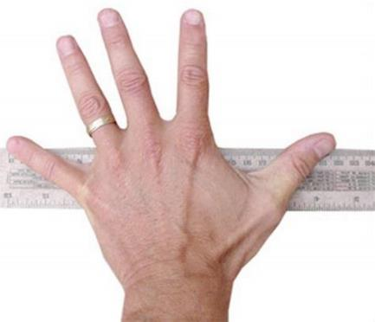
“whose height was six cubits and a span.”
1 Samuel 17:4

Slide 12
“he was armed with a coat of mail, and the weight of the coat was five thousand shekels of bronze.”
1 Samuel 17:5

Slide 13
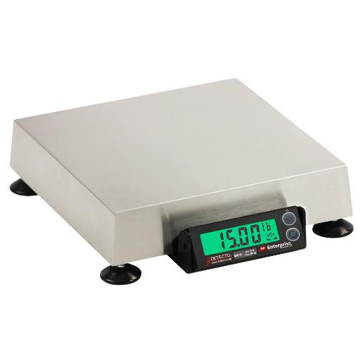
“his spear's head weighed six hundred shekels of iron.”
1 Samuel 17:7

Slide 14
He stood and shouted to the ranks of Israel, “Why have you come out to draw up for battle? Am I not a Philistine, and are you not servants of Saul? Choose a man for yourselves, and let him come down to me. If he is able to fight with me and kill me, then we will be your servants. But if I prevail against him and kill him, then you shall be our servants and serve us.” And the Philistine said, “I defy the ranks of Israel this day. Give me a man, that we may fight together.”
1 Samuel 17:8-10

Slide 15
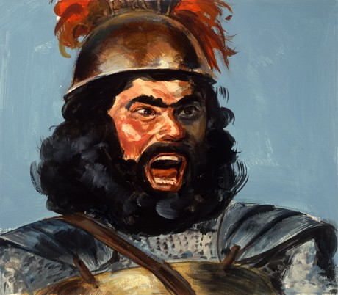
I defy the ranks of Israel this day. Give me a man, that we may fight together.

Slide 16
Saul
…From his shoulders upward he was taller than any of the people. 1 Samuel 9:2
Good Stature
…And when he stood among the people, he was taller than any of the people from his shoulders upward.
1 Samuel 10:23

Slide 17
Saul
Then Saul clothed David with his armor. He put a helmet of bronze on his head and clothed him with a coat of mail, and David strapped his sword over his armor.
1 Samuel 17:38-39
Good Stature
Good Equipment

Slide 18
Saul
Now Saul and they and all the men of Israel were in the Valley of Elah, fighting with the Philistines.
1 Samuel 17:19
Good Stature
Good Equipment
Good Experience

Slide 19
Saul
Good Stature
Good Equipment
Good Experience

Slide 20
Saul
Good Stature
Good Equipment
Good Experience
When Saul and all Israel heard these words of the Philistine, they were dismayed and greatly afraid.
1 Samuel 17:11

Slide 21
Eliab
When they came, he looked on Eliab and thought, “Surely the Lord's anointed is before him.” But the Lord said to Samuel, “Do not look on his appearance or on the height of his stature, because I have rejected him. For the Lord sees not as man sees: man looks on the outward appearance, but the Lord looks on the heart.”
1 Samuel 16:6-7
Good Stature

Slide 22
Eliab
The three oldest sons of Jesse had followed Saul to the battle. And the names of his three sons who went to the battle were Eliab the firstborn…
1 Samuel 17:13
Good Stature
Good Equipment
Good Experience

Slide 23
Eliab
Now Eliab his eldest brother heard when he spoke to the men. And Eliab's anger was kindled against David, and he said, “Why have you come down? And with whom have you left those few sheep in the wilderness? I know your presumption and the evil of your heart, for you have come down to see the battle.” 1 Samuel 17:28
Good Stature
Good Equipment
Good Experience

Slide 24
Eliab
Good Stature
Good Equipment
Good Experience

Slide 25
Eliab
Good Stature
All the men of Israel, when they saw the man, fled from him and were much afraid.
1 Samuel 17:24
Good Equipment
Good Experience

Slide 26
David
Good Stature
Good Equipment
Good Experience

Slide 27
David
David was the youngest.
1 Samuel 17:14
Good Stature
Good Equipment
you are but a youth.
1 Samuel 17:33
Good Experience
And when the Philistine looked and saw David, he disdained him, for he was but a youth.
1 Samuel 17:42

Slide 28
David
And Jesse said to David his son, “Take for your brothers an ephah of this parched grain, and these ten loaves, and carry them quickly to the camp to your brothers. Also take these ten cheeses to the commander of their thousand. See if your brothers are well, and bring some token from them.”
1 Samuel 17:17-18
Good Stature
Good Equipment
Good Experience

Slide 29
David
Good Stature
Then he took his staff in his hand and chose five smooth stones from the brook and put them in his shepherd's pouch. His sling was in his hand, and he approached the Philistine. 1 Samuel 17:40
Good Resources
Good Experience

Slide 30
David
Eager
And David left the things in charge of the keeper of the baggage and ran to the ranks and went and greeted his brothers.
1 Samuel 17:22

Slide 31
David
Eager
Faith in God

Slide 32
And David said to the men who stood by him, “What shall be done for the man who kills this Philistine and takes away the reproach from Israel? For who is this uncircumcised Philistine, that he should defy the armies of the living God?”
1 Samuel 17:26

Slide 33
Your servant has struck down both lions and bears, and this uncircumcised Philistine shall be like one of them, for he has defied the armies of the living God.” And David said, “The Lord who delivered me from the paw of the lion and from the paw of the bear will deliver me from the hand of this Philistine.” And Saul said to David, “Go, and the Lord be with you!” 1 Samuel 17:36-37

Slide 34
Then David said to the Philistine, “You come to me with a sword and with a spear and with a javelin, but I come to you in the name of the Lord of hosts, the God of the armies of Israel, whom you have defied. This day the Lord will deliver you into my hand, and I will strike you down and cut off your head. And I will give the dead bodies of the host of the Philistines this day to the birds of the air and to the wild beasts of the earth, that all the earth may know that there is a God in Israel, and that all this assembly may know that the Lord saves not with sword and spear. For the battle is the Lord's, and he will give you into our hand.”
1 Samuel 17:45-47

Slide 35
David
Eager
Faith in God

Slide 36
So David prevailed over the Philistine with a sling and with a stone, and struck the Philistine and killed him. There was no sword in the hand of David. Then David ran and stood over the Philistine and took his sword and drew it out of its sheath and killed him and cut off his head with it. When the Philistines saw that their champion was dead, they fled. And the men of Israel and Judah rose with a shout and pursued the Philistines as far as Gath and the gates of Ekron, so that the wounded Philistines fell on the way from Shaaraim as far as Gath and Ekron.
1 Samuel 17:50-52

