Slide 2
Poor in spirit
Mourn
Meek
Hunger and thirst for righteousness
Merciful
Pure in heart
Peacemakers
Persecuted
Reviled and persecuted
The Disciples’ Identity
Matt 5:3-12

Slide 3
Poor in spirit
Mourn
Meek
Hunger and thirst for righteousness
Merciful
Pure in heart
Peacemakers
Persecuted
Reviled and persecuted
The Disciples’ Identity
Matt 5:3-12
Salt and Light
Matt 5:13-16

Slide 4
Fulfill the Law, not destroy
Jesus’ Identity
Matt 5:17-18
Attitude toward God’s commandments
Matt 5:19

Slide 5
Murder
1.
2.
3.
4.
5.
6.
Adultery
Greater Righteousness
Divorce
Matt 5:20-48
Oaths

Slide 6
²¹ “You have heard that it was said to those of old…
(Murder)
²⁷ “You have heard that it was said…
(Adultery)
³¹ “It was also said…
(Divorce)
³³ “Again you have heard that it was said to those of old… (Oaths)
³⁸ “You have heard that it was said…
(Eye for an Eye)
⁴³ “You have heard that it was said…
(Love)

Slide 7
“Again you have heard that it was said to those of old,
‘You shall not swear falsely,
but shall perform to the Lord what you have sworn.’
Matthew 5:33
You shall not swear by my name falsely, and so profane the name of your God: I am the Lord.
Leviticus 19:12

Slide 8
“Again you have heard that it was said to those of old,
‘You shall not swear falsely,
but shall perform to the Lord what you have sworn.’
Matthew 5:33
Offer to God a sacrifice of thanksgiving, and perform your vows to the Most High Psalm 50:14

Slide 9
“Again you have heard that it was said to those of old,
‘You shall not swear falsely,
but shall perform to the Lord what you have sworn.’
Matthew 5:33
“If you make a vow to the Lord your God, you shall not delay fulfilling it, for the Lord your God will surely require it of you, and you will be guilty of sin. …You shall be careful to do what has passed your lips, for you have voluntarily vowed to the Lord your God what you have promised with your mouth Deuteronomy 23: 21, 23

Slide 10
“Again you have heard that it was said to those of old,
‘You shall not swear falsely,
but shall perform to the Lord what you have sworn.’
Matthew 5:33
If a man vows a vow to the Lord, or swears an oath to bind himself by a pledge, he shall not break his word. He shall do according to all that proceeds out of his mouth.
Numbers 30:2

Slide 11
“Again you have heard that it was said to those of old,
‘You shall not swear falsely,
but shall perform to the Lord what you have sworn.’
Matthew 5:33
You shall not swear by my name falsely, and so profane the name of your God: I am the Lord.
Leviticus 19:12
You shall not take the name of the Lord your God in vain, for the Lord will not hold him guiltless who takes his name in vain. Exodus 20:7

Slide 12
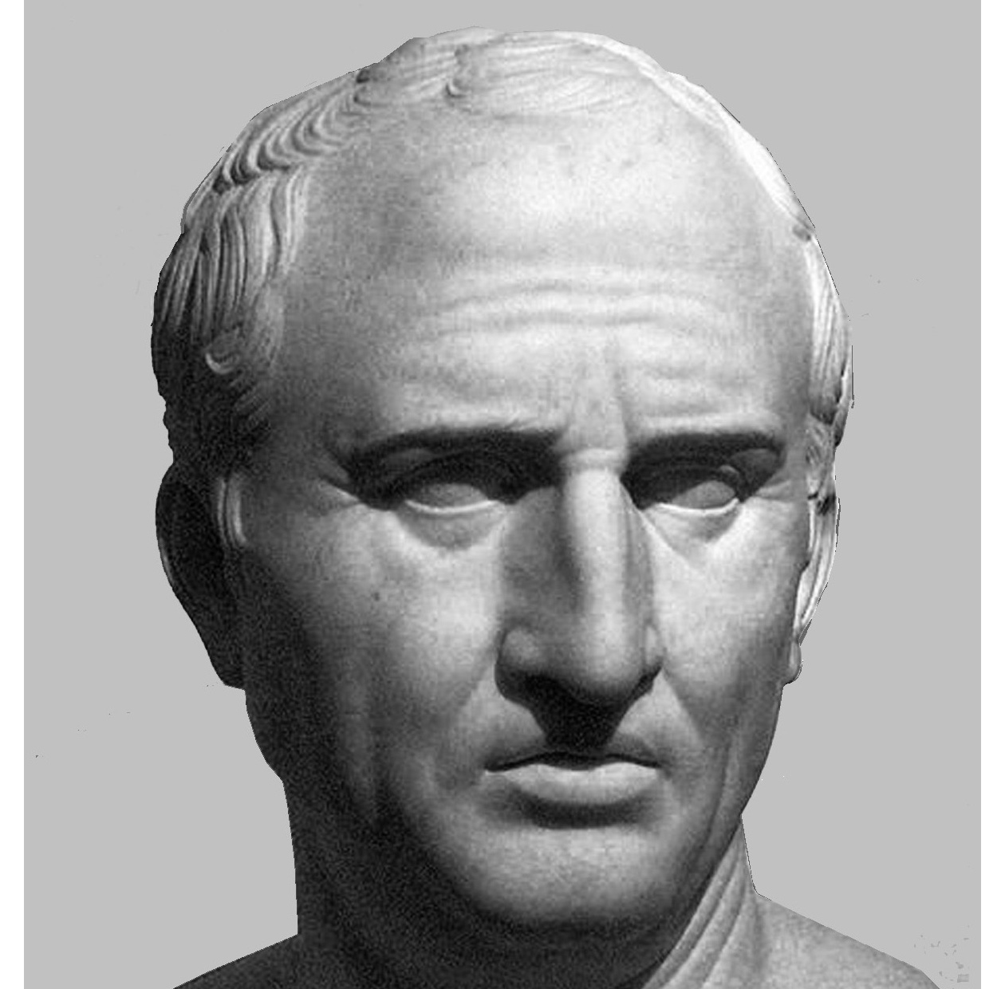
“an oath is an assurance backed by religious sanctity; and a solemn promise given, as before God as one’s witness, is to be sacredly kept.”
--Marcus Tullius Cicero, Roman philosopher, 44 BC

Slide 13
“An oath is an unproved statement supported by an appeal to the gods.”
--Anaximenes of Lampascus, Greek Historian, 4th century BC

Slide 14
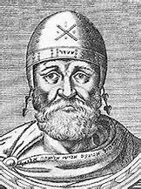
“For an oath is nothing else than to call God to bear witness in a disputed matter.”
--Philo of Alexandria, Hellenistic Jewish Philosopher, 20 BC-50 AD

Slide 15
³⁴ But I say to you,
Do not take an oath at all,
either by heaven, for it is the throne of God,
³⁵ or by the earth, for it is his footstool,
or by Jerusalem, for it is the city of the great King.
³⁶ And do not take an oath by your head, for you cannot make one hair white or black.
Matthew 5:34-36

Slide 16
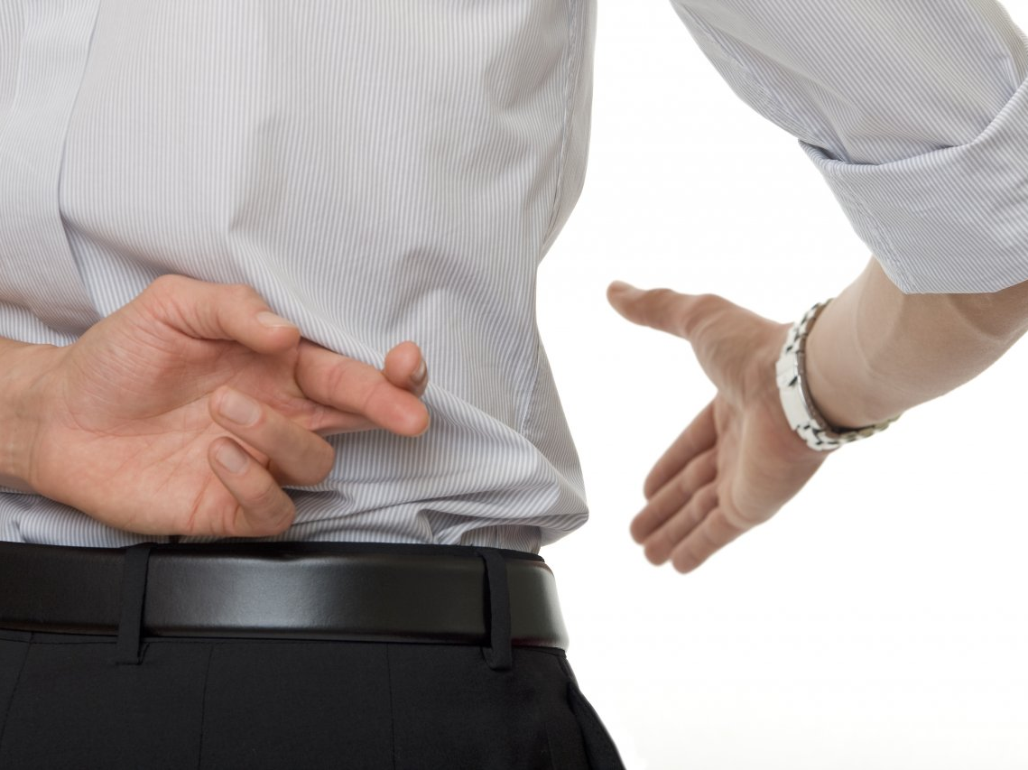

Slide 18
³⁴ But I say to you,
Do not take an oath at all,
either by heaven, for it is the throne of God,
³⁵ or by the earth, for it is his footstool,
or by Jerusalem, for it is the city of the great King.
³⁶ And do not take an oath by your head, for you cannot make one hair white or black.
Matthew 5:34-36

Slide 19
If a man said, “I adjure you” or “I command you” or “I bind you,” they are liable: but if he said “By heaven and earth” they are exempt.
m. Sebu. 1.3

Slide 20
³⁴ But I say to you,
Do not take an oath at all,
either by heaven, for it is the throne of God,
³⁵ or by the earth, for it is his footstool,
or by Jerusalem, for it is the city of the great King.
³⁶ And do not take an oath by your head, for you cannot make one hair white or black.
Matthew 5:34-36

Slide 21
³⁴ But I say to you,
Do not take an oath at all,
either by heaven, for it is the throne of God,
³⁵ or by the earth, for it is his footstool,
or by Jerusalem, for it is the city of the great King.
³⁶ And do not take an oath by your head, for you cannot make one hair white or black.
Matthew 5:34-36

Slide 22
³⁴ But I say to you,
Do not take an oath at all,
either by heaven, for it is the throne of God,
³⁵ or by the earth, for it is his footstool,
or by Jerusalem, for it is the city of the great King.
³⁶ And do not take an oath by your head, for you cannot make one hair white or black.
Matthew 5:34-36

Slide 23
If he says, “May it be by Jerusalem,” he has said naught.
m. Ned. 1.3

Slide 24
³⁴ But I say to you,
Do not take an oath at all,
either by heaven, for it is the throne of God,
³⁵ or by the earth, for it is his footstool,
or by Jerusalem, for it is the city of the great King.
³⁶ And do not take an oath by your head, for you cannot make one hair white or black.
Matthew 5:34-36

Slide 25
³⁴ But I say to you,
Do not take an oath at all,
either by heaven, for it is the throne of God,
³⁵ or by the earth, for it is his footstool,
or by Jerusalem, for it is the city of the great King.
³⁶ And do not take an oath by your head, for you cannot make one hair white or black.
Matthew 5:34-36

Slide 26
If a man take an oath before his fellow, and his fellow said to him, “Vow to me by the life of your head,” Rabbi Meir says he may retract.
m. Sanh. 3.2

Slide 27
³⁴ But I say to you,
Do not take an oath at all,
either by heaven, for it is the throne of God,
³⁵ or by the earth, for it is his footstool,
or by Jerusalem, for it is the city of the great King.
³⁶ And do not take an oath by your head, for you cannot make one hair white or black.
Matthew 5:34-36

Slide 28
³⁴ But I say to you,
Do not take an oath at all,
either by heaven, for it is the throne of God,
³⁵ or by the earth, for it is his footstool,
or by Jerusalem, for it is the city of the great King.
³⁶ And do not take an oath by your head, for you cannot make one hair white or black.
Matthew 5:34-36

Slide 29
¹⁶ “Woe to you, blind guides, who say, ‘If anyone swears by the temple, it is nothing, but if anyone swears by the gold of the temple, he is bound by his oath.’ ¹⁷ You blind fools! For which is greater, the gold or the temple that has made the gold sacred? ¹⁸ And you say, ‘If anyone swears by the altar, it is nothing, but if anyone swears by the gift that is on the altar, he is bound by his oath.’ ¹⁹ You blind men! For which is greater, the gift or the altar that makes the gift sacred? ²⁰ So whoever swears by the altar swears by it and by everything on it. ²¹ And whoever swears by the temple swears by it and by him who dwells in it. ²² And whoever swears by heaven swears by the throne of God and by him who sits upon it. Matt 23

Slide 30
¹⁶ “Woe to you, blind guides, who say, ‘If anyone swears by the temple, it is nothing, but if anyone swears by the gold of the temple, he is bound by his oath.’ ¹⁷ You blind fools! For which is greater, the gold or the temple that has made the gold sacred? ¹⁸ And you say, ‘If anyone swears by the altar, it is nothing, but if anyone swears by the gift that is on the altar, he is bound by his oath.’ ¹⁹ You blind men! For which is greater, the gift or the altar that makes the gift sacred? ²⁰ So whoever swears by the altar swears by it and by everything on it. ²¹ And whoever swears by the temple swears by it and by him who dwells in it. ²² And whoever swears by heaven swears by the throne of God and by him who sits upon it. Matt 23

Slide 31
To invoke the name of God is very serious.
So, they would swear by objects, some of which were considered holy.
But, this gave them a loophole.

Slide 32
Let what you say be simply ‘Yes’ or ‘No’; anything more than this comes from evil. Matthew 5:37
But above all, my brothers, do not swear, either by heaven or by earth or by any other oath, but let your “yes” be yes and your “no” be no, so that you may not fall under condemnation.
James 5:12

