Slide 2
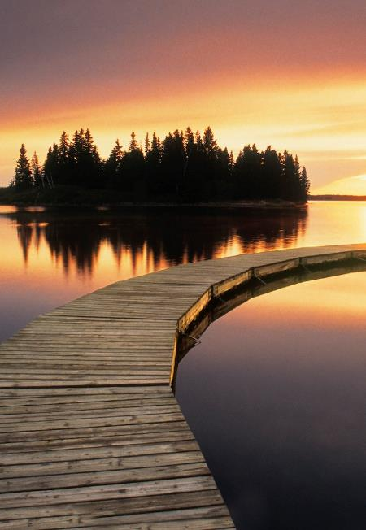
Peace
&
Panic

Slide 3
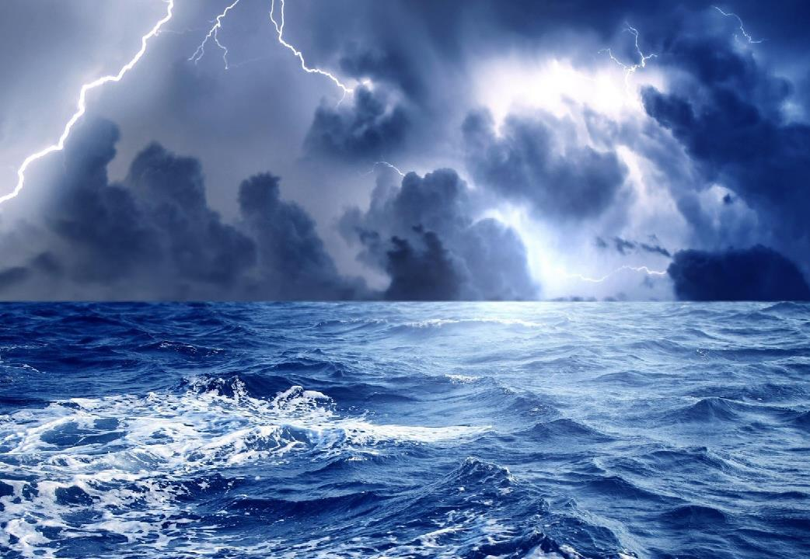

Slide 4
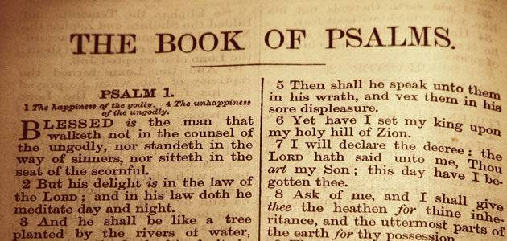

Slide 5
²² You have seen, O Lord; be not silent! O Lord, be not far from me! ²³ Awake and rouse yourself for my vindication, for my cause, my God and my Lord!
Psalm 35:22-23

Slide 6
²³ Awake! Why are you sleeping, O Lord? Rouse yourself! Do not reject us forever! ²⁴ Why do you hide your face? Why do you forget our affliction and oppression?
Psalm 44:23-24

Slide 7
³ For behold, they lie in wait for my life; fierce men stir up strife against me. For no transgression or sin of mine, O Lord, ⁴ for no fault of mine, they run and make ready. Awake, come to meet me, and see! ⁵ You, Lord God of hosts, are God of Israel. Rouse yourself to punish all the nations; spare none of those who treacherously plot evil.
Psalm 59:3-5

Slide 8
⁶ the one who by his strength established the mountains, being girded with might; ⁷ who stills the roaring of the seas, the roaring of their waves, the tumult of the peoples, ⁸ so that those who dwell at the ends of the earth are in awe at your signs. You make the going out of the morning and the evening to shout for joy. Psalm 65:6-8

Slide 9
⁸ O Lord God of hosts, who is mighty as you are, O Lord, with your faithfulness all around you? ⁹ You rule the raging of the sea; when its waves rise, you still them. Psalm 89:8-9

Slide 10
⁵ He set the earth on its foundations, so that it should never be moved. ⁶ You covered it with the deep as with a garment; the waters stood above the mountains. ⁷ At your rebuke they fled; at the sound of your thunder they took to flight. Psalm 104:5-7

Slide 11
²⁸ Then they cried to the Lord in their trouble, and he delivered them from their distress. ²⁹ He made the storm be still, and the waves of the sea were hushed. ³⁰ Then they were glad that the waters were quiet, and he brought them to their desired haven. Psalm 107:28-30

Slide 12
³⁵ On that day, when evening had come, he said to them, “Let us go across to the other side.” ³⁶ And leaving the crowd, they took him with them in the boat, just as he was. And other boats were with him. ³⁷ And a great windstorm arose, and the waves were breaking into the boat, so that the boat was already filling. ³⁸ But he was in the stern, asleep on the cushion. And they woke him and said to him, “Teacher, do you not care that we are perishing?” ³⁹ And he awoke and rebuked the wind and said to the sea, “Peace! Be still!” And the wind ceased, and there was a great calm. ⁴⁰ He said to them, “Why are you so afraid? Have you still no faith?” ⁴¹ And they were filled with great fear and said to one another, “Who then is this, that even the wind and the sea obey him?”
Mark 4:35-41

Slide 13
³⁵ On that day, when evening had come, he said to them, “Let us go across to the other side.” ³⁶ And leaving the crowd, they took him with them in the boat, just as he was. And other boats were with him. ³⁷ And a great windstorm arose, and the waves were breaking into the boat, so that the boat was already filling. ³⁸ But he was in the stern, asleep on the cushion. And they woke him and said to him, “Teacher, do you not care that we are perishing?” ³⁹ And he awoke and rebuked the wind and said to the sea, “Peace! Be still!” And the wind ceased, and there was a great calm. ⁴⁰ He said to them, “Why are you so afraid? Have you still no faith?” ⁴¹ And they were filled with great fear and said to one another, “Who then is this, that even the wind and the sea obey him?” Mark 4:35-41

Slide 14
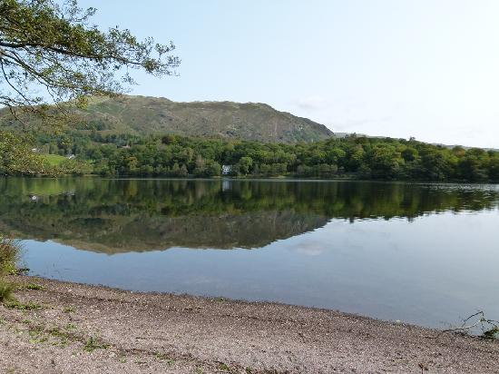
³⁵ On that day, when evening had come, he said to them, “Let us go across to the other side.” ³⁶ And leaving the crowd, they took him with them in the boat, just as he was. And other boats were with him.
Mark 4:35-36

Slide 15
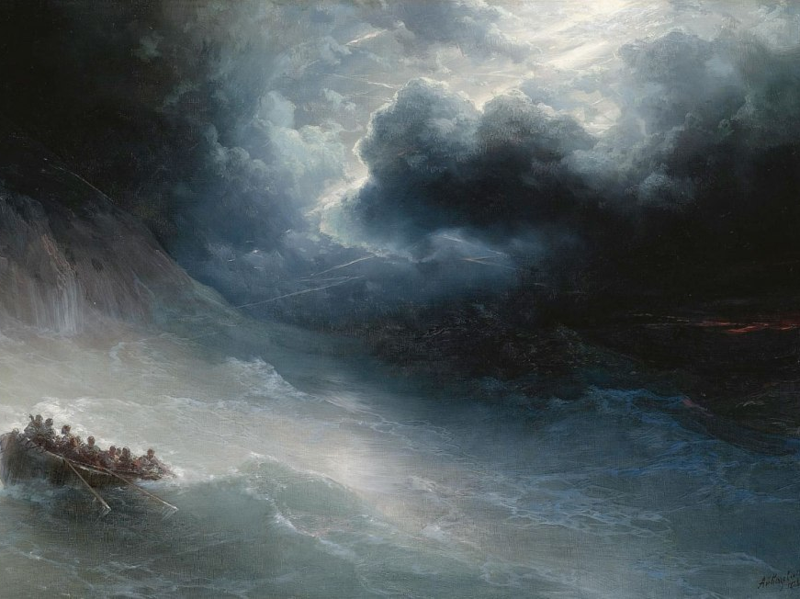
And a great windstorm arose,
and the waves were breaking into the boat,
so that the boat was already filling.
Mark 4:37

Slide 16
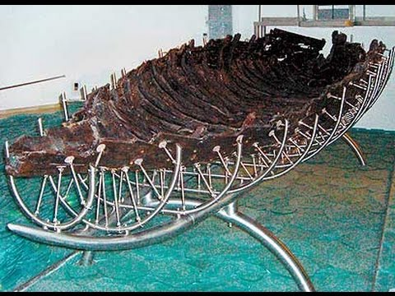

Slide 17
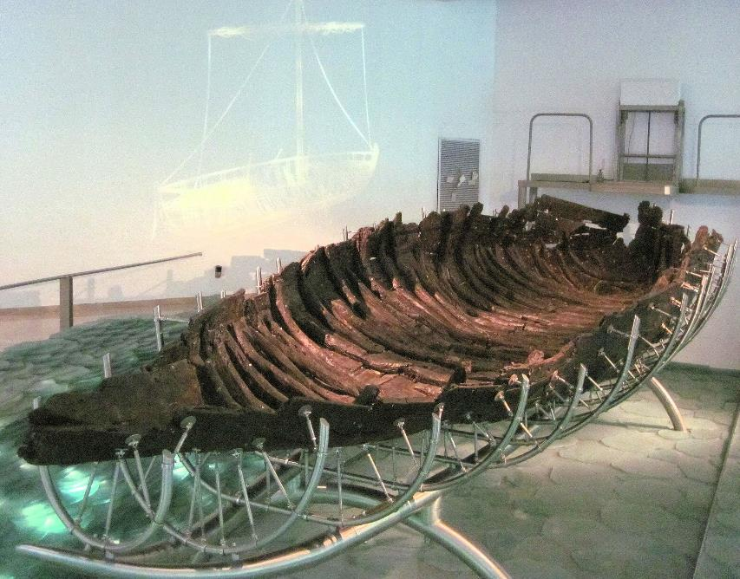

Slide 18
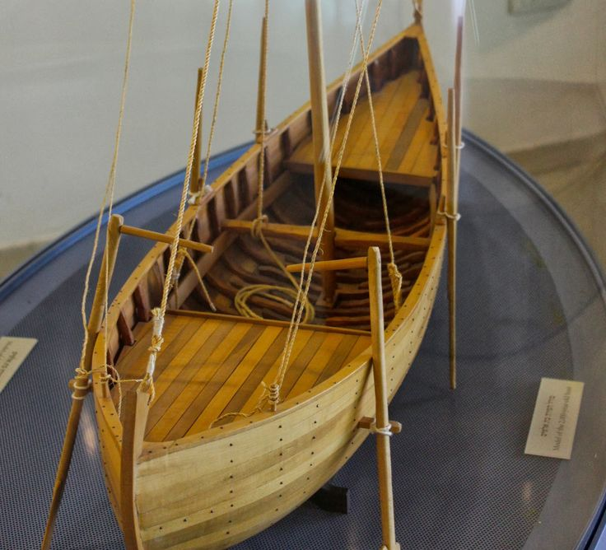
But he was in the stern, asleep on the cushion.
And they woke him and said to him, “Teacher, do you not care that we are perishing?”
Mark 4:38

Slide 19
But he was in the stern, asleep on the cushion.
And they woke him and said to him, “Teacher, do you not care that we are perishing?”
Mark 4:38

Slide 20
But he was in the stern, asleep on the cushion.
And they woke him and said to him, “Teacher, do you not care that we are perishing?”
Mark 4:38

Slide 21
And he awoke and rebuked the wind and said to the sea, “Peace! Be still!”
And the wind ceased, and there was a great calm. Mark 4:39

Slide 22
And he awoke and rebuked the wind and said to the sea, “Peace! Be still!”
And the wind ceased, and there was a great calm. Mark 4:39

Slide 23
⁴¹ And they were filled with great fear and said to one another, “Who then is this, that even the wind and the sea obey him?”
⁴⁰ He said to them, “Why are you so afraid? Have you still no faith?”

Slide 24
⁴¹ And they were filled with great fear and said to one another, “Who then is this, that even the wind and the sea obey him?”
⁴⁰ He said to them, “Why are you so afraid? Have you still no faith?”

Slide 25
⁴¹ And they were filled with great fear and said to one another, “Who then is this, that even the wind and the sea obey him?”
⁴⁰ He said to them, “Why are you so afraid? Have you still no faith?”

Slide 26
⁴¹ And they were filled with great fear and said to one another, “Who then is this, that even the wind and the sea obey him?”
⁴⁰ He said to them, “Why are you so afraid? Have you still no faith?”

Slide 27
⁴¹ And they were filled with great fear and said to one another, “Who then is this, that even the wind and the sea obey him?”
⁴⁰ He said to them, “Why are you so afraid? Have you still no faith?”

Slide 28
“Let us go across to the other side” (Mark 4:35)
“a great windstorm arose” (Mark 4:37)
“the wind ceased and there was a great calm” (Mark 4:39)
“they were filled with great fear” (Mark 4:41)

