Slide 2
Poor in spirit
Mourn
Meek
Hunger and thirst for righteousness
Merciful
Pure in heart
Peacemakers
Persecuted
Reviled and persecuted
The Disciples’ Identity
Matt 5:3-12

Slide 3
Poor in spirit
Mourn
Meek
Hunger and thirst for righteousness
Merciful
Pure in heart
Peacemakers
Persecuted
Reviled and persecuted
The Disciples’ Identity
Matt 5:3-12
Salt and Light
Matt 5:13-16

Slide 4
Fulfill the Law, not destroy
Jesus’ Identity
Matt 5:17-18
Attitude toward God’s commandments
Matt 5:19

Slide 5
Murder
1.
2.
3.
4.
5.
6.
Adultery
Greater Righteousness
Divorce
Matt 5:20-48

Slide 6
“It was also said,
‘Whoever divorces his wife, let him give her a certificate of divorce.’
Matt 5:31
When a man takes a wife and marries her, if then she finds no favor in his eyes because he has found some indecency in her, and he writes her a certificate of divorce and puts it in her hand and sends her out of his house, and she departs out of his house
Deut 24:1

Slide 7
“It was also said,
‘Whoever divorces his wife, let him give her a certificate of divorce.’
Matt 5:31
And Pharisees came up to him and tested him by asking, “Is it lawful to divorce one's wife for any cause?”
Matt 19:3

Slide 8
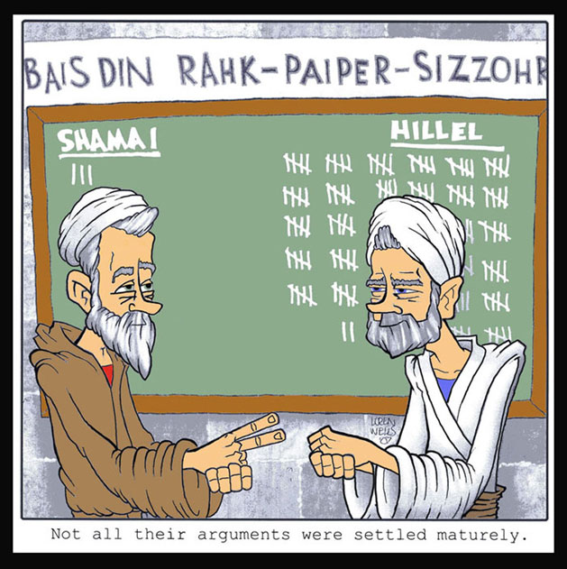

Slide 9
“It was also said,
‘Whoever divorces his wife, let him give her a certificate of divorce.’
Matt 5:31
When a man takes a wife and marries her, if then she finds no favor in his eyes because he has found some indecency in her, and he writes her a certificate of divorce and puts it in her hand and sends her out of his house, and she departs out of his house
Deut 24:1

Slide 10
“It was also said,
‘Whoever divorces his wife, let him give her a certificate of divorce.’
Matt 5:31
When a man takes a wife and marries her, if then she finds no favor in his eyes because he has found some indecency in her, and he writes her a certificate of divorce and puts it in her hand and sends her out of his house, and she departs out of his house…
Deut 24:1

Slide 11
But I say to you
that everyone who divorces his wife,
except on the ground of sexual immorality,
makes her commit adultery, and whoever marries a divorced woman commits adultery.
Matt 5:32

Slide 12
³ And Pharisees came up to him and tested him by asking, “Is it lawful to divorce one's wife for any cause?”
⁴ He answered, “Have you not read that he who created them from the beginning made them male and female, ⁵ and said, ‘Therefore a man shall leave his father and his mother and hold fast to his wife, and the two shall become one flesh’? ⁶ So they are no longer two but one flesh. What therefore God has joined together, let not man separate.”
Matt 19:3-6

Slide 13
³ And Pharisees came up to him and tested him by asking, “Is it lawful to divorce one's wife for any cause?”
⁴ He answered, “Have you not read that he who created them from the beginning made them male and female, ⁵ and said, ‘Therefore a man shall leave his father and his mother and hold fast to his wife, and the two shall become one flesh’? ⁶ So they are no longer two but one flesh. What therefore God has joined together, let not man separate.”
Matt 19:3-6

Slide 14
³ And Pharisees came up to him and tested him by asking, “Is it lawful to divorce one's wife for any cause?”
⁴ He answered, “Have you not read that he who created them from the beginning made them male and female, ⁵ and said, ‘Therefore a man shall leave his father and his mother and hold fast to his wife, and the two shall become one flesh’? ⁶ So they are no longer two but one flesh. What therefore God has joined together, let not man separate.”
Matt 19:3-6

Slide 15
The Lord will send on you curses, confusion, and frustration in all that you undertake to do, until you are destroyed and perish quickly on account of the evil of your deeds, because you have forsaken me. Deut 28:20
And the Lord said to Moses, “Behold, you are about to lie down with your fathers. Then this people will rise and whore after the foreign gods among them in the land that they are entering, and they will forsake me and break my covenant that I have made with them. Deut 31:16

Slide 16
And I will declare my judgments against them, for all their evil in forsaking me. They have made offerings to other gods and worshiped the works of their own hands.
Jeremiah 1:16
And I will dwell among the children of Israel and will not forsake my people Israel
1 Kings 6:13

Slide 17
³ And Pharisees came up to him and tested him by asking, “Is it lawful to divorce one's wife for any cause?”
⁴ He answered, “Have you not read that he who created them from the beginning made them male and female, ⁵ and said, ‘Therefore a man shall leave his father and his mother and hold fast to his wife, and the two shall become one flesh’? ⁶ So they are no longer two but one flesh. What therefore God has joined together, let not man separate.”
Matt 19:3-6

Slide 18
You shall fear the Lord your God. You shall serve him and hold fast to him, and by his name you shall swear. Deut 10:20
For if you will be careful to do all this commandment that I command you to do, loving the Lord your God, walking in all his ways, and holding fast to him Deut 11:22
You shall walk after the Lord your God and fear him and keep his commandments and obey his voice, and you shall serve him and hold fast to him. Deut 13:4

Slide 19
loving the Lord your God, obeying his voice and holding fast to him, for he is your life and length of days, that you may dwell in the land that the Lord swore to your fathers, to Abraham, to Isaac, and to Jacob, to give them. Deut 30:20

Slide 20
³ And Pharisees came up to him and tested him by asking, “Is it lawful to divorce one's wife for any cause?”
⁴ He answered, “Have you not read that he who created them from the beginning made them male and female, ⁵ and said, ‘Therefore a man shall leave his father and his mother and hold fast to his wife, and the two shall become one flesh’? ⁶ So they are no longer two but one flesh. What therefore God has joined together, let not man separate.”
Matt 19:3-6

Slide 21
The man said,
“This is now bone of my bones and flesh of my flesh; she shall be called ‘woman,’ for she was taken out of man.”
That is why a man leaves his father and mother and is united to his wife, and they become one flesh.
Gen 2:23-24
In the same way husbands should love their wives as their own bodies. He who loves his wife loves himself. For no one ever hated his own flesh, but nourishes and cherishes it, just as Christ does the church, because we are members of his body. Eph 5:28-30

Slide 22
They said to him, “Why then did Moses command one to give a certificate of divorce and to send her away?” He said to them, “Because of your hardness of heart Moses allowed you to divorce your wives, but from the beginning it was not so. And I say to you: whoever divorces his wife, except for sexual immorality, and marries another, commits adultery.” Matt 19:7-9

Slide 23
They said to him, “Why then did Moses command one to give a certificate of divorce and to send her away?” He said to them, “Because of your hardness of heart Moses allowed you to divorce your wives, but from the beginning it was not so. And I say to you: whoever divorces his wife, except for sexual immorality, and marries another, commits adultery.” Matt 19:7-9

Slide 24
They said to him, “Why then did Moses command one to give a certificate of divorce and to send her away?” He said to them, “Because of your hardness of heart Moses allowed you to divorce your wives, but from the beginning it was not so.
And I say to you:
whoever divorces his wife, except for sexual immorality, and marries another, commits adultery.” Matt 19:7-9

Slide 25
They said to him, “Why then did Moses command one to give a certificate of divorce and to send her away?” He said to them, “Because of your hardness of heart Moses allowed you to divorce your wives, but from the beginning it was not so.
And I say to you:
whoever divorces his wife, except for sexual immorality, and marries another, commits adultery.” Matt 19:7-9

Slide 26
But I say to you
that everyone who divorces his wife,
except on the ground of sexual immorality,
makes her commit adultery, and whoever marries a divorced woman commits adultery.
Matt 5:32
And I say to you:
whoever divorces his wife, except for sexual immorality,
and marries another, commits adultery.” Matt 19:9

Slide 27
But I say to you
that everyone who divorces his wife,
except on the ground of sexual immorality,
makes her commit adultery, and whoever marries a divorced woman commits adultery.
Matt 5:32
And I say to you:
whoever divorces his wife, except for sexual immorality,
and marries another, commits adultery.” Matt 19:9

Slide 28
Union
Husband
One Flesh
Wife
The covenant can be broken by the means by which the covenant was initially consummated.

Slide 29
God
Israel
Covenant

Slide 30
God
Israel
Covenant
Christ
Church
Covenant

Slide 31
God
Israel
Covenant
Christ
Church
Covenant
Husband
Wife
Covenant

Slide 32
“Matthew 19:4-5 says God’s intention in creation was one man and one woman in permanent union. Matthew 5:32 assumes a human bill of divorce does not cancel the permanent union intended by God.”
Charles Talbert, Reading the Sermon on the Mount: Character Formation and Decision Making in Matthew 5-7 (Baker: Grand Rapids, 2004), 81.

