Slide 2
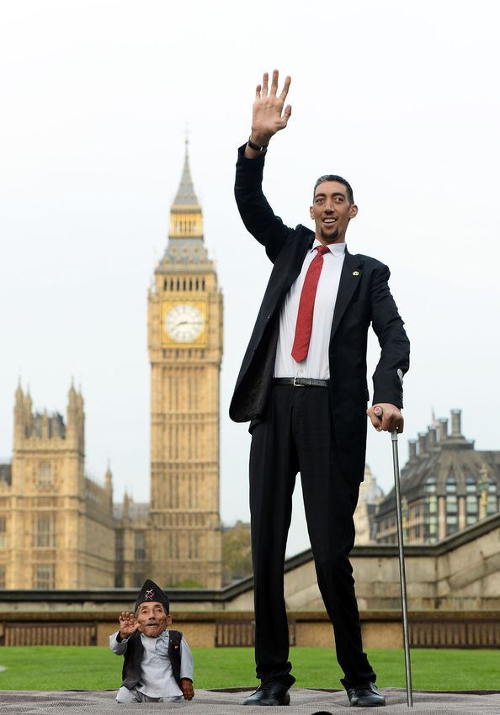

Slide 3
Noticing the Marginal Characters

Slide 4
Noticing the Marginal Characters
A Little Girl 2 Kings 5:1-14

Slide 5
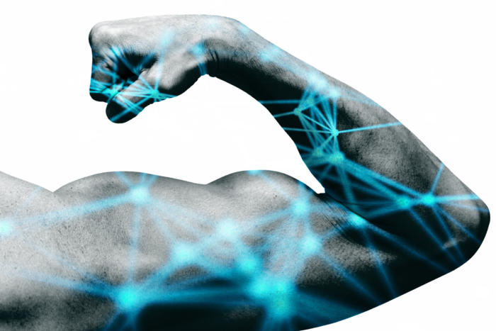
Naaman, commander of the army of the king of Syria, was a great man with his master and in high favor, because by him the Lord had given victory to Syria. He was a mighty man of valor, but he was a leper.
2 Kings 5:1

Slide 6
Naaman, commander of the army of the king of Syria, was a great man with his master and in high favor, because by him the Lord had given victory to Syria. He was a mighty man of valor, but he was a leper.
2 Kings 5:1

Slide 7
Naaman, commander of the army of the king of Syria, was a great man with his master and in high favor, because by him the Lord had given victory to Syria. He was a mighty man of valor, but he was a leper.
2 Kings 5:1

Slide 8
Now the Syrians on one of their raids had carried off a little girl from the land of Israel, and she worked in the service of Naaman's wife. 2 Kings 5:2

Slide 9
Now the Syrians on one of their raids had carried off a little girl from the land of Israel, and she worked in the service of Naaman's wife. 2 Kings 5:2

Slide 10
Naaman
Commander
Great Man
High Favor
Mighty Man of Valor
Little Girl
She was carried off
She worked in the service of Naaman’s wife

Slide 11
³ She said to her mistress, “Would that my lord were with the prophet who is in Samaria! He would cure him of his leprosy.”
⁴ So Naaman went in and told his lord, “Thus and so spoke the girl from the land of Israel.”
⁵ And the king of Syria said, “Go now, and I will send a letter to the king of Israel.”
2 Kings 5:3-5

Slide 12
³ She said to her mistress, “Would that my lord were with the prophet who is in Samaria! He would cure him of his leprosy.”
⁴ So Naaman went in and told his lord, “Thus and so spoke the girl from the land of Israel.”
⁵ And the king of Syria said, “Go now, and I will send a letter to the king of Israel.”
2 Kings 5:3-5

Slide 13
King of Israel
King of Syria
Naaman
Her Mistress
Little Girl

Slide 14
…So he went, taking with him ten talents of silver, six thousand shekels of gold, and ten changes of clothing.
2 Kings 5:5

Slide 15
…So he went, taking with him ten talents of silver, six thousand shekels of gold, and ten changes of clothing.
2 Kings 5:5

Slide 16
⁶ And he brought the letter to the king of Israel, which read, “When this letter reaches you, know that I have sent to you Naaman my servant, that you may cure him of his leprosy.” ⁷ And when the king of Israel read the letter, he tore his clothes and said, “Am I God, to kill and to make alive, that this man sends word to me to cure a man of his leprosy? Only consider, and see how he is seeking a quarrel with me.”
2 Kings 5:6-7

Slide 17
⁸ But when Elisha the man of God heard that the king of Israel had torn his clothes, he sent to the king, saying, “Why have you torn your clothes? Let him come now to me, that he may know that there is a prophet in Israel.” ⁹ So Naaman came with his horses and chariots and stood at the door of Elisha's house.
2 Kings 5:8-9

Slide 18
⁸ But when Elisha the man of God heard that the king of Israel had torn his clothes, he sent to the king, saying, “Why have you torn your clothes? Let him come now to me, that he may know that there is a prophet in Israel.” ⁹ So Naaman came with his horses and chariots and stood at the door of Elisha's house.
2 Kings 5:8-9
¹⁰ And Elisha sent a messenger to him, saying, “Go and wash in the Jordan seven times, and your flesh shall be restored, and you shall be clean.”
2 Kings 5:10

Slide 19
⁸ But when Elisha the man of God heard that the king of Israel had torn his clothes, he sent to the king, saying, “Why have you torn your clothes? Let him come now to me, that he may know that there is a prophet in Israel.” ⁹ So Naaman came with his horses and chariots and stood at the door of Elisha's house.
2 Kings 5:8-9
¹⁰ And Elisha sent a messenger to him, saying, “Go and wash in the Jordan seven times, and your flesh shall be restored, and you shall be clean.”
2 Kings 5:10

Slide 20
⁸ But when Elisha the man of God heard that the king of Israel had torn his clothes, he sent to the king, saying, “Why have you torn your clothes? Let him come now to me, that he may know that there is a prophet in Israel.” ⁹ So Naaman came with his horses and chariots and stood at the door of Elisha's house.
2 Kings 5:8-9
¹⁰ And Elisha sent a messenger to him, saying, “Go and wash in the Jordan seven times, and your flesh shall be restored, and you shall be clean.”
2 Kings 5:10

Slide 21
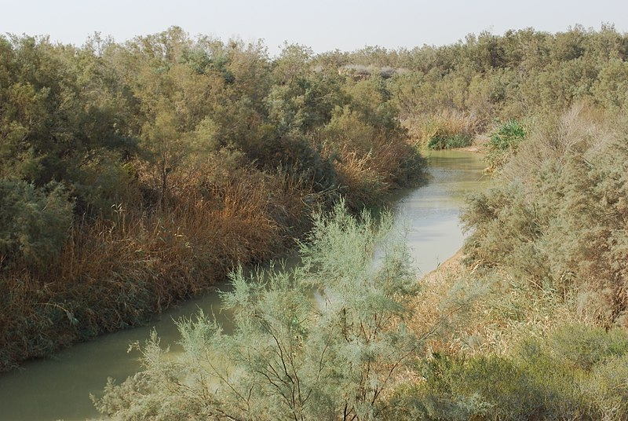

Slide 22
⁸ But when Elisha the man of God heard that the king of Israel had torn his clothes, he sent to the king, saying, “Why have you torn your clothes? Let him come now to me, that he may know that there is a prophet in Israel.” ⁹ So Naaman came with his horses and chariots and stood at the door of Elisha's house.
2 Kings 5:8-9
¹⁰ And Elisha sent a messenger to him, saying, “Go and wash in the Jordan seven times, and your flesh shall be restored, and you shall be clean.”
2 Kings 5:10

Slide 23
¹¹ But Naaman was angry and went away, saying, “Behold, I thought that he would surely come out to me and stand and call upon the name of the Lord his God, and wave his hand over the place and cure the leper. ¹² Are not Abana and Pharpar, the rivers of Damascus, better than all the waters of Israel? Could I not wash in them and be clean?” So he turned and went away in a rage.
2 Kings 5:11-12

Slide 24
¹¹ But Naaman was angry and went away, saying, “Behold, I thought that he would surely come out to me and stand and call upon the name of the Lord his God, and wave his hand over the place and cure the leper. ¹² Are not Abana and Pharpar, the rivers of Damascus, better than all the waters of Israel? Could I not wash in them and be clean?” So he turned and went away in a rage.
2 Kings 5:11-12

Slide 25
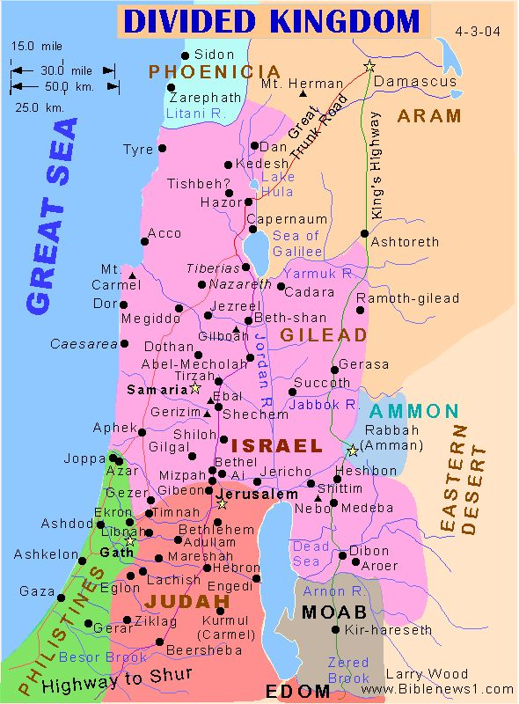

Slide 26
But his servants came near and said to him, “My father, it is a great word the prophet has spoken to you; will you not do it? Has he actually said to you, ‘Wash, and be clean’? 2 Kings 5:13 (ESV)
Then his servants came near and spoke to him and said, “My father, had the prophet told you to do some great thing, would you not have done it? How much more then, when he says to you, ‘Wash, and be clean’?” 2 Kings 5:13 (NASB)

Slide 27
But his servants came near and said to him, “My father, it is a great word the prophet has spoken to you; will you not do it? Has he actually said to you, ‘Wash, and be clean’? 2 Kings 5:13 (ESV)
Then his servants came near and spoke to him and said, “My father, had the prophet told you to do some great thing, would you not have done it? How much more then, when he says to you, ‘Wash, and be clean’?” 2 Kings 5:13 (NASB)

Slide 28
But his servants came near and said to him, “My father, it is a great word the prophet has spoken to you; will you not do it? Has he actually said to you, ‘Wash, and be clean’? 2 Kings 5:13 (ESV)
Then his servants came near and spoke to him and said, “My father, had the prophet told you to do some great thing, would you not have done it? How much more then, when he says to you, ‘Wash, and be clean’?” 2 Kings 5:13 (NASB)

Slide 29
So he went down and dipped himself seven times in the Jordan, according to the word of the man of God, and his flesh was restored like the flesh of a little child, and he was clean.
2 Kings 5:14

Slide 30
So he went down and dipped himself seven times in the Jordan, according to the word of the man of God, and his flesh was restored like the flesh of a little child, and he was clean.
2 Kings 5:14

Slide 32
⁴⁶ An argument arose among them as to which of them was the greatest. ⁴⁷ But Jesus, knowing the reasoning of their hearts, took a child and put him by his side ⁴⁸ and said to them, “Whoever receives this child in my name receives me, and whoever receives me receives him who sent me. For he who is least among you all is the one who is great.” Luke 9:46-48

Slide 33
⁴⁶ An argument arose among them as to which of them was the greatest. ⁴⁷ But Jesus, knowing the reasoning of their hearts, took a child and put him by his side ⁴⁸ and said to them, “Whoever receives this child in my name receives me, and whoever receives me receives him who sent me. For he who is least among you all is the one who is great.” Luke 9:46-48

Slide 34
⁴⁶ An argument arose among them as to which of them was the greatest. ⁴⁷ But Jesus, knowing the reasoning of their hearts, took a child and put him by his side ⁴⁸ and said to them, “Whoever receives this child in my name receives me, and whoever receives me receives him who sent me. For he who is least among you all is the one who is great.” Luke 9:46-48
“Truly, I say to you, unless you turn and become like children, you will never enter the kingdom of heaven. Whoever humbles himself like this child is the greatest in the kingdom of heaven.
Matt 18:3-4

Slide 35
²⁰ Where is the one who is wise? Where is the scribe? Where is the debater of this age? Has not God made foolish the wisdom of the world? ²¹ For since, in the wisdom of God, the world did not know God through wisdom, it pleased God through the folly of what we preach to save those who believe. ²² For Jews demand signs and Greeks seek wisdom, ²³ but we preach Christ crucified, a stumbling block to Jews and folly to Gentiles, ²⁴ but to those who are called, both Jews and Greeks, Christ the power of God and the wisdom of God. ²⁵ For the foolishness of God is wiser than men, and the weakness of God is stronger than men.
1 Corinthians 1:20-25

Slide 36
Noticing the Marginal Characters
A Little Girl 2 Kings 5:1-14

