Slide 2
³ “Blessed are the poor in spirit, for theirs is the kingdom of heaven.
⁴ “Blessed are those who mourn, for they shall be comforted.
⁵ “Blessed are the meek, for they shall inherit the earth.
⁶ “Blessed are those who hunger and thirst for righteousness, for they shall be satisfied.
⁷ “Blessed are the merciful, for they shall receive mercy.
⁸ “Blessed are the pure in heart, for they shall see God.
⁹ “Blessed are the peacemakers, for they shall be called sons of God.
¹⁰ “Blessed are those who are persecuted for righteousness' sake, for theirs is the kingdom of heaven.
Matt 5:3-10

Slide 3
Blessed are you when others revile you and persecute you and utter all kinds of evil against you falsely on my account. Rejoice and be glad, for your reward is great in heaven, for so they persecuted the prophets who were before you. Matt 5:11-12

Slide 5
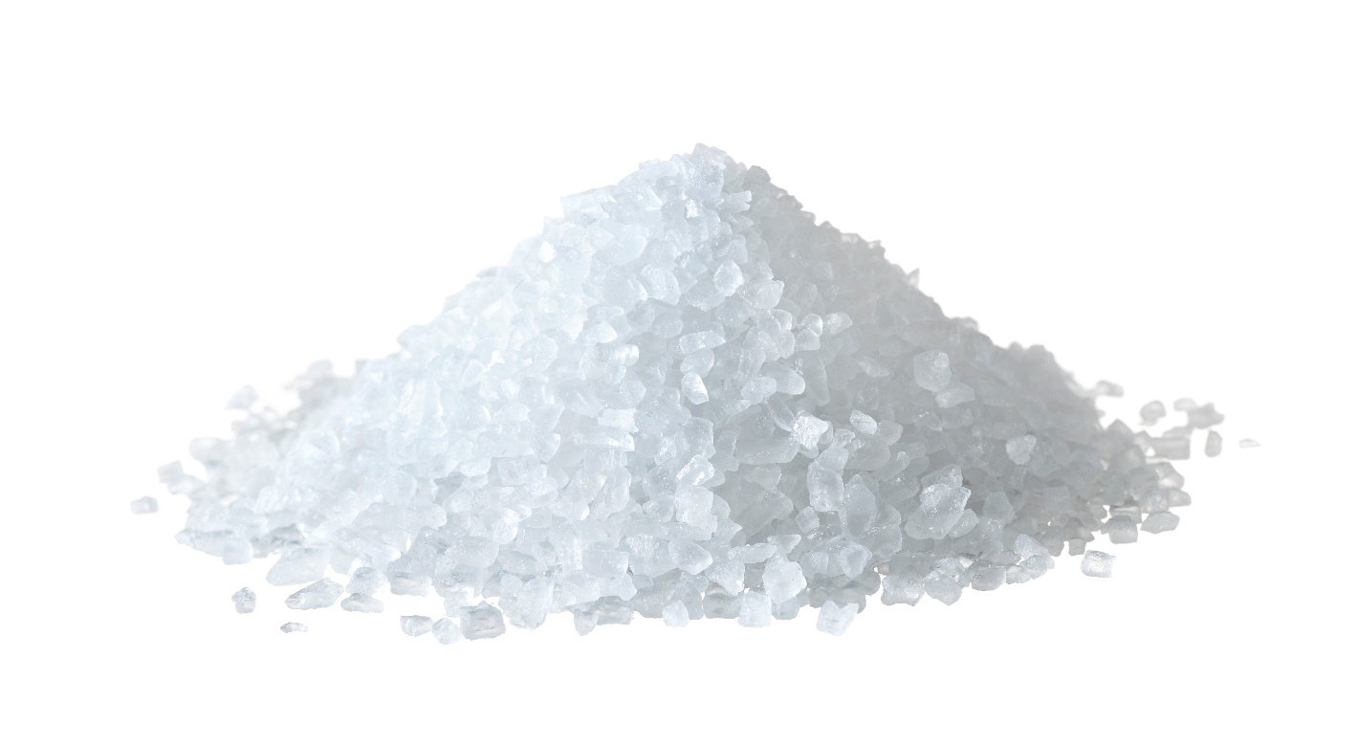
Seasoning
“Can something tasteless be eaten without salt, Or is there any taste in the white of an egg? Job 6:6
Let your speech always be gracious, seasoned with salt, so that you may know how you ought to answer each person.
Col 4:6

Slide 6
Sacrifices
You shall season all your grain offerings with salt. You shall not let the salt of the covenant with your God be missing from your grain offering; with all your offerings you shall offer salt.
Lev 2:13

Slide 7
Preservation
You shall season all your grain offerings with salt. You shall not let the salt of the covenant with your God be missing from your grain offering; with all your offerings you shall offer salt.
Lev 2:13
All the holy contributions that the people of Israel present to the Lord I give to you, and to your sons and daughters with you, as a perpetual due. It is a covenant of salt forever before the Lord for you and for your offspring with you. Num 18:19

Slide 8
“Salt is good, but if salt has lost its taste, how shall its saltiness be restored? It is of no use either for the soil or for the manure pile. It is thrown away. He who has ears to hear, let him hear.” Lk 14:34-35

Slide 9
And if your eye causes you to sin, tear it out. It is better for you to enter the kingdom of God with one eye than with two eyes to be thrown into hell, ‘where their worm does not die and the fire is not quenched.’ For everyone will be salted with fire. Salt is good, but if the salt has lost its saltiness, how will you make it salty again? Have salt in yourselves, and be at peace with one another.” Mark 9:47-50

Slide 10
You are the salt of the earth, but if salt has lost its taste, how shall its saltiness be restored? It is no longer good for anything except to be thrown out and trampled under people's feet.
Matt 5:13

Slide 11
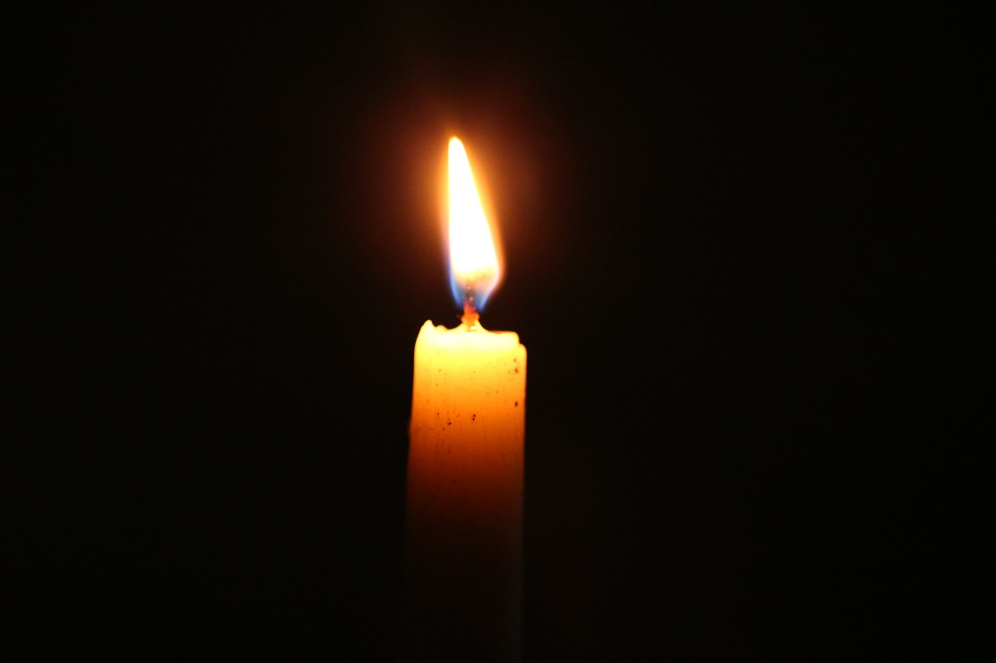
I am the Lord; I have called you in righteousness; I will take you by the hand and keep you; I will give you as a covenant for the people, a light for the nations
Isaiah 42:6
“It is too light a thing that you should be my servant to raise up the tribes of Jacob and to bring back the preserved of Israel; I will make you as a light for the nations, that my salvation may reach to the end of the earth.”
Isaiah 49:6

Slide 12
the people dwelling in darkness have seen a great light, and for those dwelling in the region and shadow of death, on them a light has dawned.” Matt 4:16 (Isaiah 9:2)

Slide 13
You are the light of the world. A city set on a hill cannot be hidden. Nor do people light a lamp and put it under a basket, but on a stand, and it gives light to all in the house. In the same way, let your light shine before others, so that they may see your good works and give glory to your Father who is in heaven. Matt 5:14-16

Slide 14
You are the light of the world. A city set on a hill cannot be hidden. Nor do people light a lamp and put it under a basket, but on a stand, and it gives light to all in the house. In the same way, let your light shine before others, so that they may see your good works and give glory to your Father who is in heaven. Matt 5:14-16

Slide 15
You are the light of the world. A city set on a hill cannot be hidden. Nor do people light a lamp and put it under a basket, but on a stand, and it gives light to all in the house. In the same way, let your light shine before others, so that they may see your good works and give glory to your Father who is in heaven. Matt 5:14-16

Slide 16
You are the light of the world. A city set on a hill cannot be hidden. Nor do people light a lamp and put it under a basket, but on a stand, and it gives light to all in the house. In the same way, let your light shine before others, so that they may see your good works and give glory to your Father who is in heaven. Matt 5:14-16

