Slide 2
Noticing the Marginal Characters

Slide 3
Noticing the Marginal Characters
The Slave Girl Acts 16:16-18

Slide 4
¹¹ So, setting sail from Troas, we made a direct voyage to Samothrace, and the following day to Neapolis, ¹² and from there to Philippi, which is a leading city of the district of Macedonia and a Roman colony. We remained in this city some days.
Acts 16:11-12

Slide 5
¹¹ So, setting sail from Troas, we made a direct voyage to Samothrace, and the following day to Neapolis, ¹² and from there to Philippi, which is a leading city of the district of Macedonia and a Roman colony. We remained in this city some days.
Acts 16:11-12

Slide 6
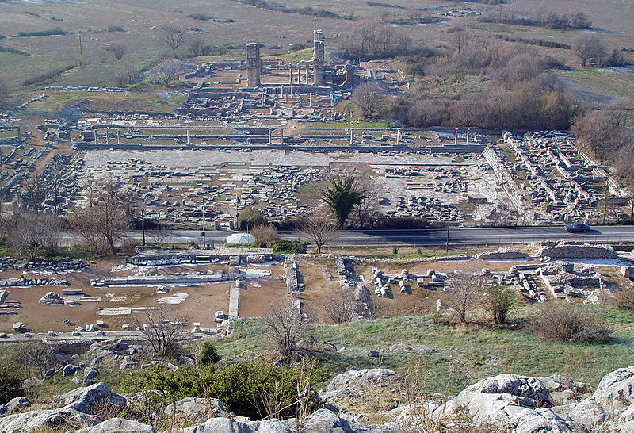

Slide 7
¹³ And on the Sabbath day we went outside the gate to the riverside, where we supposed there was a place of prayer, and we sat down and spoke to the women who had come together. ¹⁴ One who heard us was a woman named Lydia, from the city of Thyatira, a seller of purple goods, who was a worshiper of God. The Lord opened her heart to pay attention to what was said by Paul. ¹⁵ And after she was baptized, and her household as well, she urged us, saying, “If you have judged me to be faithful to the Lord, come to my house and stay.” And she prevailed upon us.
Acts 16:13-15

Slide 8
¹³ And on the Sabbath day we went outside the gate to the riverside, where we supposed there was a place of prayer, and we sat down and spoke to the women who had come together. ¹⁴ One who heard us was a woman named Lydia, from the city of Thyatira, a seller of purple goods, who was a worshiper of God. The Lord opened her heart to pay attention to what was said by Paul. ¹⁵ And after she was baptized, and her household as well, she urged us, saying, “If you have judged me to be faithful to the Lord, come to my house and stay.” And she prevailed upon us.
Acts 16:13-15

Slide 9
¹³ And on the Sabbath day we went outside the gate to the riverside, where we supposed there was a place of prayer, and we sat down and spoke to the women who had come together. ¹⁴ One who heard us was a woman named Lydia, from the city of Thyatira, a seller of purple goods, who was a worshiper of God. The Lord opened her heart to pay attention to what was said by Paul. ¹⁵ And after she was baptized, and her household as well, she urged us, saying, “If you have judged me to be faithful to the Lord, come to my house and stay.” And she prevailed upon us.
Acts 16:13-15

Slide 10
And on the Sabbath day we went outside the gate to the riverside, where we supposed there was a place of prayer, and we sat down and spoke to the women who had come together. Acts 16:13
As we were going to the place of prayer… Acts 16:16

Slide 11
¹⁶ As we were going to the place of prayer, we were met by a slave girl who had a spirit of divination and brought her owners much gain by fortune-telling. ¹⁷ She followed Paul and us, crying out, “These men are servants of the Most High God, who proclaim to you the way of salvation.” ¹⁸ And this she kept doing for many days. Paul, having become greatly annoyed, turned and said to the spirit, “I command you in the name of Jesus Christ to come out of her.” And it came out that very hour.
Acts 16:16-18

Slide 12
¹⁶ As we were going to the place of prayer, we were met by a slave girl who had a spirit of divination and brought her owners much gain by fortune-telling. ¹⁷ She followed Paul and us, crying out, “These men are servants of the Most High God, who proclaim to you the way of salvation.” ¹⁸ And this she kept doing for many days. Paul, having become greatly annoyed, turned and said to the spirit, “I command you in the name of Jesus Christ to come out of her.” And it came out that very hour.
Acts 16:16-18

Slide 13
¹⁶ As we were going to the place of prayer, we were met by a slave girl who had a spirit of divination and brought her owners much gain by fortune-telling. ¹⁷ She followed Paul and us, crying out, “These men are servants of the Most High God, who proclaim to you the way of salvation.” ¹⁸ And this she kept doing for many days. Paul, having become greatly annoyed, turned and said to the spirit, “I command you in the name of Jesus Christ to come out of her.” And it came out that very hour.
Acts 16:16-18

Slide 14
¹⁶ As we were going to the place of prayer, we were met by a slave girl who had a spirit of divination and brought her owners much gain by fortune-telling. ¹⁷ She followed Paul and us, crying out, “These men are servants of the Most High God, who proclaim to you the way of salvation.” ¹⁸ And this she kept doing for many days. Paul, having become greatly annoyed, turned and said to the spirit, “I command you in the name of Jesus Christ to come out of her.” And it came out that very hour.
Acts 16:16-18

Slide 15
³³ And in the synagogue there was a man who had the spirit of an unclean demon, and he cried out with a loud voice, ³⁴ “Ha! What have you to do with us, Jesus of Nazareth? Have you come to destroy us? I know who you are—the Holy One of God.” ³⁵ But Jesus rebuked him, saying, “Be silent and come out of him!” And when the demon had thrown him down in their midst, he came out of him, having done him no harm. Luke 4:33-35

Slide 16
³³ And in the synagogue there was a man who had the spirit of an unclean demon, and he cried out with a loud voice, ³⁴ “Ha! What have you to do with us, Jesus of Nazareth? Have you come to destroy us? I know who you are—the Holy One of God.” ³⁵ But Jesus rebuked him, saying, “Be silent and come out of him!” And when the demon had thrown him down in their midst, he came out of him, having done him no harm. Luke 4:33-35
And demons also came out of many, crying, “You are the Son of God!” But he rebuked them and would not allow them to speak, because they knew that he was the Christ. Luke 4:41

Slide 17
³³ And in the synagogue there was a man who had the spirit of an unclean demon, and he cried out with a loud voice, ³⁴ “Ha! What have you to do with us, Jesus of Nazareth? Have you come to destroy us? I know who you are—the Holy One of God.” ³⁵ But Jesus rebuked him, saying, “Be silent and come out of him!” And when the demon had thrown him down in their midst, he came out of him, having done him no harm. Luke 4:33-35
And demons also came out of many, crying, “You are the Son of God!” But he rebuked them and would not allow them to speak, because they knew that he was the Christ. Luke 4:41

Slide 18
²⁶ Then they sailed to the country of the Gerasenes, which is opposite Galilee. ²⁷ When Jesus had stepped out on land, there met him a man from the city who had demons. For a long time he had worn no clothes, and he had not lived in a house but among the tombs. ²⁸ When he saw Jesus, he cried out and fell down before him and said with a loud voice, “What have you to do with me, Jesus, Son of the Most High God? I beg you, do not torment me.” ²⁹ For he had commanded the unclean spirit to come out of the man. (For many a time it had seized him. He was kept under guard and bound with chains and shackles, but he would break the bonds and be driven by the demon into the desert.) Luke 8:26-29

Slide 19
²⁶ Then they sailed to the country of the Gerasenes, which is opposite Galilee. ²⁷ When Jesus had stepped out on land, there met him a man from the city who had demons. For a long time he had worn no clothes, and he had not lived in a house but among the tombs. ²⁸ When he saw Jesus, he cried out and fell down before him and said with a loud voice, “What have you to do with me, Jesus, Son of the Most High God? I beg you, do not torment me.” ²⁹ For he had commanded the unclean spirit to come out of the man. (For many a time it had seized him. He was kept under guard and bound with chains and shackles, but he would break the bonds and be driven by the demon into the desert.) Luke 8:26-29

Slide 20
¹⁶ As we were going to the place of prayer, we were met by a slave girl who had a spirit of divination and brought her owners much gain by fortune-telling. ¹⁷ She followed Paul and us, crying out, “These men are servants of the Most High God, who proclaim to you the way of salvation.” ¹⁸ And this she kept doing for many days. Paul, having become greatly annoyed, turned and said to the spirit, “I command you in the name of Jesus Christ to come out of her.” And it came out that very hour.
Acts 16:16-18

Slide 21
¹⁶ As we were going to the place of prayer, we were met by a slave girl who had a spirit of divination and brought her owners much gain by fortune-telling. ¹⁷ She followed Paul and us, crying out, “These men are servants of the Most High God, who proclaim to you the way of salvation.” ¹⁸ And this she kept doing for many days. Paul, having become greatly annoyed, turned and said to the spirit, “I command you in the name of Jesus Christ to come out of her.” And it came out that very hour.
Acts 16:16-18

Slide 22
¹⁶ As we were going to the place of prayer, we were met by a slave girl who had a spirit of divination and brought her owners much gain by fortune-telling. ¹⁷ She followed Paul and us, crying out, “These men are servants of the Most High God, who proclaim to you the way of salvation.” ¹⁸ And this she kept doing for many days. Paul, having become greatly annoyed, turned and said to the spirit, “I command you in the name of Jesus Christ to come out of her.” And it came out that very hour.
Acts 16:16-18

Slide 23
¹⁶ As we were going to the place of prayer, we were met by a slave girl who had a spirit of divination and brought her owners much gain by fortune-telling. ¹⁷ She followed Paul and us, crying out, “These men are servants of the Most High God, who proclaim to you the way of salvation.” ¹⁸ And this she kept doing for many days. Paul, having become greatly annoyed, turned and said to the spirit, “I command you in the name of Jesus Christ to come out of her.” And it came out that very hour.
Acts 16:16-18

Slide 24
But Saul, still breathing threats and murder against the disciples of the Lord, went to the high priest and asked him for letters to the synagogues at Damascus, so that if he found any belonging to the Way, men or women, he might bring them bound to Jerusalem. Acts 9:1-2
But when some became stubborn and continued in unbelief, speaking evil of the Way… Acts 19:9
About that time there arose no little disturbance concerning the Way. Acts 19:23

Slide 25
¹⁶ As we were going to the place of prayer, we were met by a slave girl who had a spirit of divination and brought her owners much gain by fortune-telling. ¹⁷ She followed Paul and us, crying out, “These men are servants of the Most High God, who proclaim to you the way of salvation.” ¹⁸ And this she kept doing for many days. Paul, having become greatly annoyed, turned and said to the spirit, “I command you in the name of Jesus Christ to come out of her.” And it came out that very hour.
Acts 16:16-18

Slide 26
The jailer is converted and is hospitable (Acts 16:33-34)
“he brought them up into his house”
The slave girl
(Acts 16:16-18)
Lydia is converted and is hospitable (Acts 16:15)
“come to my house”

Slide 28
Soon afterward he went on through cities and villages, proclaiming and bringing the good news of the kingdom of God. And the twelve were with him, and also some women who had been healed of evil spirits and infirmities: Mary, called Magdalene, from whom seven demons had gone out, and Joanna, the wife of Chuza, Herod's household manager, and Susanna, and many others, who provided for them out of their means.
Luke 8:1-3

