Slide 3
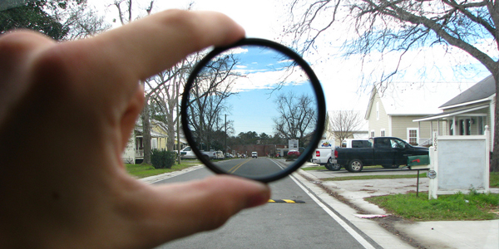

Slide 4
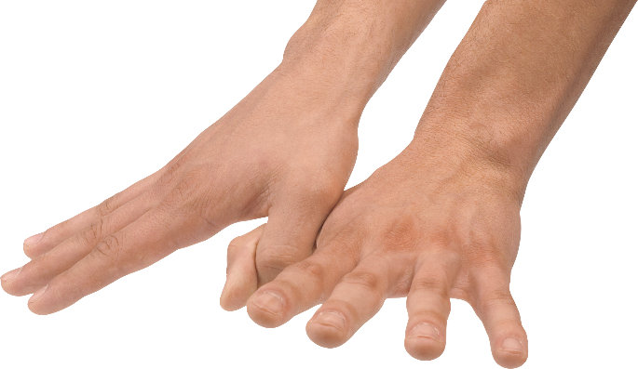

Slide 5
poor in spirit
mourn
gentle
hunger and thirst for righteousness
merciful
pure in heart
peacemakers
persecuted
salt
light
Fulfills and Respects the Law
Jesus’ Identity

Slide 6
For I tell you, unless your righteousness exceeds that of the scribes and Pharisees, you will never enter the kingdom of heaven.
Matt 5:20

Slide 7
The Antitheses
Matthew 5:21-48
Two ways of reading the antitheses…
Jesus is raising the bar.
Jesus is restoring the Law.

Slide 9
“You have heard that it was said to those of old,
‘You shall not murder;
and
whoever murders will be liable to judgment.’
Matt 5:21

Slide 10
“You have heard that it was said to those of old,
‘You shall not murder;
and
whoever murders will be liable to judgment.’
Matt 5:21
You shall not murder.
Ex 20:13; Deut 5:17

Slide 11
“You have heard that it was said to those of old,
‘You shall not murder;
and
whoever murders will be liable to judgment.’
Matt 5:21
Whoever strikes a man so that he dies shall be put to death.
Ex 21:12
Whoever takes a human life shall surely be put to death.
Lev 24:17

Slide 12
But I say to you
that everyone who is angry with his brother will be liable to judgment;
whoever insults his brother will be liable to the council;
and whoever says, ‘You fool!’ will be liable to the hell of fire.
Matt 5:22
Raca-empty person
(Airhead)
More
(Moron)

Slide 13
and whoever says, ‘You fool!’ will be liable to the hell of fire.
whoever insults his brother will be liable to the council
everyone who is angry with his brother will be liable to judgment

Slide 14
and whoever says, ‘You fool!’ will be liable to the hell of fire.
whoever insults his brother will be liable to the council
everyone who is angry with his brother will be liable to judgment

Slide 15
So if you are offering your gift at the altar and there remember that your brother has something against you, leave your gift there before the altar and go. First be reconciled to your brother, and then come and offer your gift.
Matt 5:23-24

Slide 16
So if you are offering your gift at the altar and there remember that your brother has something against you, leave your gift there before the altar and go. First be reconciled to your brother, and then come and offer your gift.
Matt 5:23-24

Slide 17
¹⁵ “If your brother sins against you, go and tell him his fault, between you and him alone. If he listens to you, you have gained your brother. ¹⁶ But if he does not listen, take one or two others along with you, that every charge may be established by the evidence of two or three witnesses. ¹⁷ If he refuses to listen to them, tell it to the church. And if he refuses to listen even to the church, let him be to you as a Gentile and a tax collector.
Matt 18:15-17

Slide 18
So if you are offering your gift at the altar and there remember that your brother has something against you, leave your gift there before the altar and go. First be reconciled to your brother, and then come and offer your gift.
Matt 5:23-24

Slide 19
So if you are offering your gift at the altar and there remember that your brother has something against you, leave your gift there before the altar and go. First be reconciled to your brother, and then come and offer your gift.
Matt 5:23-24
God
Man
Man
Man

Slide 20
Come to terms quickly with your accuser while you are going with him to court, lest your accuser hand you over to the judge, and the judge to the guard, and you be put in prison. Truly, I say to you, you will never get out until you have paid the last penny.
Matt 5:25-26

Slide 21
We must do more than just suppress anger.

