Slide 2
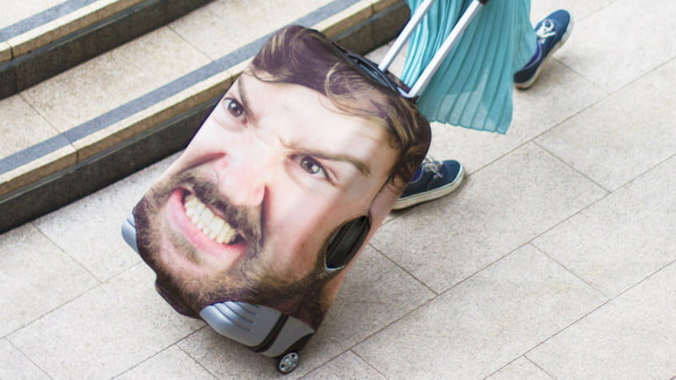

Slide 4
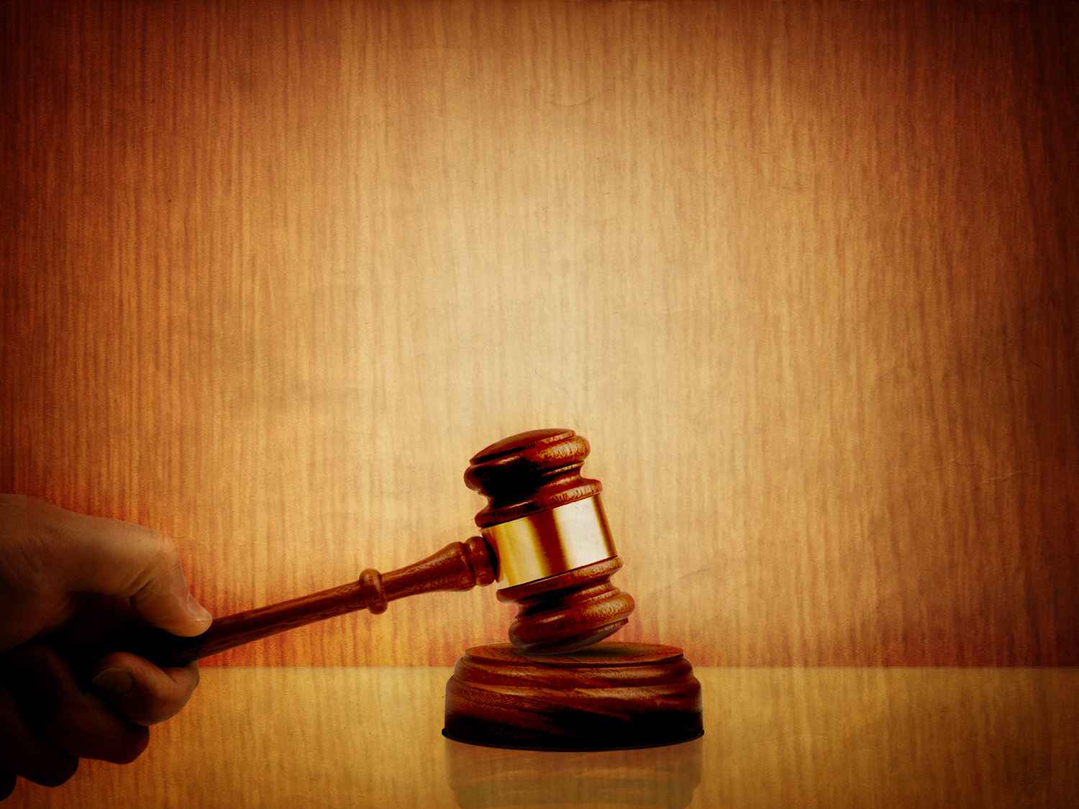
God’s
Judgment

Slide 5
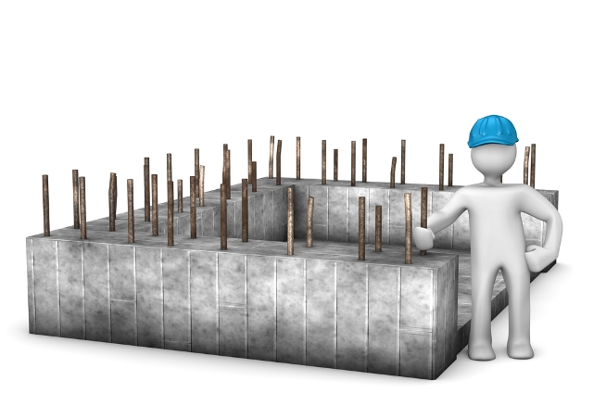
The ruler is to uphold justice by making wise judgments.

Slide 6
And all Israel heard of the judgment that the king had rendered, and they stood in awe of the king, because they perceived that the wisdom of God was in him to do justice.
1 Kings 3:28

Slide 7
The “All’s” of God’s Judgment
Our Attitude toward God’s Judgment

Slide 8
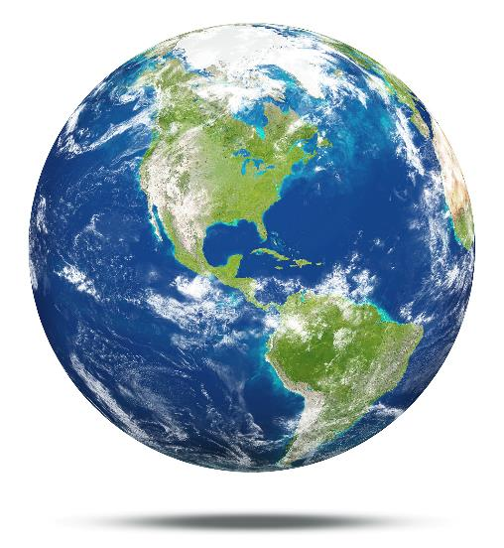
God is the Judge of all the earth.
Far be it from you to do such a thing, to put the righteous to death with the wicked, so that the righteous fare as the wicked! Far be that from you! Shall not the Judge of all the earth do what is just? Gen 18:25

Slide 9
God is the Judge of all the earth.
Say among the nations, “The Lord reigns! Yes, the world is established; it shall never be moved; he will judge the peoples with equity.”
Let the heavens be glad, and let the earth rejoice; let the sea roar, and all that fills it; let the field exult, and everything in it! Then shall all the trees of the forest sing for joy before the Lord, for he comes, for he comes to judge the earth. He will judge the world in righteousness, and the peoples in his faithfulness. Ps 96:10-13

Slide 10
God is the Judge of all the earth.
Let the sea roar, and all that fills it; the world and those who dwell in it! Let the rivers clap their hands; let the hills sing for joy together before the Lord, for he comes to judge the earth. He will judge the world with righteousness, and the peoples with equity.
Ps 98:7-9

Slide 11
God is the Judge of all the earth.
Now therefore, if you will indeed obey my voice and keep my covenant, you shall be my treasured possession among all peoples, for all the earth is mine Ex 19:5
The earth is the Lord's and the fullness thereof, the world and those who dwell therein
Ps 24:1

Slide 12
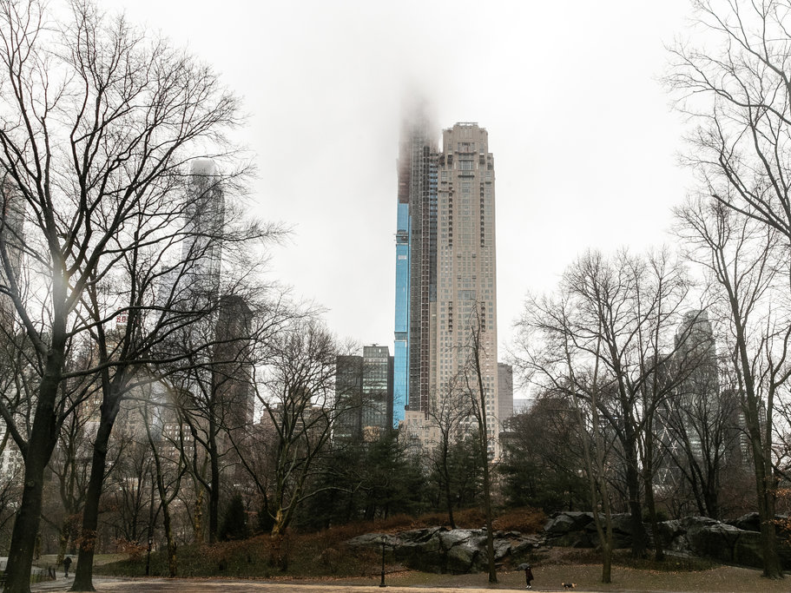

Slide 13
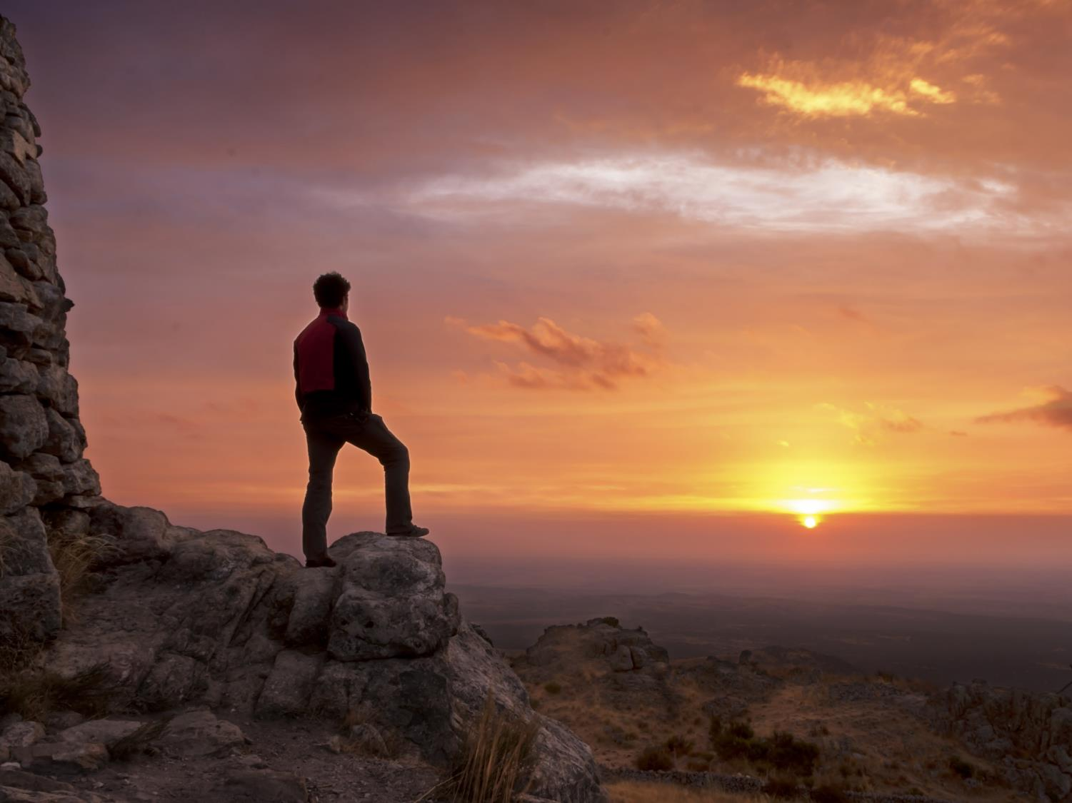
The Judge of all the earth is all-knowing.
For God will bring every deed into judgment, with every secret thing, whether good or evil. Eccl 12:14
I tell you, on the day of judgment people will give account for every careless word they speak Matt 12:36

Slide 14
The Judge of all the earth is all-knowing.
For God will bring every deed into judgment, with every secret thing, whether good or evil. Eccl 12:14
I tell you, on the day of judgment people will give account for every careless word they speak Matt 12:36

Slide 15
The all-knowing Judge of all the earth will judge all people.
Why do you pass judgment on your brother? Or you, why do you despise your brother? For we will all stand before the judgment seat of God.
Rom 14:10
For we must all appear before the judgment seat of Christ, so that each one may receive what is due for what he has done in the body, whether good or evil. 2 Cor 5:10

Slide 16
The all-knowing Judge of all the earth will judge all people.
Why do you pass judgment on your brother? Or you, why do you despise your brother? For we will all stand before the judgment seat of God.
Rom 14:10
For we must all appear before the judgment seat of Christ, so that each one may receive what is due for what he has done in the body, whether good or evil. 2 Cor 5:10

Slide 18
¹ I charge you in the presence of God and of Christ Jesus, who is to judge the living and the dead, and by his appearing and his kingdom… ⁶ For I am already being poured out as a drink offering, and the time of my departure has come. ⁷ I have fought the good fight, I have finished the race, I have kept the faith. ⁸ Henceforth there is laid up for me the crown of righteousness, which the Lord, the righteous judge, will award to me on that day, and not only to me but also to all who have loved his appearing.
2 Tim 4:1, 6-8

Slide 19
¹⁷ By this is love perfected with us, so that we may have confidence for the day of judgment, because as he is so also are we in this world. ¹⁸ There is no fear in love, but perfect love casts out fear. For fear has to do with punishment, and whoever fears has not been perfected in love. ¹⁹ We love because he first loved us.
1 John 4:17-19

Slide 20
For as many of you as were baptized into Christ have put on Christ.
Gal 3:27

